Slide 1
The incentives and rewards in scholarly communication: the good, the bad and the possible
Radovan Vrana
Department for information and communication sciences
Faculty of Humanities and Social Sciences, University of Zagreb
rvrana@ffzg.hr

Slide 2
Introduction
Science – creating new values – disruption of existing values – ideally, breakthroughs and innovations should occur more frequently
Evaluation of scientists’ work: old and antiqated system – new system(s) (in development) – more oriented towards impacts of science on society
Incentives for scientists to perform better (mostly in the domain of publishing)

Slide 3
Incentives and rewards
Incentive / reward: a benefit, reward, or cost that motivates an […] action” (Rowhani-Farid, Allen M, Barnett, 2017, 2)

Slide 4
Incentives and rewards
The first academic monetary reward was initiated by Académie des Sciences in France in 1719 to scientists who contribute to the advancement of knowledge in astronomy
The Nobel Prize the largest monetary prize in the academic world Quan, Chen and Shu (2017)

Slide 5
Incentives and rewards
3 key drivers of scientists' motivation (Catillon, 2020):
the intrinsic reward of doing science – satisfaction of solving a scientific problem
academic prestige – relates to recognition, career and monetary rewards, promotion, tenure, salary and ability to change jobs, and
monetary rewards – income differences across scientists; royalties from patents, equity in startups, consulting fees or research sponsoring, monetary rewards.
These motivations may not align with the production of high quality science Catillon (2020)

Slide 6
Examples / cases (extracted from literature)
Chinese universities
Cash reward policy at Chinese universities was launched around 1990 by rewarding scientists USD25 for each published WoS paper, and that the amount increased to between USD60 and USD120 in the mid-1990s (Quan, Chen and Shu, 2017)
Since then, cash reward policy were then copied by other universities and research institutions
$43 000 for publishing a paper in Science or Nature, with the top reward reaching $165 000 (most frequently to the first author)
Cash reward practices intended to be stopped / to cease in 2020.
Qatar University in Doha - paper authors share up to $13 700 for a paper in Nature or Science
Miller College of Business in Muncie, Indiana, published peer-reviewed article in a list of more than 100 business journals earns $200

Slide 7
Examples / cases (extracted from literature) Data sharing
“The persons who initially gathered the data should receive appropriate and standardized credit that can be used for academic advancement, for grant applications, and in broader situations” (Bierer, Crosas and Pierce, 2017, 1684)
Research data sharing and storing related incentive include badges for digitally sharable data and materials available in an open data repository; data attributions; credit for data linking (Rowhani-Farid, Allen M, Barnett, 2017) preregistration of research to avoid data scooping, advertising research in meetings, presentations, in social media, and discussion forums, and increased citations (Promoting Open Science: A Holistic Approach to Changing Behaviour. 2021.)

Slide 8
Examples / cases (from the Web)

Slide 9
https://cast.illinoisstate.edu/faculty-staff/teaching/publication.php

Slide 10
Conference Attendance Support for Faculty Members https://www.bilgi.edu.tr/en/research/scientific-research-incentive/

Slide 11
https://www.usp.ac.fj/research/research/output-and-awards/rewards-for-publications/

Slide 12
https://www.usp.ac.fj/research/research/output-and-awards/rewards-for-publications/

Slide 13
https://www.zuj.edu.jo/FET/files/Instructions-for-incentives-and-support-for-publishing-research.pdf

Slide 14
https://www.deakin.edu.au/__data/assets/pdf_file/0006/1900626/Publication-incentive-scheme-June-2020.pdf

Slide 15
http://www.gmrit.org/facilities-perks.pdf

Slide 16
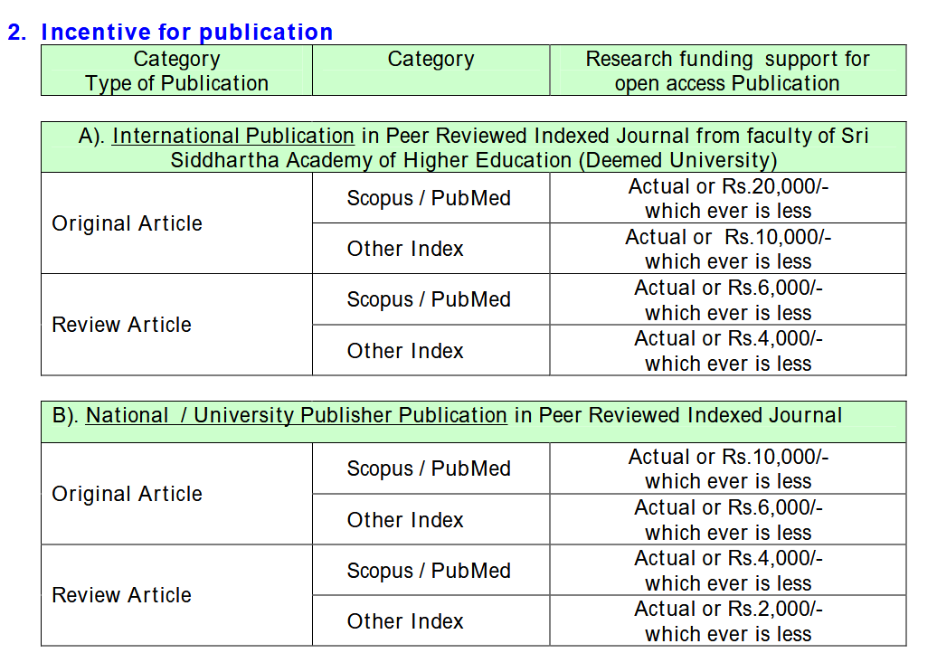
https://ssdctumkur.org/assets/regulations/Policy%20on%20Incentive%20and%20Awards%20for%20Research%20and%20Publication.pdf

Slide 17
https://wiki.bath.ac.uk/download/attachments/109617864/Research%20Publication%20Incentives_Final_SoM.pdf?version=1&modificationDate=1516616923000&api=v2

Slide 18
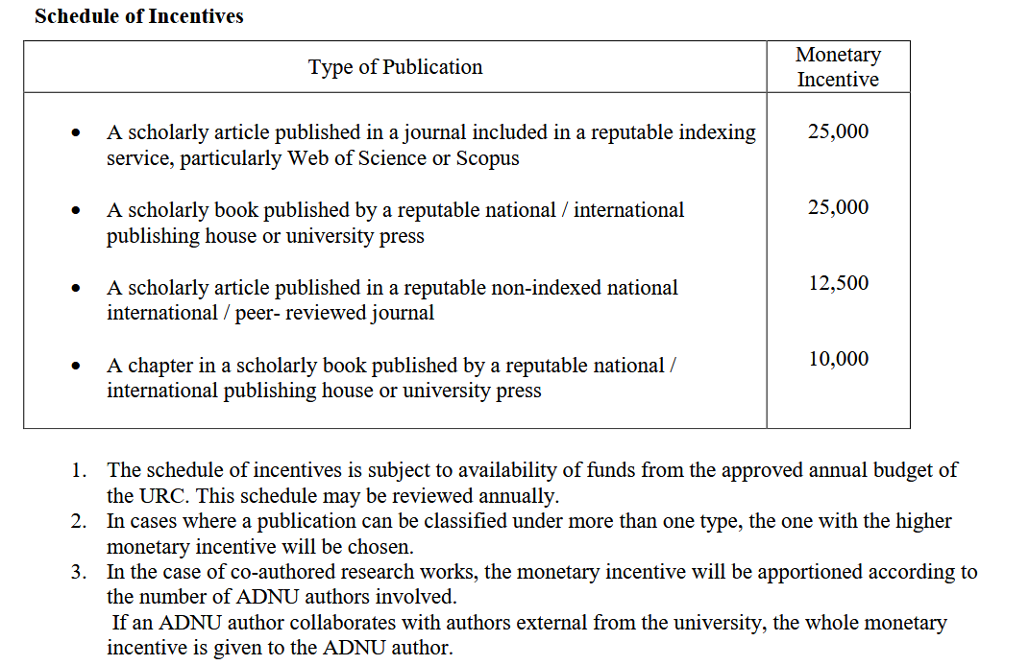
https://www.adnu.edu.ph/urc/download/Approved-Incentive-Awards-for-Publication-August-2016.pdf

Slide 19
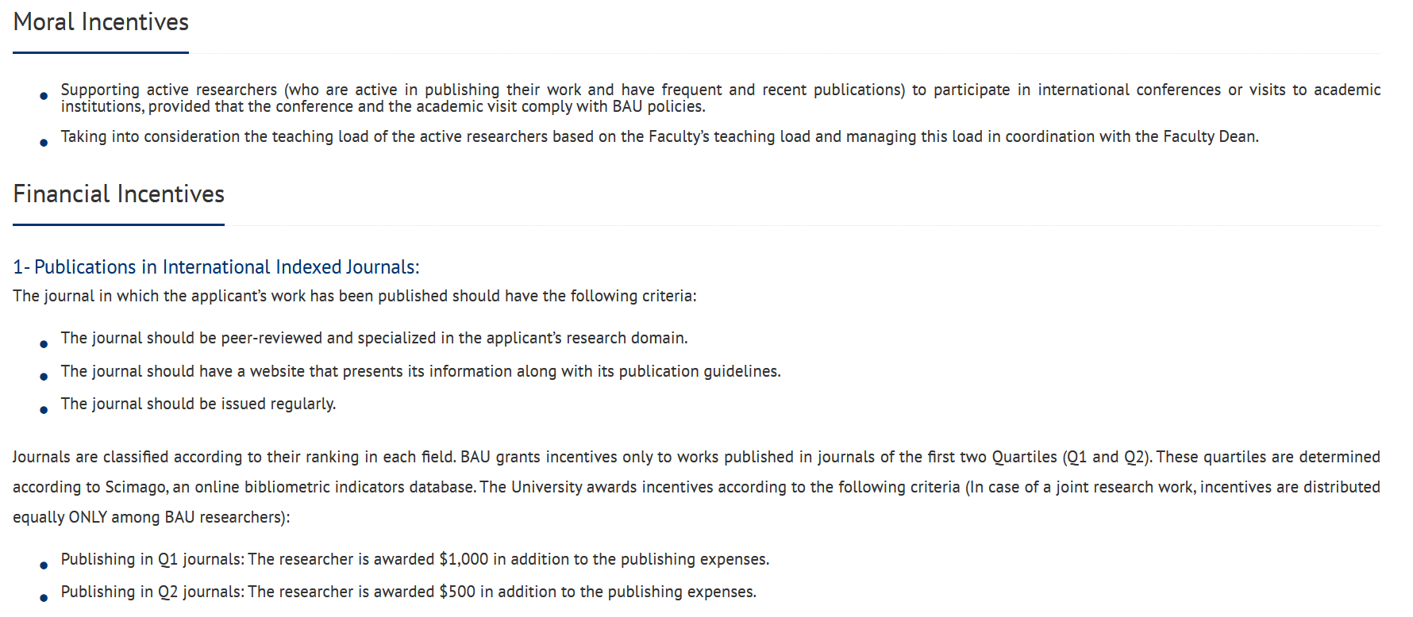
https://www.bau.edu.lb/Research/Awarded-Incentives

Slide 20
Conclusion
Incentives are perhaps good for young researchers and emerging universities but are generally bad because they could lead to hyperproduction, low quality non longitudinal research, plagiarism and fraud
Possible: various new systems of evaluation of scientists’ work that will emerge but will not include monetary rewards
All scientists are suggested (by their employers) to take active part in open science – but not without cost

