Slide 1
Development and implementation of data sharing policies
Collaboration of social science data archives and journals
PUBMET2022 : The 9th Conference on Scholarly Communication in the Context of Open Science 14-16 September 2022 | University of Zadar, Croatia
Marijana Glavica¹, Irena Kranjec¹, Janez Štebe², Sonja Bezjak²
¹Faculty of Humanities and Social Sciences, University of Zagreb, Croatian Social Science Data Archive
²Faculty of Social Sciences, University of Ljubljana, Social Science Data Archives

Slide 2
Who are we?
Social Science Data Archives
ADP Social Science Data Archives, Slovenia
CROSSDA Croatian Social Science Data Archive
providing national infrastructure public services
CESSDA ERIC Service Providers

Slide 3
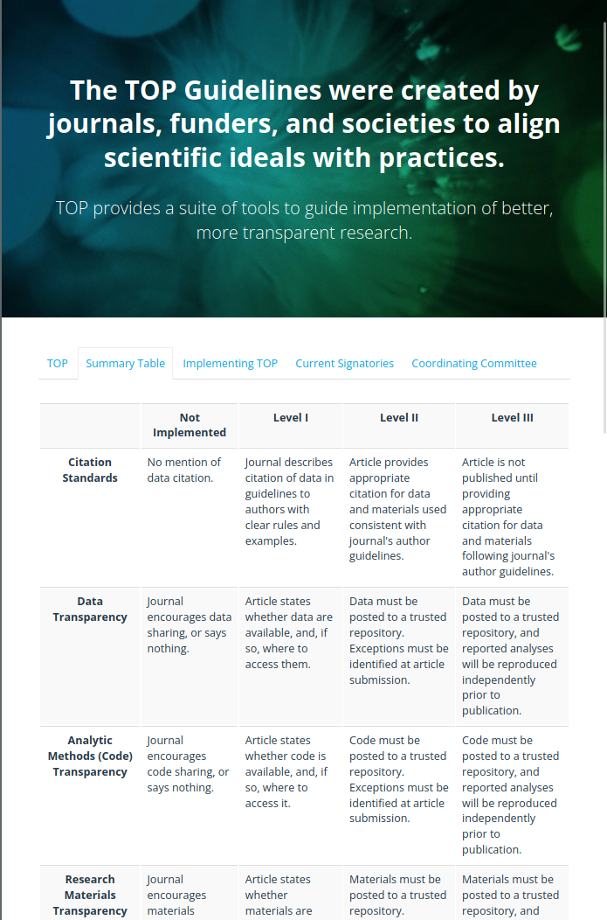
What are we going to show you and in which context?
Services offered by social science data archives relevant to journals' data sharing policies
Examples of collaboration between data archives and journal editors
Context:
Open Science, transparency, data sharing
Slovenia and Croatia: Underdeveloped data sharing culture; Slow implementation of open data strategy by the national research funder

Slide 4
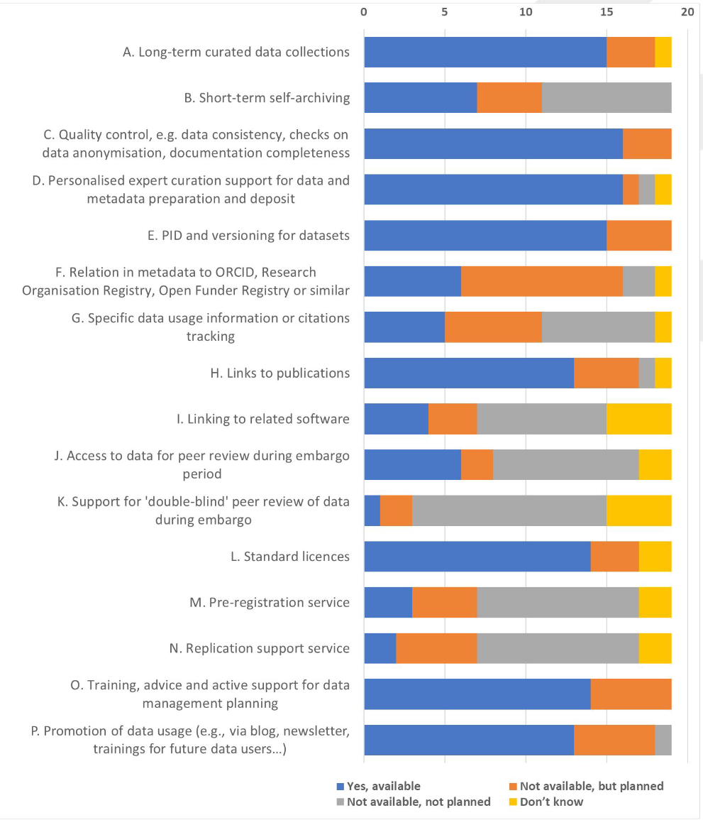
Services
Long-term curated data collections
Quality control (data consistency, anonymisation checks, documentation completeness)
Personalised expert curation support for data and metadata preparation and deposit
PIDs and versioning
Links to publications
Standard licences
Training, advice and active support for data management planning
Promotion of data usage

Slide 5
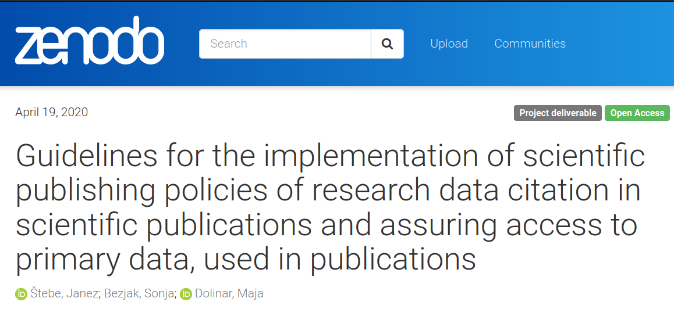
Slovenian case
Implementing the RDA Research Data Policy Framework in Slovenian scientific journals
Partners from other RIs: ELIXIR-SI, CLARIN-SI, DARIAH-SI
Journals participating in a pilot from different fields: archaeology, history, linguistics and social sciences
Continued cooperation with ADP: Until now, four social science journals have implemented research data policies:
Socialno delo Journal
Central European Public Administration Review
Economic and Business Review
Social Science Forum [Družboslovne razprave]

Slide 6
CESSDA Journals Outreach
Dialogs with journal editors - what are their views on data sharing?
Discussing possibilities of support that can be provided for journals by data archives
Exploring capacities of data archives for supporting journals
Connecting data archives; developing services related to journals' data sharing policies
Organising events
Open forum: Challenges of sharing data linked to publications
Making Social Science Transparent
Journal and Data Archive Collaboration Forum UPCOMING! Nov 8, 2022 @14:00-16:30
https://www.cessda.eu/Training/Journals-outreach
PARTNERS
GESIS, Germany
CROSSDA, Croatia
EKKE, Greece
ADP, Slovenia
FORS, Switzerland
FSD, Finland
SND, Sweden
TARKI, Hungary
DCS, Serbia

Slide 7
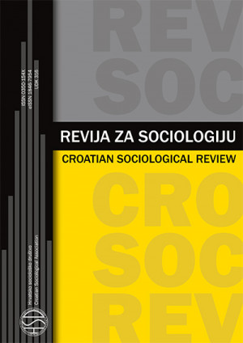
Croatian case
Started a dialog with 3 editors of Croatian social science journals
Croatian Sociological Review introduced its first open science policy in 2021
Considering various epistemological assumptions in the humanities and social sciences
The next step: in cooperation with CROSSDA, define instructions for authors and reviewers to make this policy official
2022 Webinar co-organised with the CROASC: The role of journals in encouraging access to research data
Vučković Juroš, T. (2021). Looking Ahead: Fast-Track Research Notes and Open Science Policy. Revija za sociologiju, 51(3), 301-307. https://hrcak.srce.hr/269681
Vlašiček, D. & Flis, I. (2021). Otvorena znanost. Kratak pregled pokreta i metodološkog značaja. Revija za sociologiju, 51 (3), 507-516. https://hrcak.srce.hr/269814

Slide 8
Thank you.
Same for sub. Few words about the project/archive in general.

