Slide 1
A European Discovery Platform for the SSH
A new approach to scholarly discovery and collaboration
Name | Organisation | DAY | PLACE
Sona Arasteh|MWS | September 15th 2022 | PubMet 2022, Zadar

Slide 2
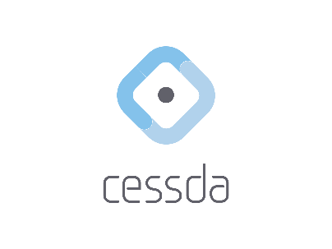
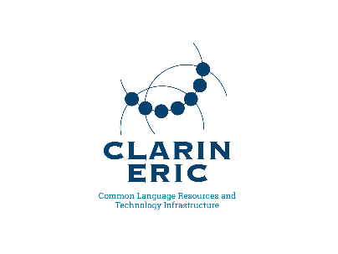
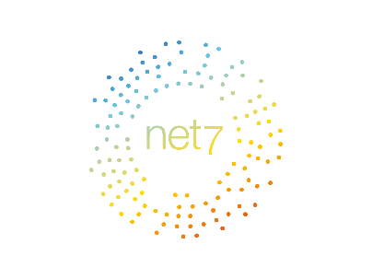
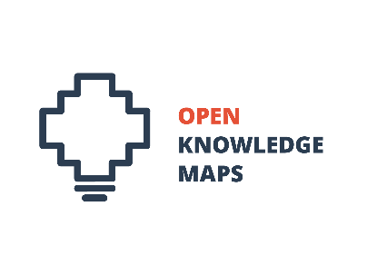
TRIPLE Consortium
Notes:
Research centres CNRS, EKT, National Research Council (CNR), IBL PAN
Foundations : Max Weber Foundation, MEOH
SMEs :Know-Center, Lexical Computing,Net7, Nuromedia,OAPEN, Open Knowledge Maps
Universities Abertay University, University of Coimbra, University of Zadar, Croatia
European Research infrastructures DARIAH CESSDA, CLARIN
European e-infrastructure : EGI

Slide 3
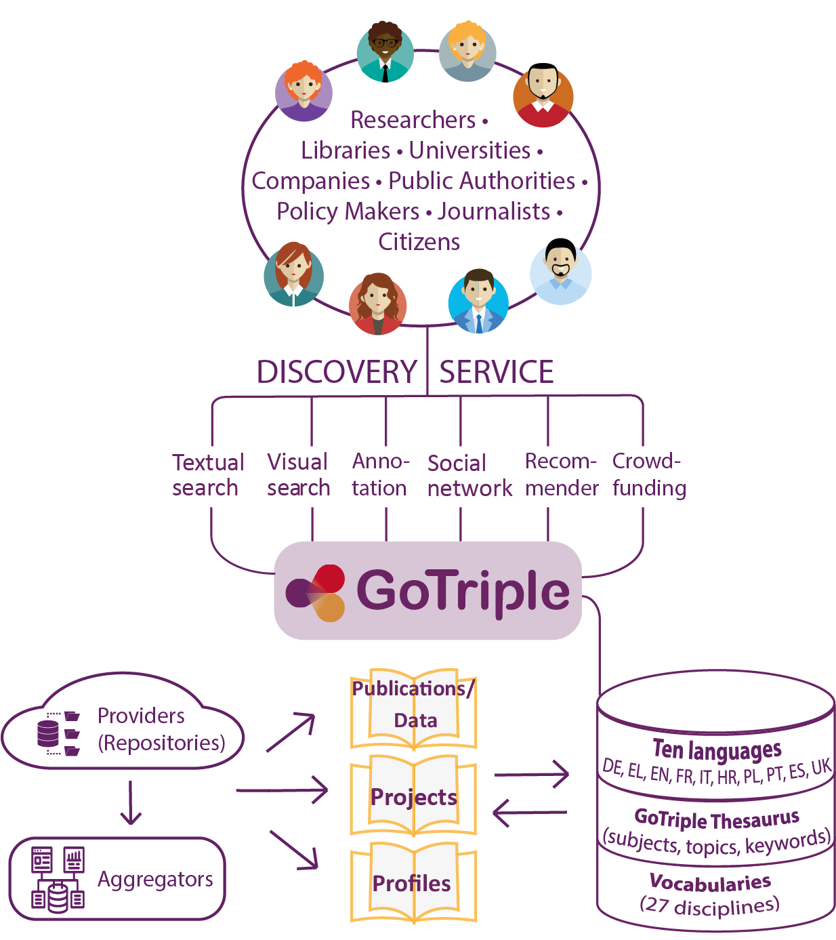
GoTriple (gotriple.eu)
multilingual (11 languages) discovery platform for Social Sciences and Humanities
featuring innovative services
dedicated to SSH community & the vision of Open Science
Notes:
TRIPLE focuses on subject-specific and multilingual diversity on the one hand, and on the other hand enables researchers to identify not only data, but also other scientists and projects in the European research area across subject and language boundaries, and to reuse the data generated in these project contexts.
That is to say it is delivering scientific SSH data in 10 languages (French, Spanish, English, German, Greek, Portuguese, Croatian, Italian, Polish and Ukrainian). We decided to focus on languages less present in the international exchange of knowledge and to confront the difficulties in non-English speaking circuits. We used openly available resources.
Innovative services increase the potentialities of the platform offering to the users new ways to work with the data : Crowdfunding service, Social network, Open annotation tool, Visualisations system and the Recommender system
The multilingual data have been enriched and annotated by aligning the vocabularies in the 10 languages, making them easily accessible regardless of the user's language.

Slide 4
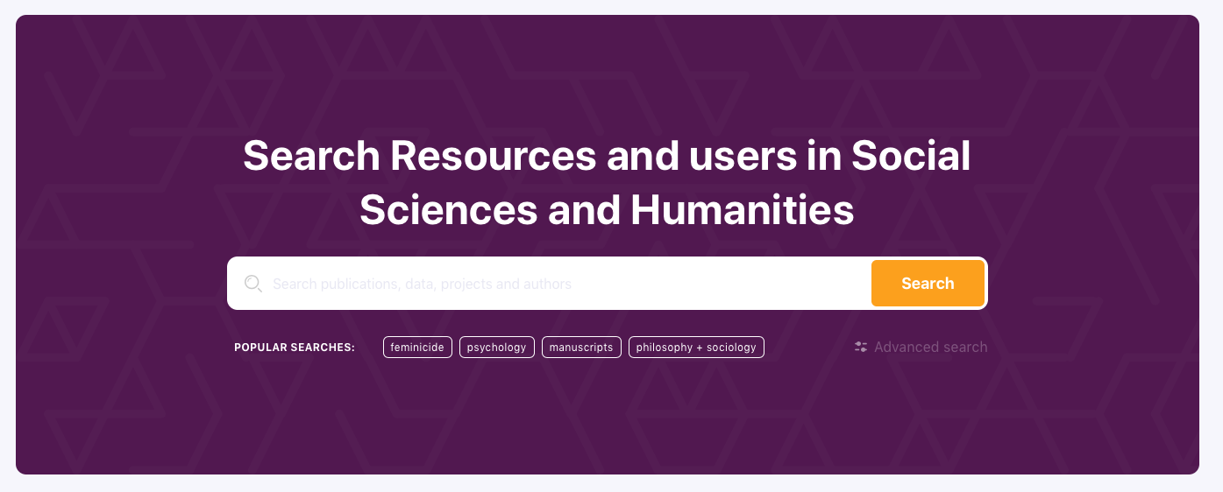
the entry point for SSH in the EOSC
Notes:
The project was launched in October 2019 for 42 months, it is a H2020 funded project and it gathers 21 partners coming from 15 European countries.
The first platform release was published in 2020 and the second one will in the coming weeks. We are constantly improving and implementing new features. On of the specificities of the project is the strong users' oriented approach, from the very beginning to define the needs and requirements and to make sure that as we go along in the development, we still fit the users' expectations.

Slide 5
SSH Discovery
The GoTriple platform will promote a "Community of Practice"
foster new collaborations and networking
encourage interdisciplinarity
take into account multilingual and multicultural diversity
facilitate crowdfunding
Notes:
"The community of practice" concept to capture the idea that a group of people have a common interest in a certain area to deliver better learning and improved results by working together and sharing expertise, which benefits the larger collective.
TRIPLE focuses on subject-specific and multilingual diversity on the one hand, and on the other hand enables researchers to identify not only data, but also other scientists and projects in the European research area across subject and language boundaries, and to reuse the data generated in these project contexts.
That is to say it is delivering scientific SSH data in 10 languages (French, Spanish, English, German, Greek, Portuguese, Croatian, Italian, Polish and Ukrainian). We decided to focus on languages less present in the international exchange of knowledge and to confront the difficulties in non-English speaking circuits. We used openly available resources.
Innovative services increase the potentialities of the platform offering to the users new ways to work with the data : Crowdfunding service, Social network, Open annotation tool, Visualisations system and the Recommender system
The multilingual data have been enriched and annotated by aligning the vocabularies in the 10 languages, making them easily accessible regardless of the user's language.

Slide 6
GoTriple tackles…
strong fragmentation of SSH research (several disciplines, multilingualism, etc.)
SSH open scholarly resources (data, publications, other researchers‘ profiles and projects) currently scattered across local repositories
low use and reuse of SSH research (lack of standards and interoperability between repositories)
missed interdisciplinary collaboration possibilities
limited societal impact
Notes:
Why an additional platform : GoTriple answers to 2 scientific studies led by the OPERAS research infrastructure highlighting that SSH suffer from a strong fragmentation due to a strong diversity in the disciplines, in the languages and resources are dispersed throughout many repositories. Because we still miss standards and interoperability SSH research are underused in relation to their usefulness with 2 ways of improvement that are the interdisciplinarity and the societal impacts

Slide 7
Transforming Research Through Innovative
Practices for Linked Interdisciplinary Exploration
innovative, multilingual and multicultural
dedicated to the SSH
a single access point to explore, find, access and reuse materials at European scale.
one of the dedicated services of OPERAS Research Infrastructure
an SSH service of European Open Science Cloud
https://project.gotriple.eu/

Slide 8
TRIPLE: Main impacts
co-design principles: Users are key to all phases of the process, from needs analysis to tool testing and evaluation (WP3)
User-orientation
Integration into the European Open Science Cloud (EOSC)
Strong ties between research, industry and society
access to open content and resources and facilitates collaborations across disciplinary and language boundaries;
involve new economic actors into the EOSC
Main impacts
by involving stakeholders into scientific projects, thus enhancing citizens' trust towards science.
Contribution to the objectives of Open Science
Reconnection of culture and science
discover, understand and highlight European diversity in terms of societies, languages and practices. It helps to promote cultural diversity in Europe.
Notes:
User-orientation:
TRIPLE integrates co-design principles into research and the development of new services. Users are key to all phases of the process, from needs analysis to tool testing and evaluation, as they know best how they work and what they need.
Strong ties between research, industry and society:
TRIPLE facilitates more efficient and effective SSH research for societies at large by involving public institutions and companies into scientific projects, thus strengthening the links between different types of stakeholders.
Reconnection of culture and science:
TRIPLE is not only a platform that ensures the discoverability of SSH resources and facilitates collaborations, but also a cultural platform to discover, understand and highlight European diversity in terms of societies, languages and practices. It helps to promote cultural diversity in Europe.
Contribution to the objectives of Open Science:
TRIPLE improves the access to open content and resources and facilitates collaborations across disciplinary and language boundaries. Data sharing and usage according to the FAIR principles - Findable, Accessible, Interoperable, Reusable - is fostered.
Integration into the European Open Science Cloud (EOSC):
Because of a close link with the SSH Open Cloud (SSHOC) project, TRIPLE will be a major component of the SSH marketplace, which will be the entry door of the EOSC for all the different SSH services. Through TRIPLE, new innovative actors will be involved in the complex EOSC ecosystem.

Slide 9
Innovative Services
Visualisations
Recommender System
Open Annotation Tool
Trust Building System
Crowdfunding Service

Slide 10
Knowledge Map

Slide 11
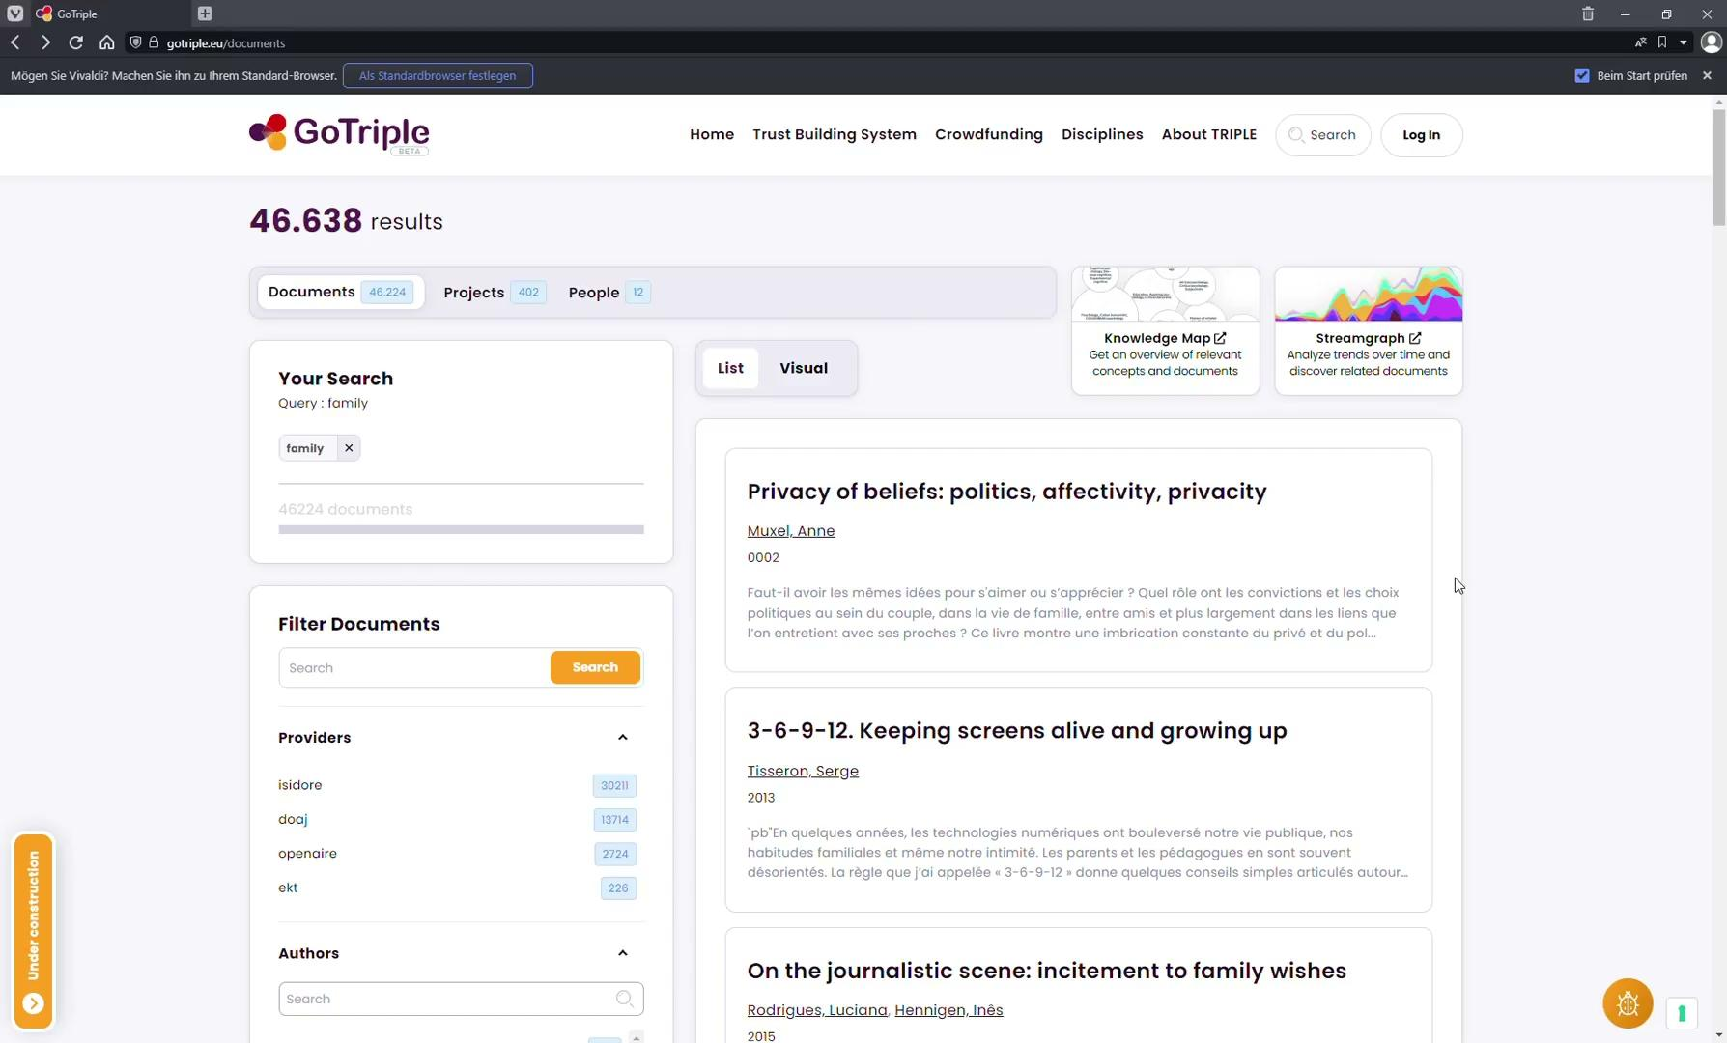
Streamgraph

Slide 12
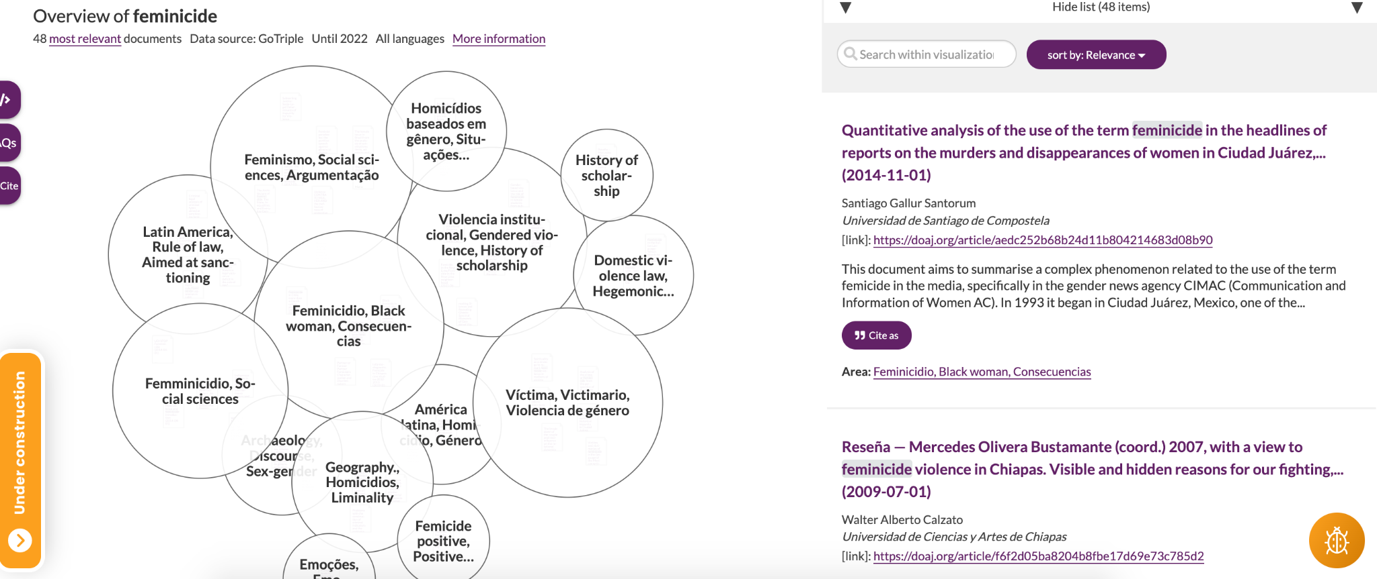
Visualisations
Notes:
Sona

Slide 13
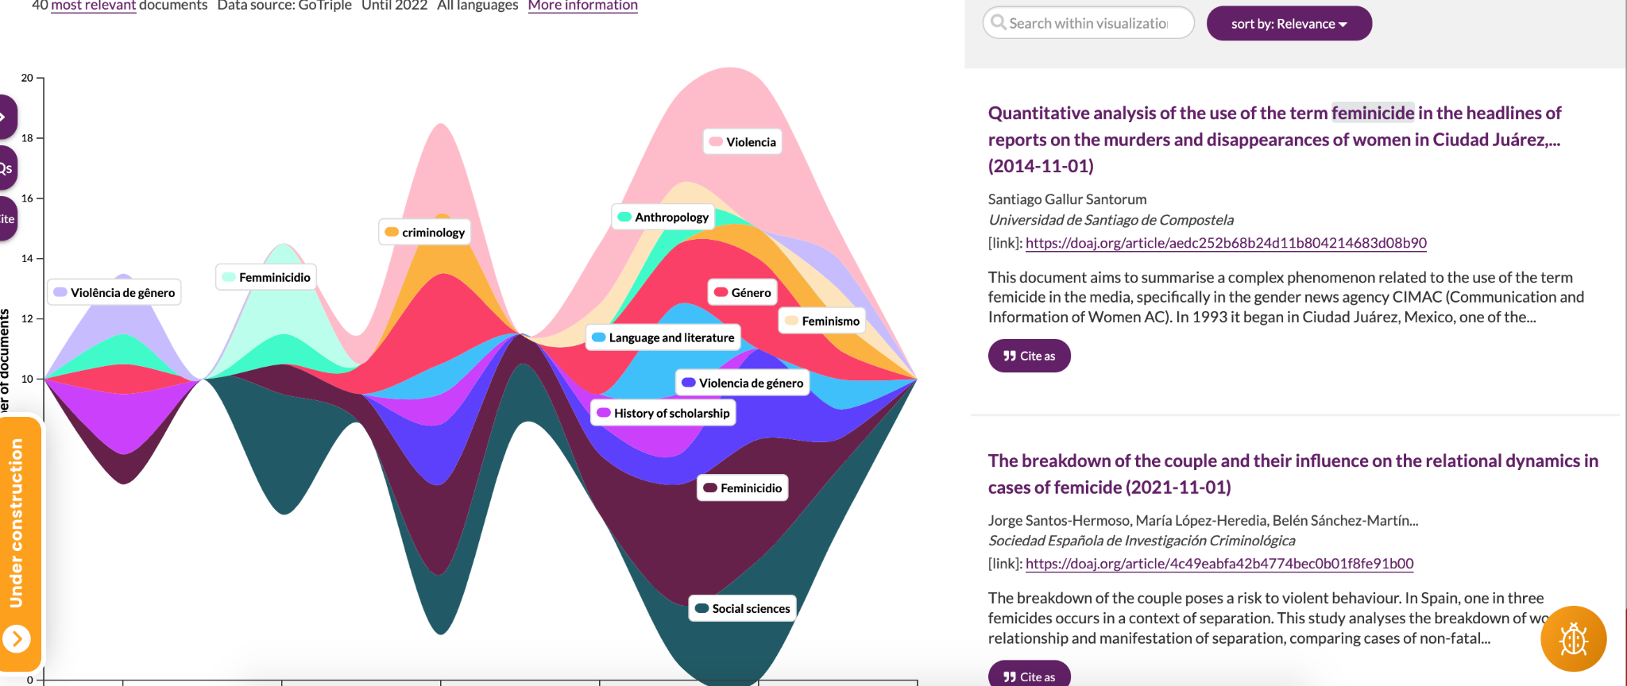
Visualisations
Notes:
Sona

Slide 14
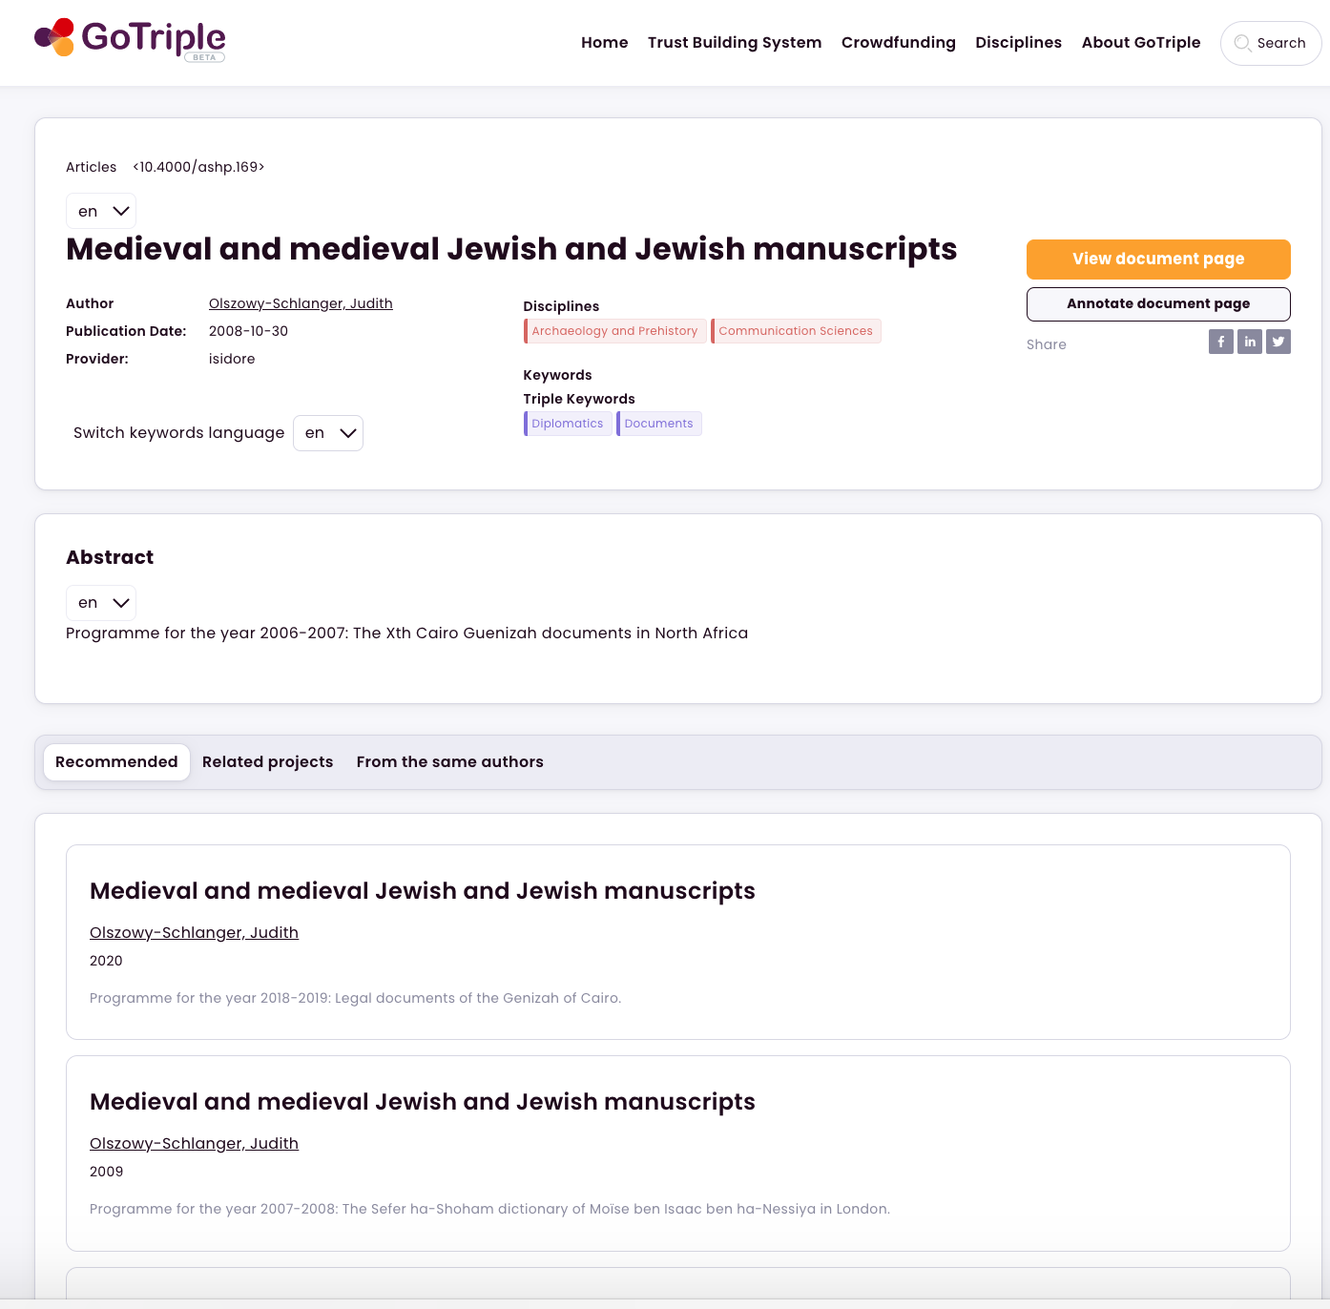
Recommender System
Recommendations of publications
Projects related to the search item
Publications from the same authors
in My GoTriple page :

Slide 15
New ways to collaborate
Open Annotation Tool (Pundit)
Network (Trust Building System)
Crowdfunding service
My GoTriple page & full public profile

Slide 16
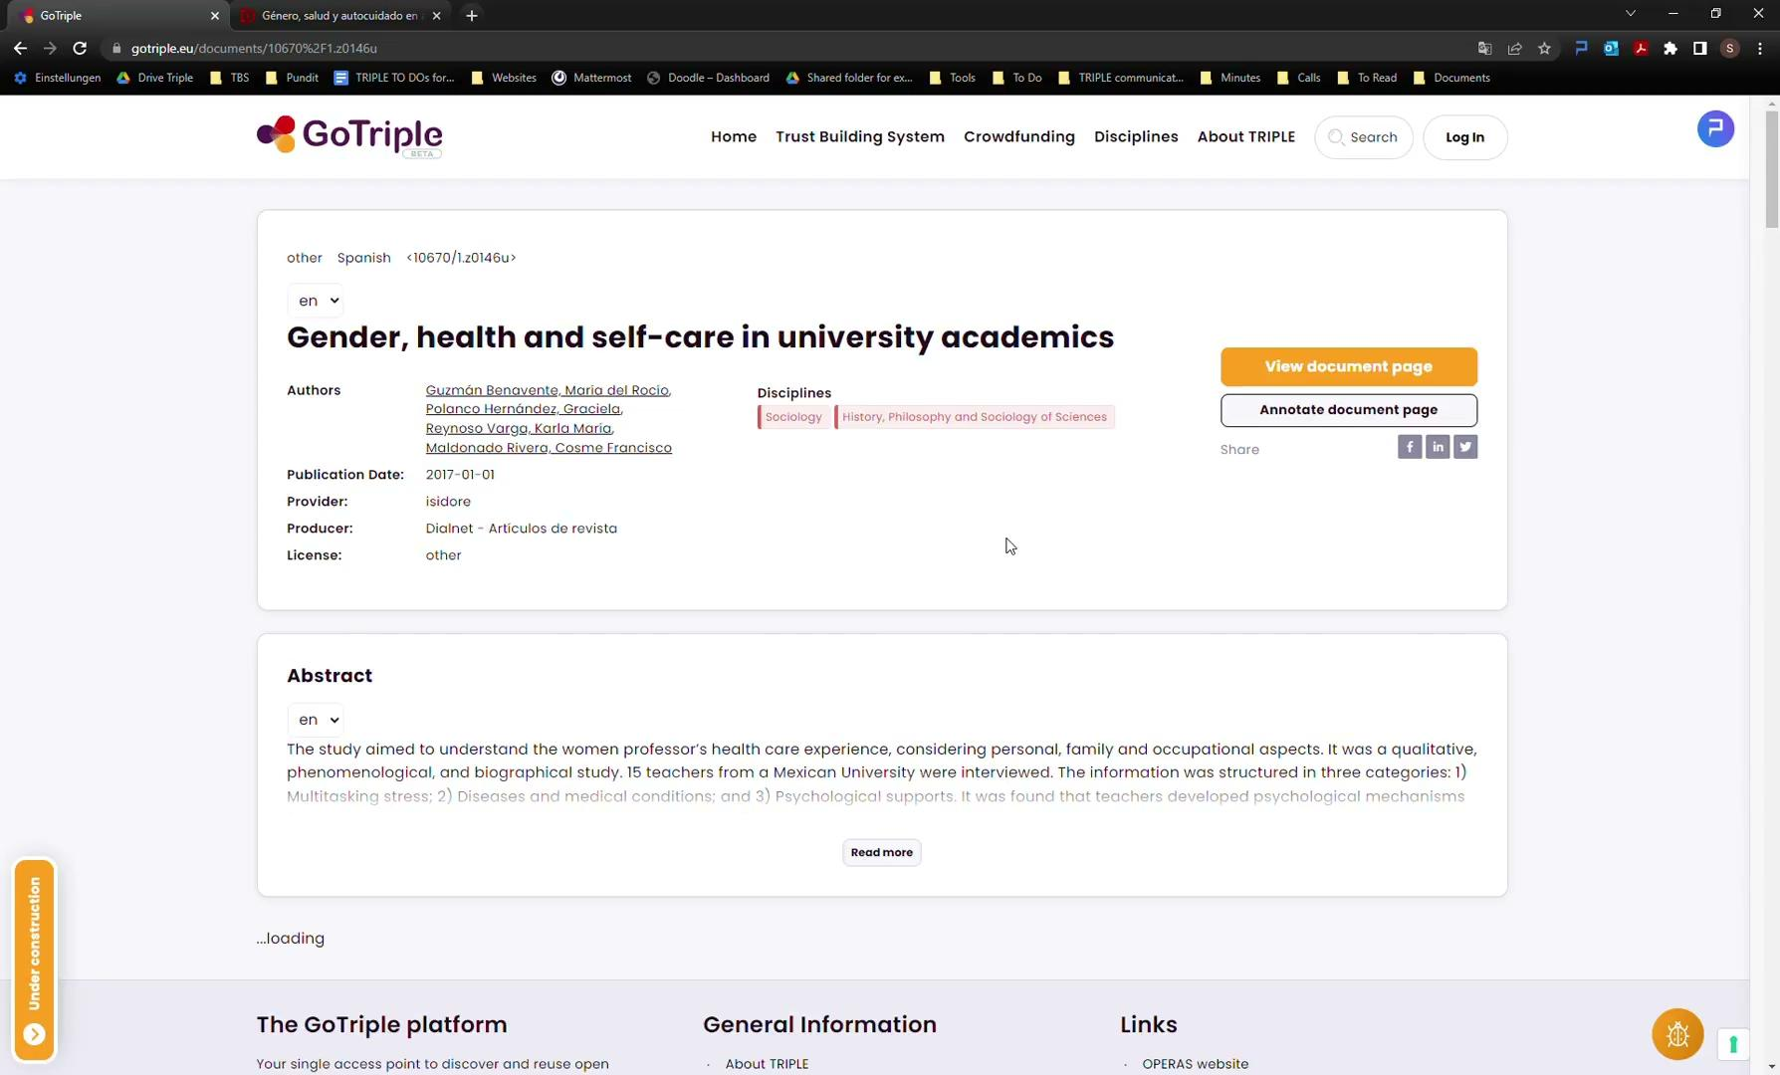

Slide 17
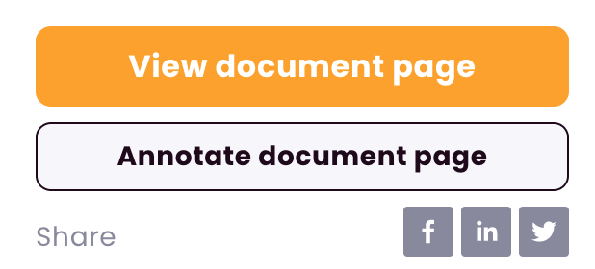
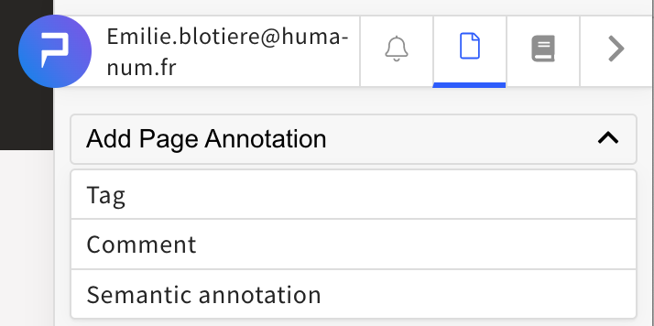
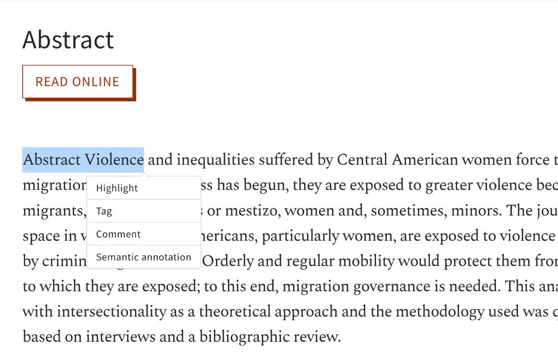
Open Annotation Tool (PUNDIT)
Notes:
Pundit : Sona

Slide 18
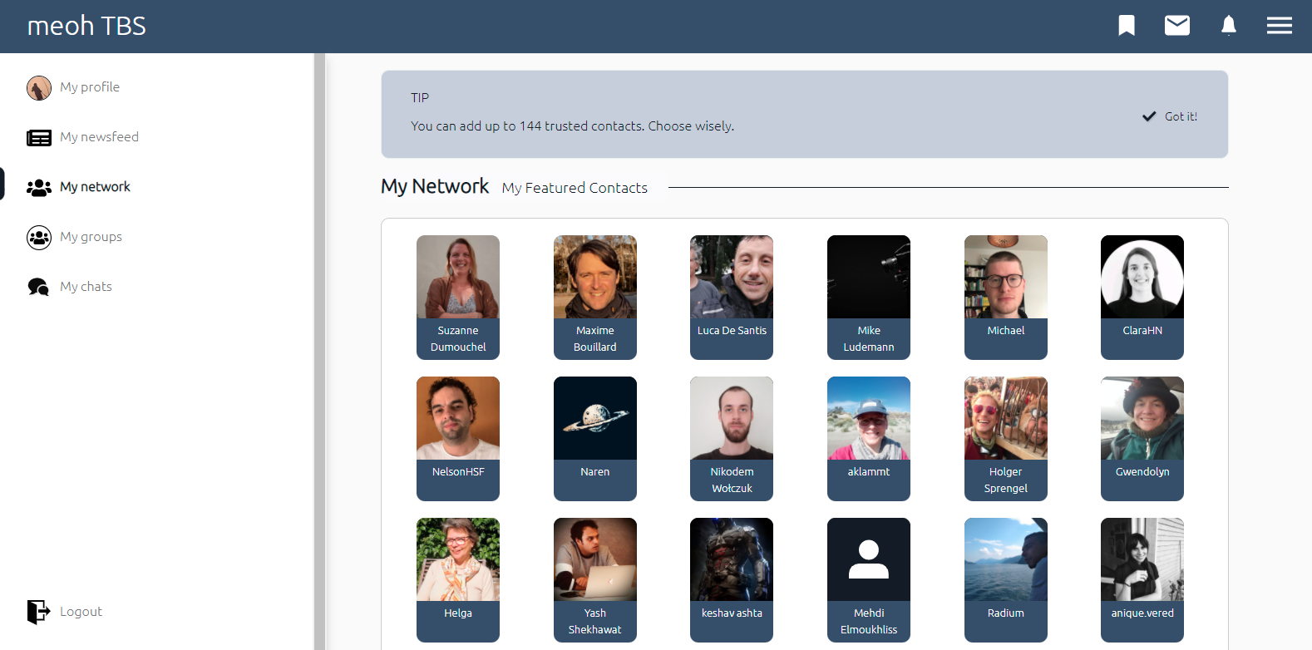
Social network: Trust Building System
Notes:
A network of reliable partners to assist you
Cooptation : social community based on aligning research interest with business interests
Major features:
My groups: to discuss topics of interest with peers
My newsfeed: for your asks and requests or to disseminate info
My network: A private network of reliable peers

Slide 19
Crowdfunding service
Launched in January 2022
Increase SSH impact and outreach by citizen funding
Initiate cascade funding for SSH research
Strengthen the links between science and society
For Social Science and Humanities research projects in the European Research Area
Applications welcome: https://wemakeit.com/pages/operas
Notes:
Sona : OPERAS is the Research Infrastructure supporting open scholarly communication in the Social Sciences and Humanities (SSH) in the European Research Area. The aim of OPERAS is to make Open Science a reality for research in the SSH and achieve a scholarly communication system where knowledge produced in the SSH benefits researchers, academics, students and more generally the whole society across Europe and worldwide, without barriers.
OPERAS is creating a portfolio of different scholarly communication services at European level, addressing the specific needs of the research community. One of these services is the discovery platform GoTriple, developed by us, the TRIPLE project (2019–2023). It is through the TRIPLE project that OPERAS and wemakeit collaborate.

Slide 20
Criteria for the selected projects in the crowdfunding service
A researcher in Europe or in a European institution
2 letters of support coming from researchers that are not working in the same research institution
Topic must be from SSH domain
Validation by the TAB members (during the lifetime of TRIPLE project)

Slide 21
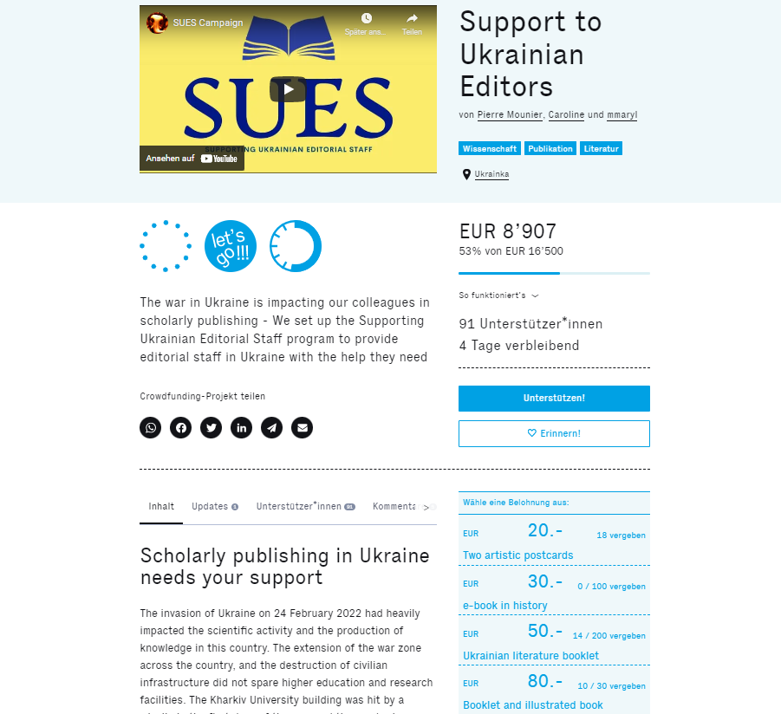
Crowdfunding Service
https://wemakeit.com/pages/operas?locale=de
https://wemakeit.com/projects/support-to-ukrainian-editors

Slide 22
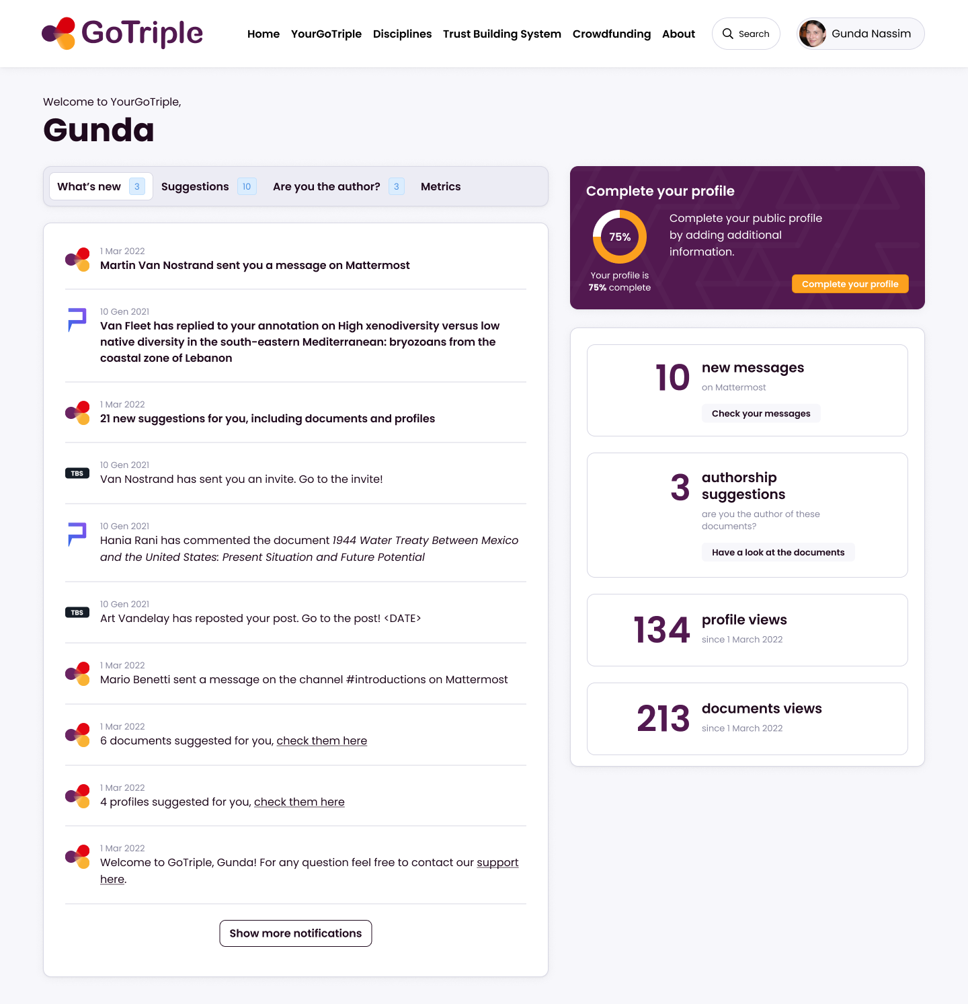
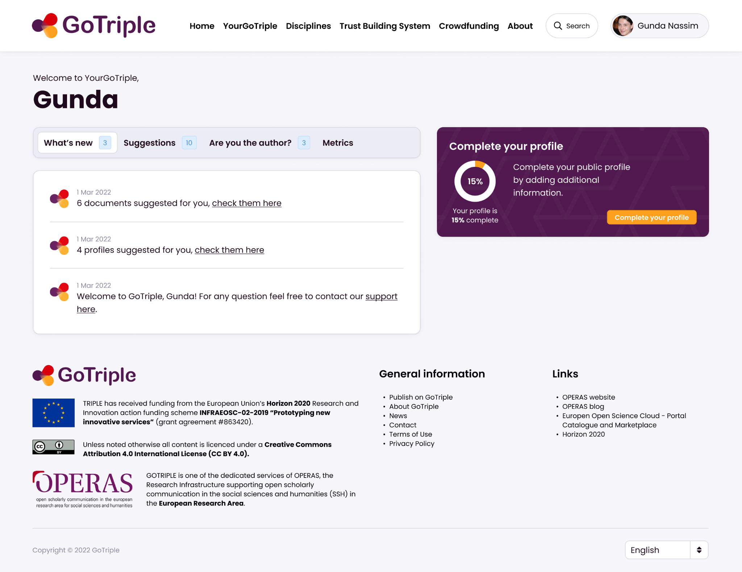
My GoTriple page

Slide 23
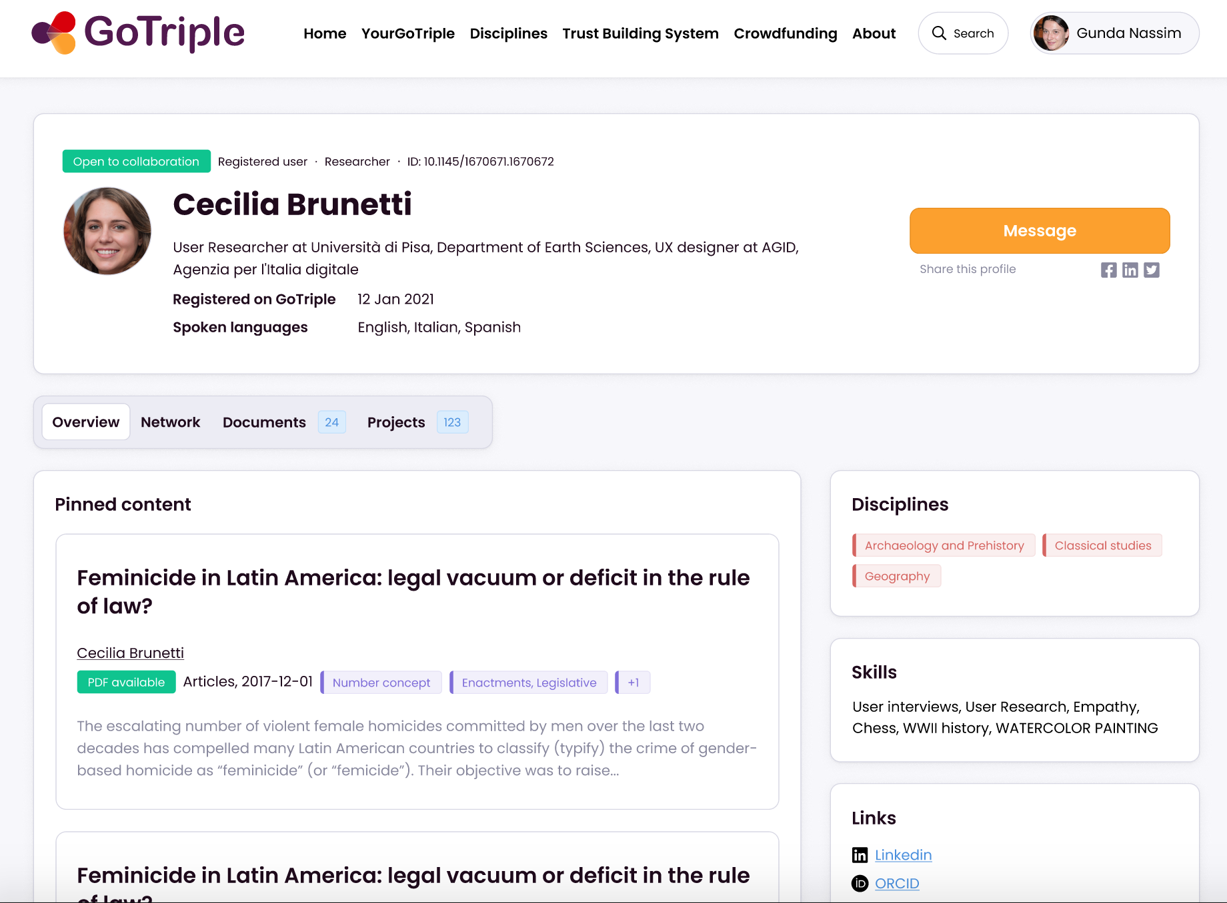
Full public profile
Notes:
Emilie

Slide 24
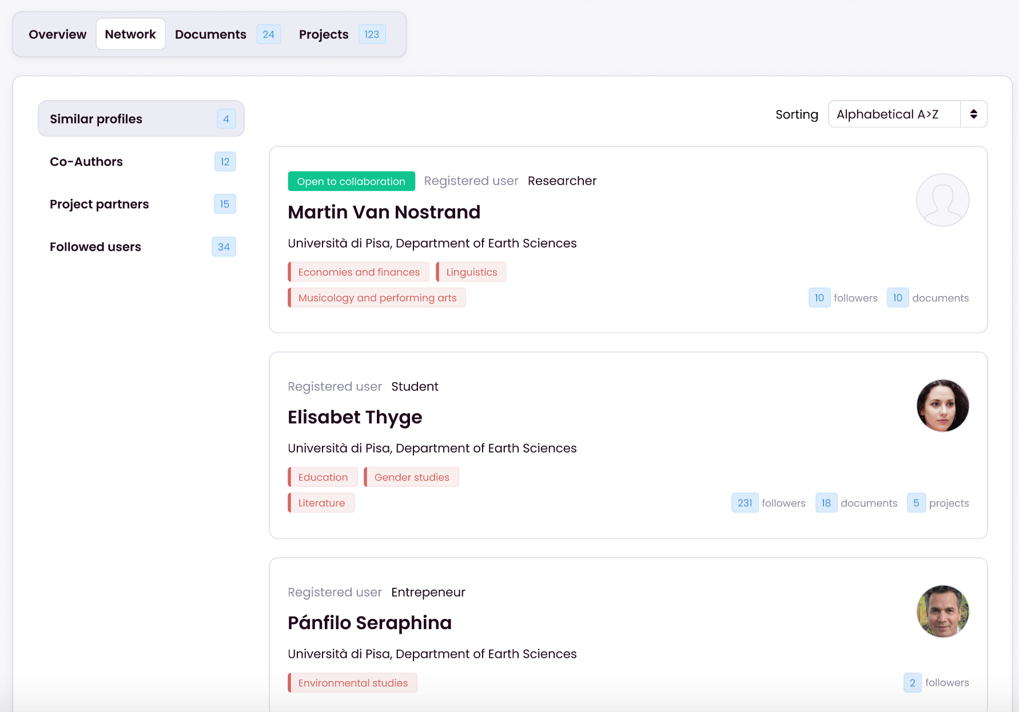
Collaboration opportunities
Similar profiles
Co-authors
Project partners
Followed users

Slide 25
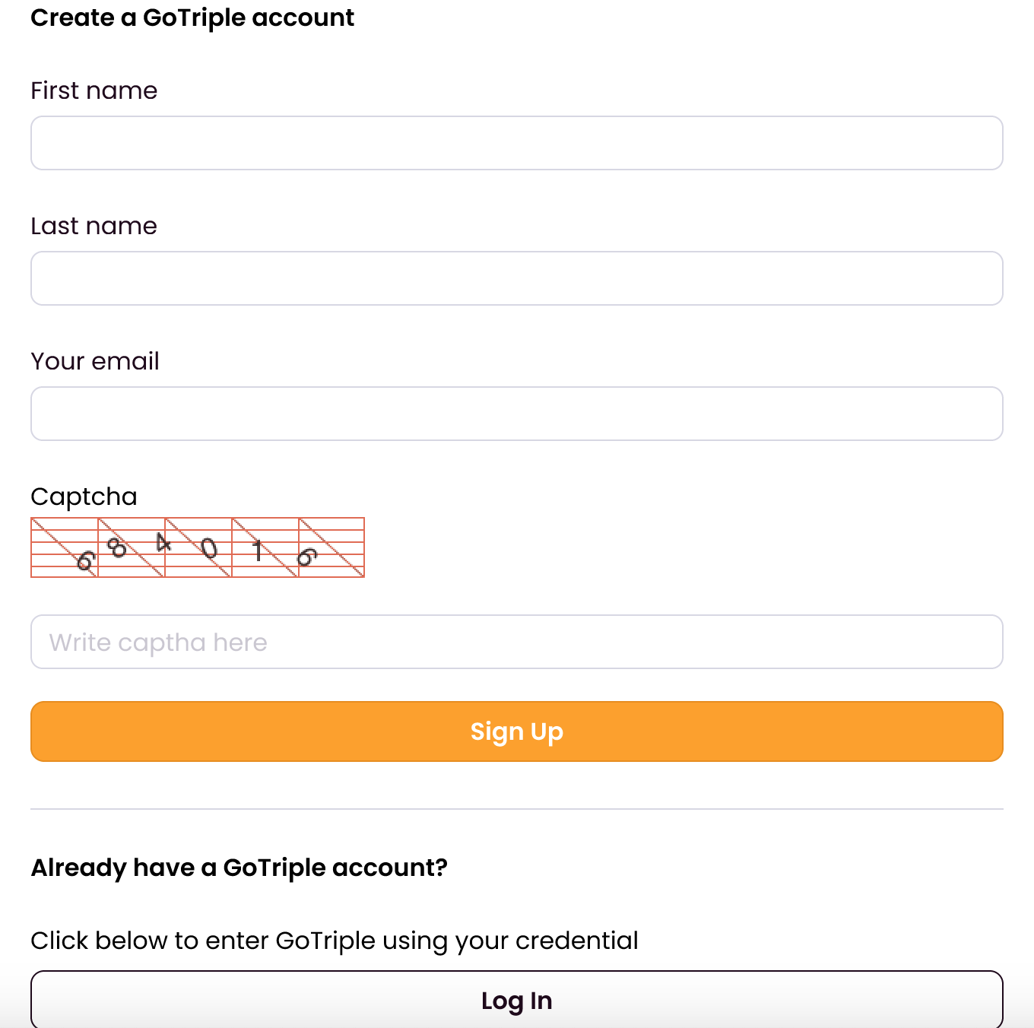
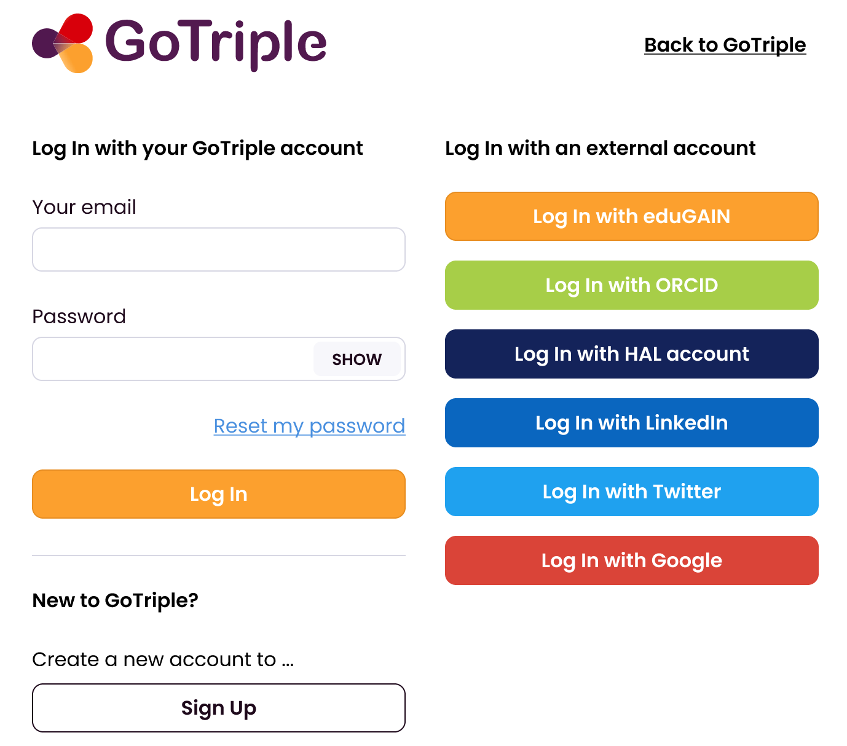
Single check-in
Single check-in solution
the user needs to validate her registration by receiving a confirmation email

Slide 26
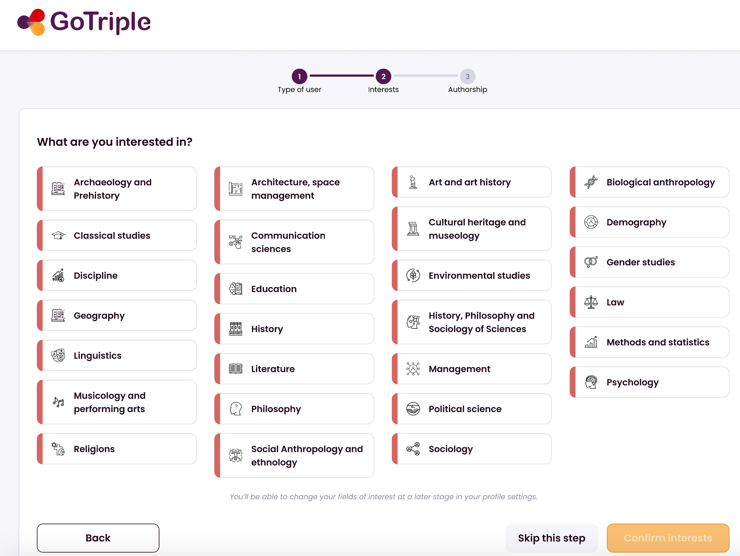
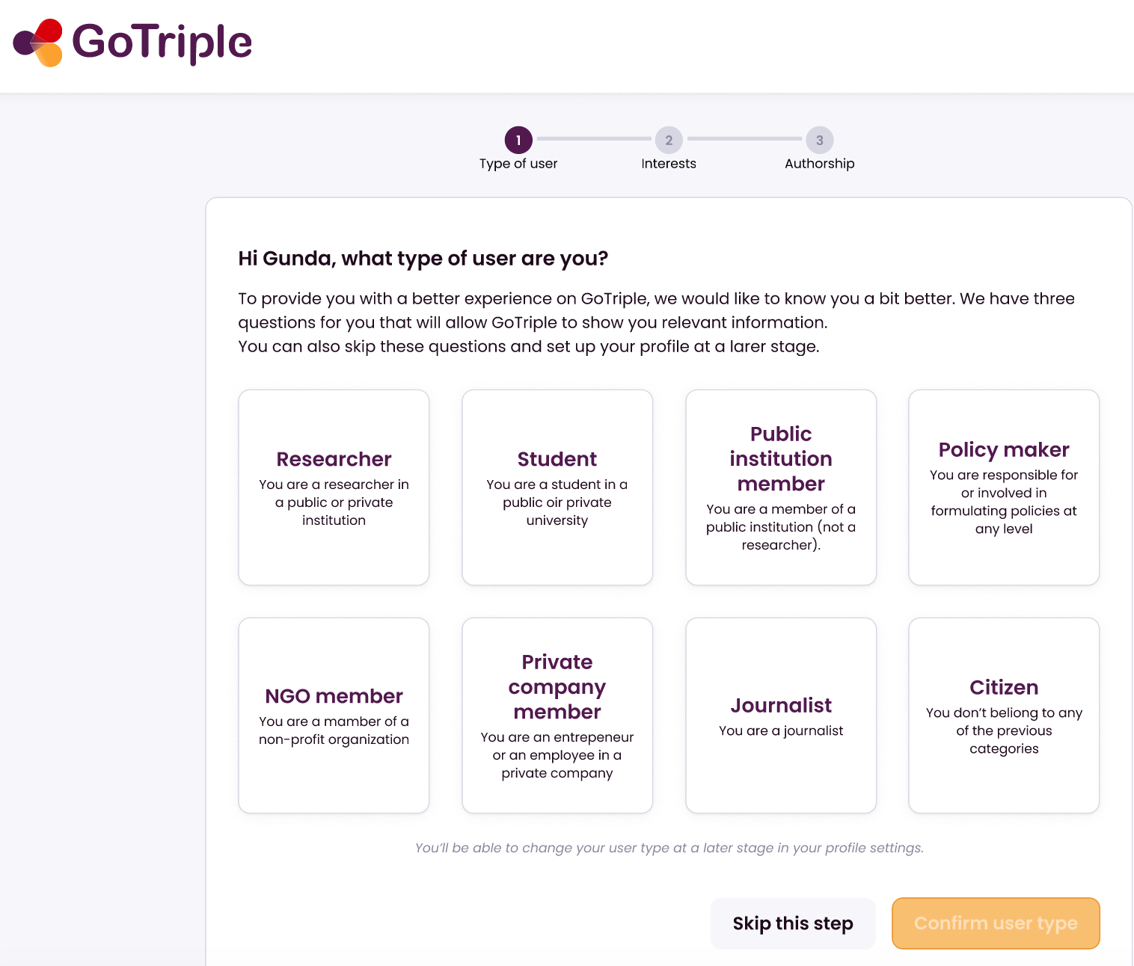
Onboarding

Slide 27
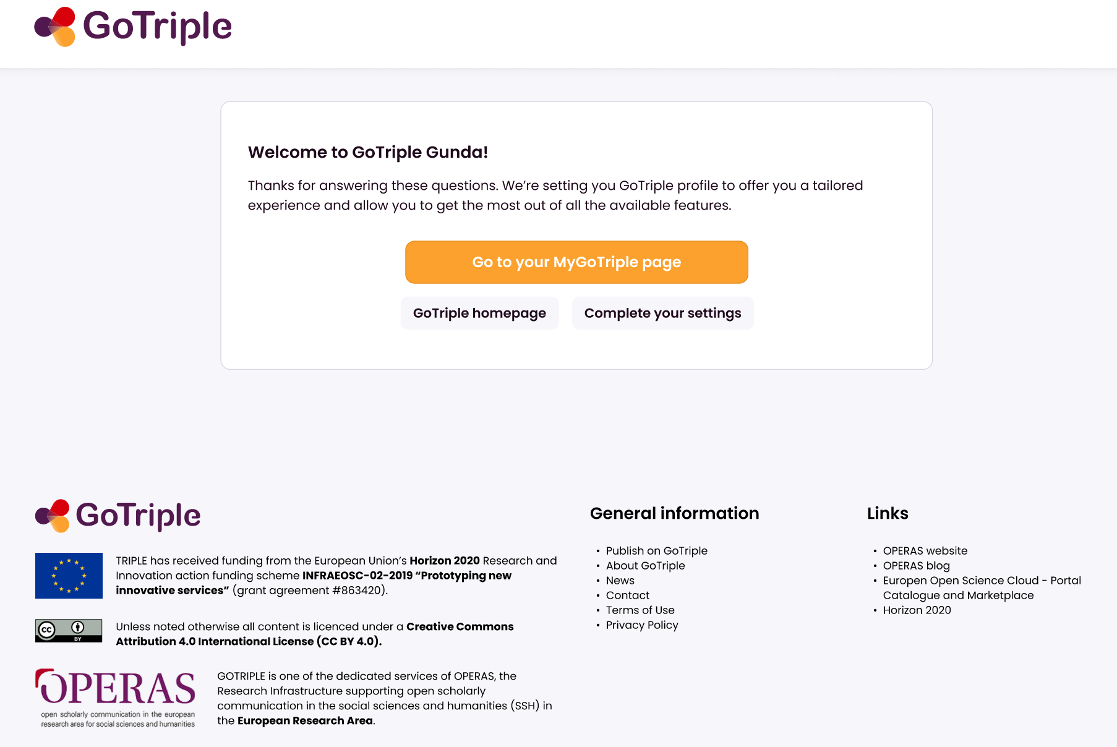
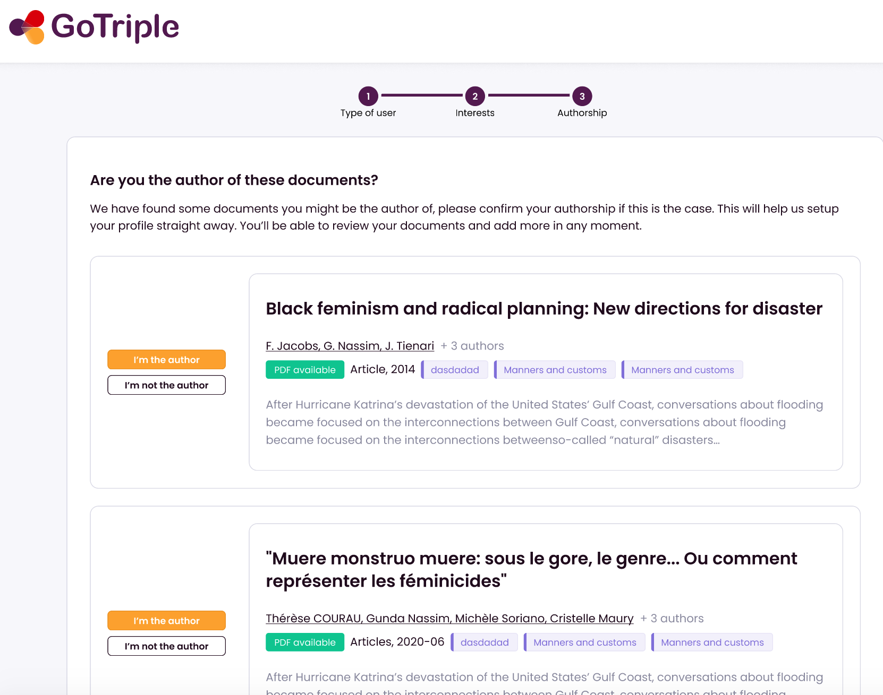
Onboarding
Notes:
link your profile with your publications

Slide 28
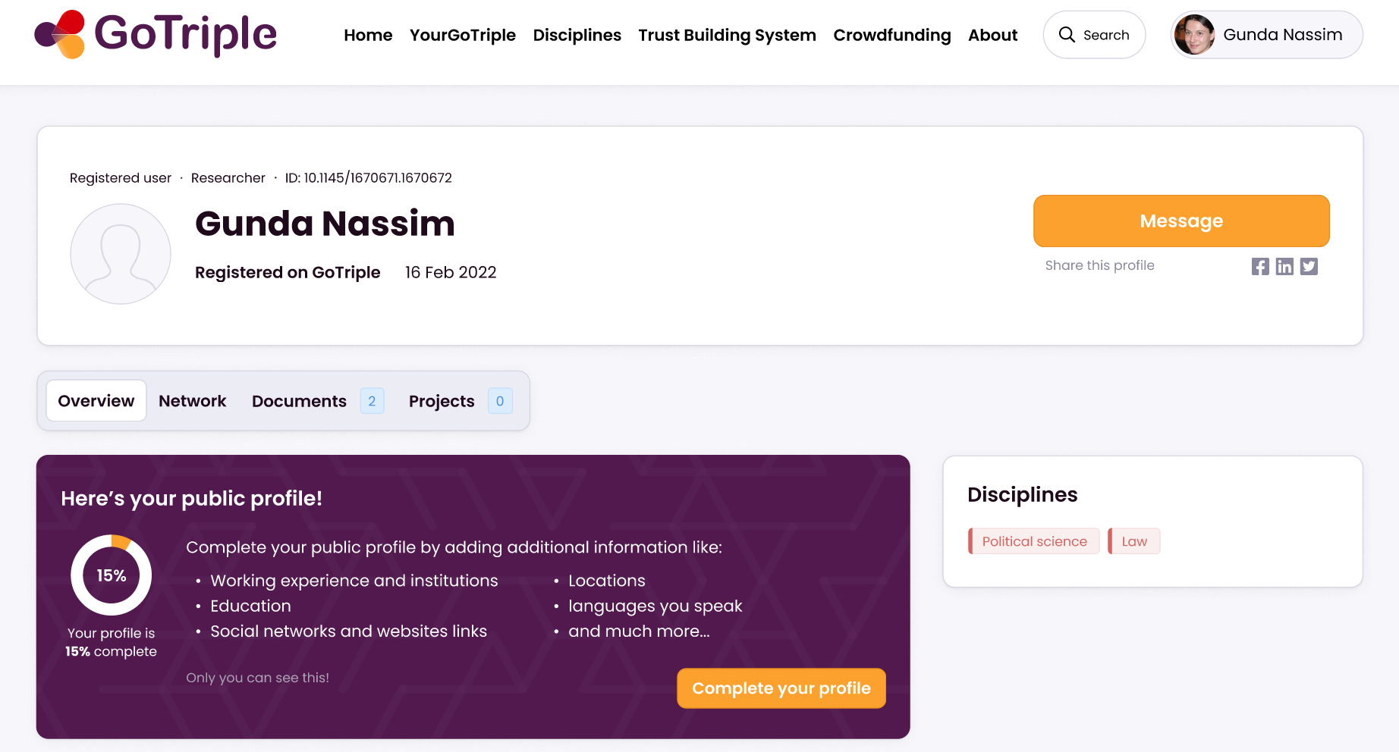
Profile management
Profile settings
Notes:
US002 - Profile management:
Profile Settings
Full public profile
Unregistered author profile
MyGoTriple page
Figma boards with all these pages and some comments

Slide 29
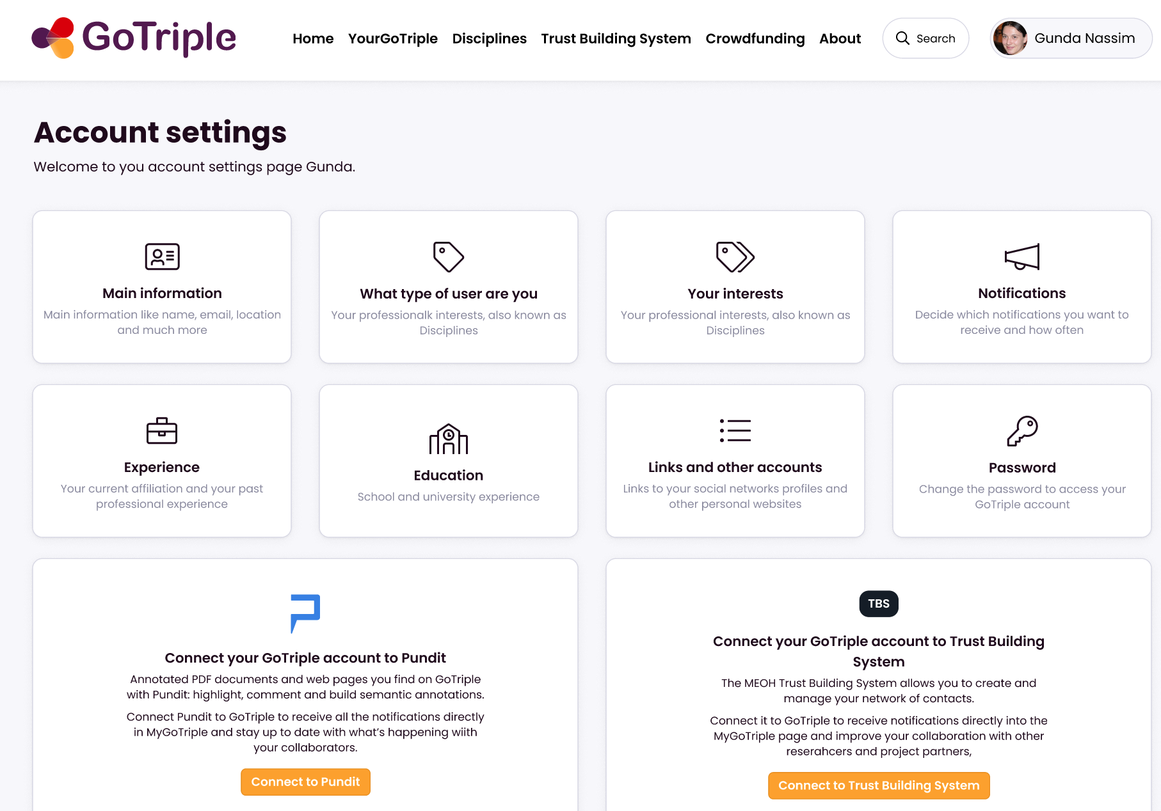
Profile settings
Complete my profile
Main info
Type of user
My interests
Notifications
Experience
Education
Links & other accounts
Pwd
PUNDIT
TBS (social network)

Slide 30
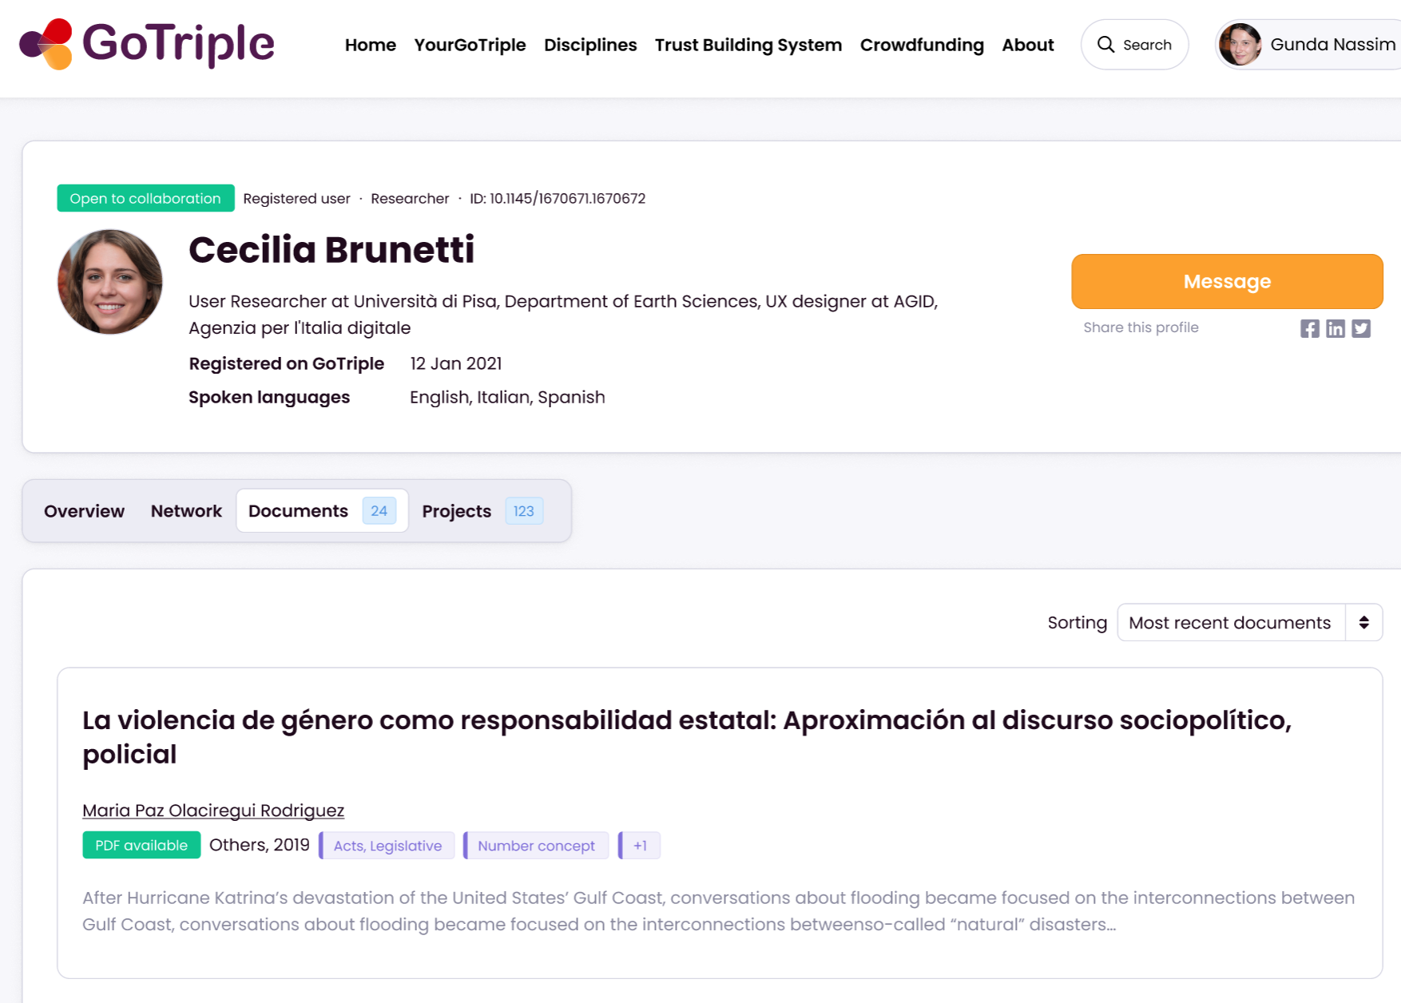
Full public profiles

Slide 31
Materials to learn to use GoTriple
The platform : https://www.gotriple.eu/
Project website TRIPLE series :https://project.gotriple.eu/training/
TRIPLE project Youtube channel
GoTriple promotional video: https://youtu.be/4HCNt1nZ2I0
Material available in the website (flyers, factsheets): https://project.gotriple.eu/information-material/
List of publications : https://project.gotriple.eu/publications/

Slide 32
TRIPLE UX design diary https://andreinidesign.notion.site/TRIPLE-UX-design-diary-32ad6e84dbe0440b8ff54d7be242de86
Tutorials about :
User registration and onboarding (6min)
How can a user edit the public profile and public profile pages (13 min)
How to export bibliographic data (4 min)
How to search profiles (8min)
Present the homepage and discovery of publications (16 min)

Slide 33
AISBL : European research infrastructure
Coordinate and federate resources to address SSH scholarly communication needs
Vision: to make Open Science a reality for the SSH
Member of EOSC Association
5 H2020 projects funded: OPERAS-D, HIRMEOS,
OPERAS-P, TRIPLE, COESO
Special Interests Groups in
Advocacy (Max Weber Stiftung)
Best Practices (OAPEN)
Business Models (UCL Press)
Common Standards (EKT)
Multilingualism (University of Coimbra University)
Platforms and Services (OpenEdition)
Tools (OpenEdition)
https://www.operas-eu.org/special-interest-group-living-book/
Notes:
OPERAS is a European RI which coordinates and federate resources to address SSH scholarly communication needs. DARIAH collaborates OPERAS and is a supporting member of the association. is a research infrastructure. It addresses SSH needs in the context of Open Science. The "Research for society" (COSEO) service began in January last year; The Diamond S project funded by cOAlition S is completed.
OPERAS is organised in Special Interest Groups (SIGs). Special Interest Groups are the place where new initiatives, new discussions take place and emerge. They work collaboratively, share information, watch, and prepare projects. The SIGs have recently published White Papers on their topics, accessible from the OPERAS website https://www.operas-eu.org/special-interest-group-living-book/

Slide 34
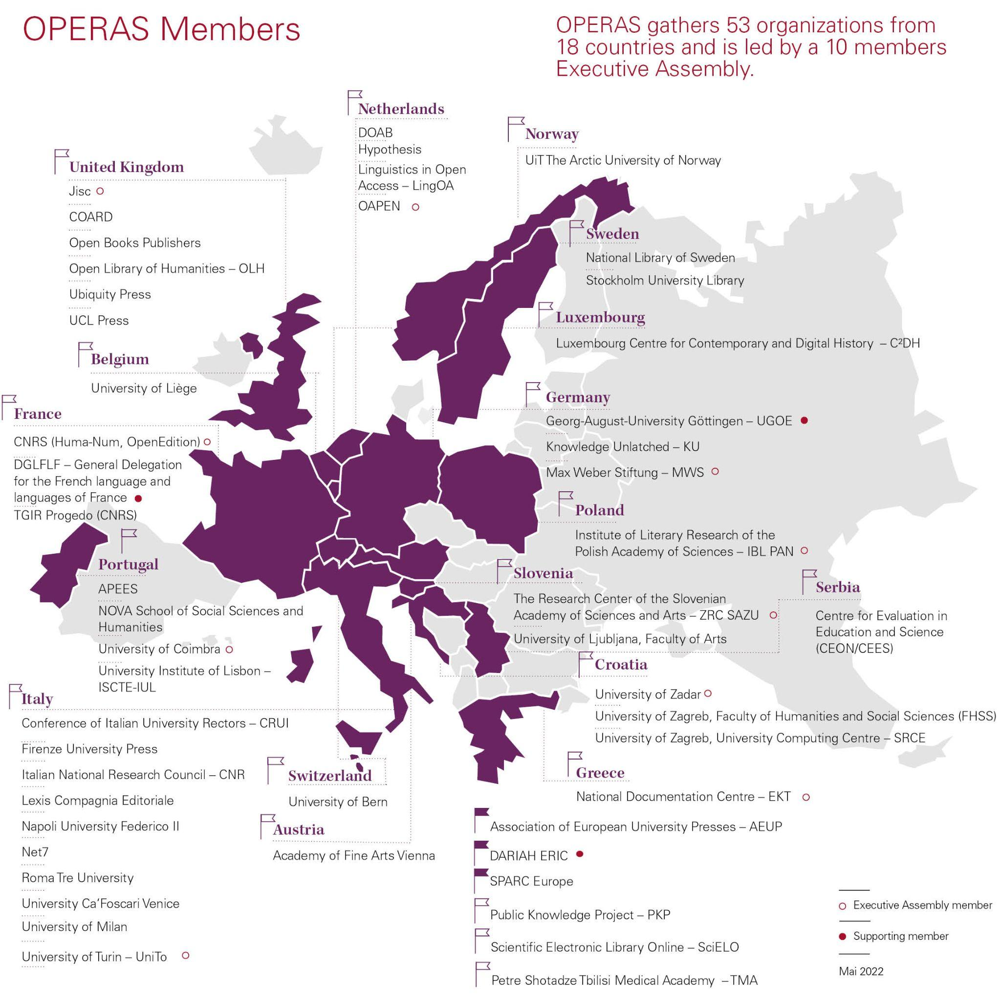
OPERAS members
53 organisations from 18 countries
Led by 10 members, composing the EA
Notes:
OPERAS is constantly growing, Georgia and Switzerland joint as latest and we have 3 supporting members
the EA meets each month to decide on the strategic decisions

Slide 35
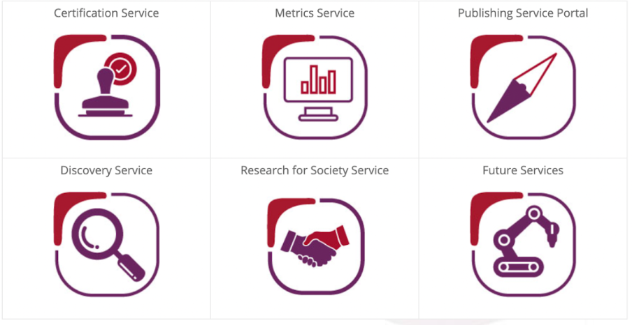
Build five core services

Slide 36
arasteh@maxweberstiftung.de
TRIPLE project website: project.gotriple.eu

