Slide 1
A shared path to
reforming rights retention in Europe

Slide 2
Project Retain
Today authors require the rights to publish, share, adapt, and reuse material for research, educational and multilingual needs
1-year project, started in July 2022. Arcadia Fund
reforming copyright policies to improve access to and use of copyrighted works
accelerating the uptake of rights retention and open licensing to enable researchers to share their work openly
T

Slide 3
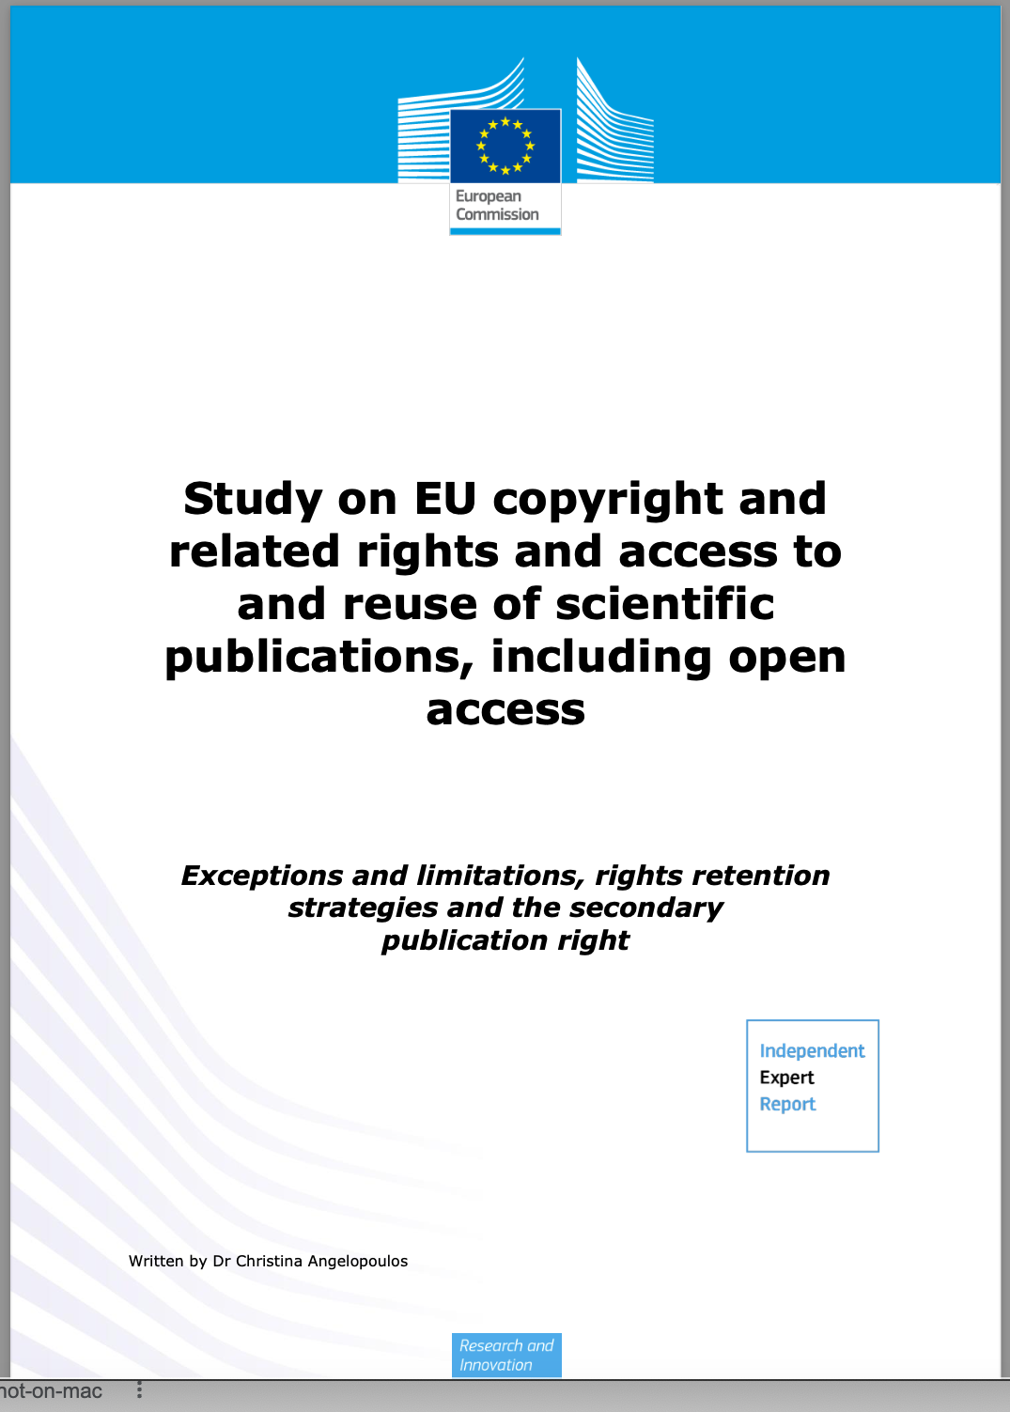
Recent EC Study 2022
“Copyright … has the potential to stifle the free exchange of scientific output” p7

Slide 4
Recent positive developments
Funders: cOAlition S RRS and resources
EC study on EU copyright and related rights and access and reuse of scientific publications, incl. OA, 1 Aug 2022
Publisher changes
Institutions: Growth in number of European institutions implementing Harvard-style non-exclusive assignment of rights to the institution (e.g. Edinburgh), adopting language to include in publishing agreements (e.g. Cambridge) or directing researchers to Plan S requirements (eg TiB Leibniz)

Slide 5
Publisher policies: First results
Finding 1:
When authors publish openly, they do not always retain reuse rights
Some publishers still ask authors to sign an exclusive licence; it restricts the reuse of the contribution for the original authors
“For articles published OA, the authors license exclusive rights in their article where a CC BY-NC-ND end user license is selected”
Notes:
I think the worst is that authors think that when publishing OA they retain all rights, and some choose NC and/or ND to have “control” of future derivatives or commercial uses. However, in this situation what they do is to transfer this “right” to decide to the publisher and moreover they restrict themselves to do so because, as Elsevier states, authors have the same rights than users when choosing NC-ND. Author cannot decide - it’s the publisher

Slide 6
Publisher policies: First results
Finding 2:
We are seeing change in publisher policies towards self-archiving, some positive
Some have reduced embargo periods or have eliminated them, e.g. 6m after publication or acceptance
“You may share the Original Submission or AAM at any time after your paper is accepted and in any format” SAGE

Slide 7
Publisher policies: First results
We are seeing change in publisher policies towards self-archiving, some positive, some less so
An increase in the use of the CC license on AAM, but not CC BY
“We recommend the Creative Commons Attribution-NonCommercial (CC BY-NC) license, which allows anyone to reuse your work, provided they credit you and don’t reuse your work for commercial reasons”
Notes:
Allowing use of CC license for AAM. publishers are more flexible on the copyright regime of the AAM in repositories. In the past they could made be public but with all rights reserved but now they can be made available under a CC license allowing some reuses, like reproduction and dissemination in other venues beyond repositories but publishers are still reluctant to get rid of the NC

Slide 8
Publisher policies: First results
Finding 3: Many publishers state on their sites that they do not support Plan S policies
“While Green OA can continue to have a role during the transition to fully open research, we cannot support the Green OA route as implemented in Plan S”

Slide 9
Publisher policies: First results
Finding 3: Many publishers state on their sites that they do not support Plan S policies, but some do
“To facilitate compliance with Coalition S/Plan S Open Access mandates, Karger permits authors, independently and without Karger`s action, to upload a copy of their Author Accepted Manuscripts (AAM), applying a CC BY license, to a repository designated by their Plan S funders”
What are the good practices?

Slide 10
Open licensing Most restrictive licences: DOAJ source
Since 2020 only about 6% of journals have changed the most restrictive licence available on their title
Source: DOAJ July 2022

Slide 11
University of Edinburgh
Research Publications and Copyright Policy came into force 1 Jan 2022
“Upon acceptance of publication each staff member with a responsibility for research agrees to grant the University of Edinburgh a non‐exclusive, irrevocable, worldwide licence to make manuscripts of their scholarly articles publicly available under the terms of a Creative Commons Attribution (CC BY) licence, or a more permissive licence.”
https://www.ed.ac.uk/information-services/about/policies-and-regulations/research-publications
Notes:
no copyright transfer, no exclusive license

Slide 12
Institutional Survey
Seeking insight from research institutions about policies on RR and copyright to sci publications, and the attitudes and challenges facing their researchers
Attitudes and awareness
Researcher priorities and focus
Institutional policies
Assertion of copyright
Open in the autumn 2022 to inform 2023 report and action plan

Slide 13
More information
More on Project Retain here:
https://sparceurope.org/copyright
copyright@sparceurope.org

