Slide 1
Citizen Science in Europe – challenges in conducting Citizen Science activities in cooperation with university and public libraries
Alisa Martek, Dorja Mučnjak, Dolores Mumelaš
National and University Library in Zagreb, Croatia
amartek@nsk.hr
dmucnjak@nsk.hr
dmumelas@nsk.hr
16.9.2022

Slide 2
About CeOS_SE project
1 Jan 2022 – 31 Dec 2024
Project led by LIBER with partners in 7 countries
GOAL: raise awareness of mainstream Open Science and Citizen Science practices in SE European countries
Notes:
1 Jan 2022 – 31 dec 2024
project led by LIBER with partners from Denmark, Italy, Greece, Cyprus, Serbia, Bulgaria and Croatia
project's goal is to raise awareness of mainstream Open Science and Citizen Science practices in SE European countries, specifically in countries that have been seen to perform less well in OS or CS, or where there is limited awareness of or involvement in major developments related to the European Open Science Cloud (EOSC)

Slide 3
PR2: Report on implementation of citizen-enhanced open science in various open knowledge hubs in SE Europe
PR2 facilitates transfer and participation in SE Europe between university libraries (project partners) and public libraries (associated partners)
3 activities
PR2A1. Survey
PR2A3. Study
PR2A2. Report
Notes:
PR2 facilitates transfer and participation in SE Europe between university libraries (project partners) and public libraries (associated partners) for a social purpose, by means of citizen engagement in OS. Therefore, PR2 seeks to trigger and build up the dialog and partnership between mentioned types of libraries as knowledge and innovation hubs in SE Europe, that will carry out together in CS activities.
3 activities:
PR2A1. Collection of practices of university and public libraries’ collaboration in SE Europe to mainstream CEOS – survey
PR2A2. A report on citizen science co-created activities by university and public libraries and application to SE Europe
PR2A3. Study: Upscaling collaboration between academic and public libraries for CEOS in SE Europe

Slide 4
Libraries and Citizen Science (CS)
Libraries bridges that connect citizens and science!
MUTURAL TERMS
SCIENTIFIC STANDARDS
COLLABORATION
OPEN SCIENCE
COMMUNICATION
DANA MANAGEMENT
European libraries – CS activities exist but little is said about them
Notes:
The fundamental concepts we associate with CS are scientific standards, collaboration, open science, communication and data management. All these terms can be related to librarianship, so it is not surprising that libraries are stakeholders in the CS implementation
Libraries can serve as a bridge that connects citizens and science, but also as the main bearers of ideas and initiators of activities in the community in which they operate
CS activities in European libraries do exist, but unfortunately there is little case study literature written and available in the English language. More importantly, some libraries that implement such projects are not familiar with the term citizen science

Slide 5
Cooperation between libraries - barriers
Barriers
Lack of ideas
Lack of time
Lack of staff
Insufficient funding
Notes:
More frequent cooperational problems are lack of unique ideas, time, staff and funding. Libraries probably face the same challenges while creating CS activities, as well as the lack of knowledge about what CS is and what its benefits are for the library community and the community in general.

Slide 6
Survey methodology
Survey conducted by:
University Library of Southern Denmark + National and University Library in Zagreb
Number of responses: 81
Fully completed survey: 56
Research questions:
1. What are the challenges of conducting CS activites
in cooperation of university and public libraries?
2. What are the possible solutions to those challenges?
Notes:
In order to indentify collection of practicies of university and public libraries’ collaboration the survey was conducted in partnership with the University Library of Southern Denmark which, as a project partner, was in charge of implementing PR1 "Framework for Transfer of Knowledge and Innovation on citizen-enhanced open science (CeOS)" (možda nepotrebno?)
joint survey was conducted because the target respondents were the same – European university and higher education libraries
total number of responses was 81 – 56 responses fully completed survey
The main research questions for this study were: What are the challenges of conducting CS activites in cooperation of university and public libraries?What are the possible solutions to those challenges?
34,5% from Southern Europe
30,4% from Northern Europe
19,5% from Eastern Europe
15,2% from Western Europe

Slide 7
Survey results… cont.
results about actual CS activities in cooperation of university and public libraries
Two groups:
Interviews conducted with colleagues from Serbia, Denmark and Portugal
G1
G2
56 libraries
NO cooperation with public library
4 libraries
Cooperation with public library
Notes:
results about actual CS activities in cooperation of university and public libraries
Two groups:
G1 – didn’t have cooperation with public library – 56 libraries
G2 – have had cooperation with public library – 4 libraries (Serbia, Denmark, Portugal and Finland)
Interviews conducted with colleagues from Serbia, Denmark and Portugal

Slide 8
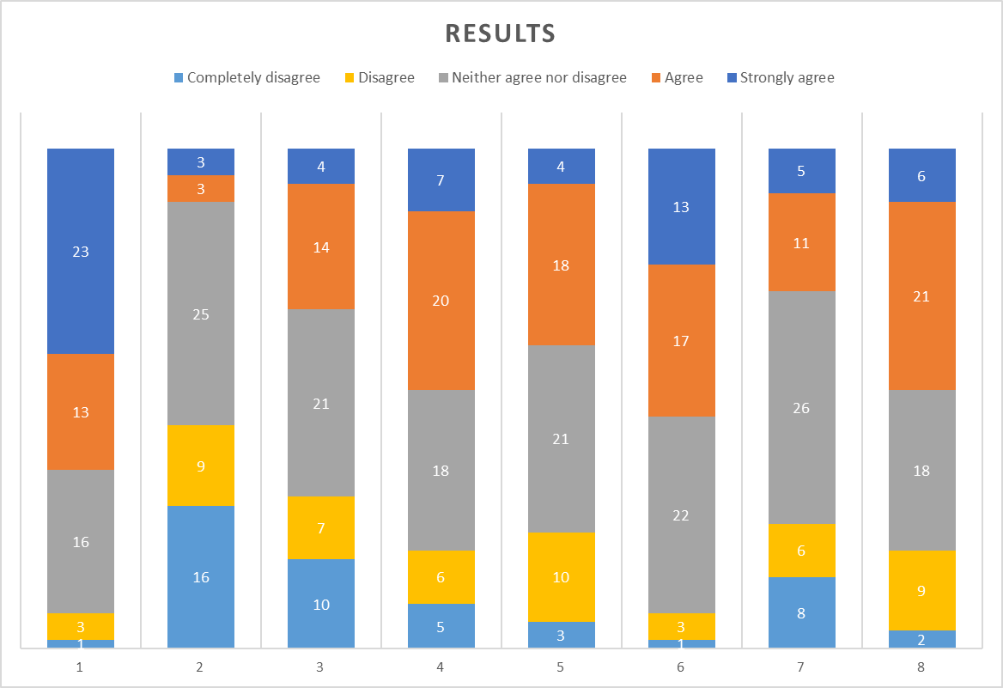
How would you rate the organization of CS activities in cooperation with your library?
1. lack of resources (staff, time, institutional funding),
2. bad previous experiences in organizing joint events,
3. lack of experience in co-organizing events,
4. different work culture in university and public libraries,
5. administrative barriers,
6. financial barriers,
7. insufficient technical equipment,
8. lack of knowledge about citizen science.
G1

Slide 9
G1

Slide 10
Examples of good practice
Portugal = P1
Project Abeirar
Denmark = D1
Find the lake
Serbia = S1
Wiki marathon
Nature up close and personal
Narrative medicine
Workshop of democratization of digitization
Language laboratory
Transcribiton
G2
Notes:
Druga skupina (G2) broji samo četiri visokoškolske knjižnice koje su dosada ostvarile suradnju s narodnim knjižnicama u organizaciji aktivnosti građanske znanosti. Nabrojati države i nazive aktivnosti. Te države provele su 8 aktivnosti CS.
Napomenuti da se Finska nije odazvala na intervju!

Slide 11
Interview results – lack of resources
P1: „And one difficulty is that all of us have other jobs and we all depend on hierarchical orders to be able to advance and it is a bit difficult to reconcile everything…”
P1: „Another difficulty was to secure people who would be in charge of security because the activity was held in nature. We told everyone to participate at their own risk, but people still came. Ensuring security was complicated.“
G2
Notes:
Jedna od najistaknutijih prepreka je lack of resources (staff, time, financial funding). Naime, i tijekom ostvarenih suradnji potvrđeno je da postoje određene prepreke u vidu nedostatka vremena, osoblja i slično pri zajedničkoj organizaciji takvih aktivnosti

Slide 12
Interview results – lack of resources
D1: „Then another barrier is mapping of skills at libraries. And to be honest, I think that could be a barrier in research libraries as well, because I can see from my own library that a lot of the skills our staff have are transferable skills that we use in citizen science projects, and I will bet that at many Danish public libraries the same skills are there.“
G2
Notes:
Jedna od najistaknutijih prepreka je lack of resources (staff, time, financial funding). Naime, i tijekom ostvarenih suradnji potvrđeno je da postoje određene prepreke u vidu nedostatka vremena, osoblja i slično pri zajedničkoj organizaciji takvih aktivnosti

Slide 13
Interview results – insufficient funding
S1: „We have no finances for CS activities.
D1: „In Denmark, public libraries have been cut almost 20% in budgets the last few years. […] So in the public sector in Denmark, and it's also true. For example, at our own library we have to do more for less money.“
P1: „The major barrier was the financing of the activity.”
G2
Notes:
Intervjuirane knjižnice potvrđuju da je jedna od prepreka i nedostatnost financijskih sredstava. Naime, vidljivo je da se aktivnosti često provode kroz entuzijazam organizatora, ali za uspostavljen sustav potrebna su osigurana sredstva:

Slide 14
Interview results – awareness of CS
S1: „We didn't even understand that what we do is citizen science!”
D1: „. I think there is a big barrier in knowledge in public libraries: What is citizen science? Why should we do it? Why is it good or potentially good, and why does it live up to the things we should be doing? So, advocacy is a big barrier.“
P1: „As for prior knowledge in the organization of citizen science activities, only I and my colleague were familiar with open science.“
G2
Notes:
Kroz intervjue, dokazano je da je i svijest o samom građanskoj znanosti nedovoljno izražena u narodnim knjižnicama, pa i u visokoškolskima, te da tu sigurno postoji prostor za razvoj svjesnosti.

Slide 15
Conclusion
Higher education libraries that cooperated with public libraries in organizing citizen science activities have a positive attitude about cooperation
Certain obstacles exist:
lack of resources and financial barriers
lack of awareness and knowledge about Citizen science.
Notes:
Certain obstacles exist:
lack of resources and financial barriers,
lack of awareness and knowledge about Citizen science.
Improvement points:
mapping of transferable skills in order to know exactly the human resources in libraries,
better leadership and prioritization
citizen science activities become the basic activities of the library,
collegiality is crucial for carrying out these activities.

Slide 16
Improvement points
mapping of transferable skills of staff
better leadership and prioritization
citizen science activities as basic activities
collegiality
Notes:
Certain obstacles exist:
lack of resources and financial barriers,
lack of awareness and knowledge about Citizen science.
Improvement points:
mapping of transferable skills in order to know exactly the human resources in libraries,
better leadership and prioritization
citizen science activities become the basic activities of the library,
collegiality is crucial for carrying out these activities.

Slide 17
Thank you for your attention!!

