Slide 1
Article Processing Charges and the Stratification of Open Access Publishing
Thomas Klebel
PUBMET 2022
15/09/2022
Slides: https://doi.org/10.5281/zenodo.7079196

Slide 2
Open Science → Equity?
Notes:
Why do we talk about fairness? After all, one would assume that open science should be fair by design, one pillar of open science, open data, even has FAIR as its leading acronym (although it stands for something else).
Should not forget: societies have inequality, and science as well. While we could reasonable assume that some aspects of OS should lead to more fairness, we should look more closely at how OS might actually be unfair, how it might create more inequalities than reducing them. That’s what I’m here to talk about.

Slide 3
Stating the obvious: Academia is unequal
Structural inequalities persist across regions and demographics
For example:
Global North dominates, pushing Global South research to the periphery
Even within richer regions, a fetish for the poorly-defined goal of “excellence” breeds cumulative advantage in funding allocation for the highest-funded institutions
Women occupy relatively fewer higher positions, tend to achieve senior positions at a later age, are awarded less grant funding and have fewer publications
STEM privileged over SSH

Slide 4
Open Science and Equity
The Budapest Open Access Initiative claimed Open Access could share learning between rich and poor and “lay the foundation for uniting humanity in a common intellectual conversation and quest for knowledge” (Chan et al. 2002).
But: open practices alone do not necessarily lead to more equity and diversity
Factors like region, gender, discipline and access to resources will continue to shape the possibilities of participation in an Open Science world

Slide 5
Might Open Science be at risk of reinforcing existing privileges or creating new ones?

Slide 6
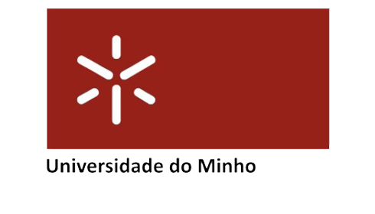
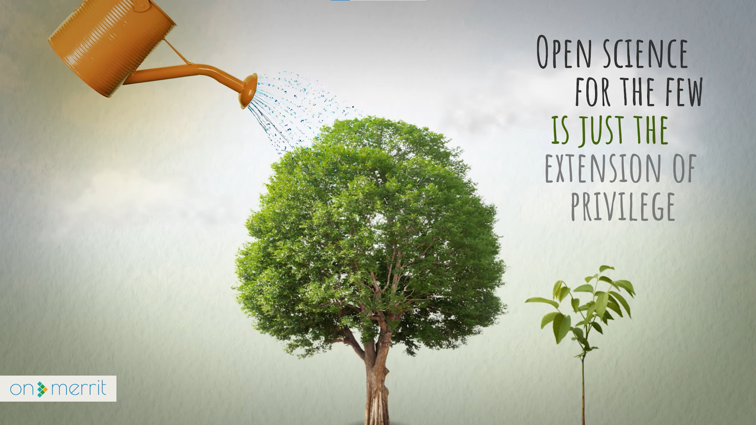
The ON-MERRIT project
H2020 project: October 2019 - March 2022
Methods: Sociological, bibliometric and computational approaches
https://on-merrit.eu
Objectives
Ensure that Open Science & RRI interventions contribute to a more equitable scientific system
Distribution of rewards based on merit rather than privilege
Universidade do Minho
Notes:
Methods: Sociological, bibliometric and computational approaches

Slide 7
Scoping review
Question:
“What evidence and discourse exists in the literature about the ways in which dynamics and structures of inequality could persist or be exacerbated in the transition to Open Science, across disciplines, regions and demographics?”
Synthesizing results from 268 relevant studies
Many (diverse) threats – for example:
Costs of participation
Discriminatory OA APC business-model
Cumulative nature of data inequalities
Platform-logic of Open Science
Lack of reward structures
Exclusion of societal voices

Slide 8
The APC issue

Slide 9
Stratification of OA publishing
In US, authors from higher-ranked institutions publish APC-OA more often, and pay higher APCs (Siler et al. 2018)
Publishing OA with APCs is more likely for authors of male gender, from prestigious institutions, with previous federal (US) research funding, or an association with a STEM field (Olejniczak & Wilson 2020)
OA involving APCs is associated with lower geographic diversity of authors (Smith et al. 2021)
We investigated:
the relationship between proxies of institutional resourcing and average APCs on a global level.
Differences between fields and countries
Changes over time
Notes:
Methods: Sociological, bibliometric and computational approaches

Slide 10
Evidence base
Sample: 1.5 million journal articles
Articles published in journals listed in the Directory of Open Access Journals
Timeframe: 2009-2019
First and/or last author affiliated with university listed in 2021 CWTS Leiden Ranking
Data sources: OpenAlex, DOAJ, CWTS Leiden Ranking, World Bank
Main indicator: P_{top 10%}
“[t]he number [...] of a university’s publications that, compared with other publications in the same field and in the same year, belong to the top 10% most frequently cited.“

Slide 11
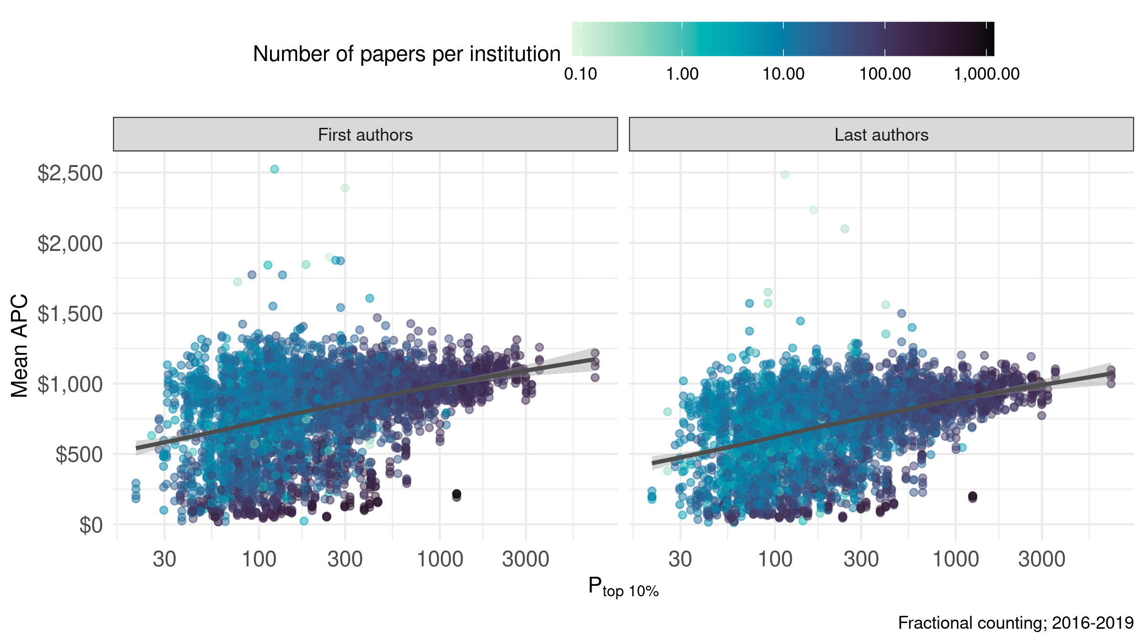
Institutional resources and APCs are linked
There is an association between institutional resources and average APCs
Equally strong for first and last authors
Might be explained by other factors (country, field)

Slide 12
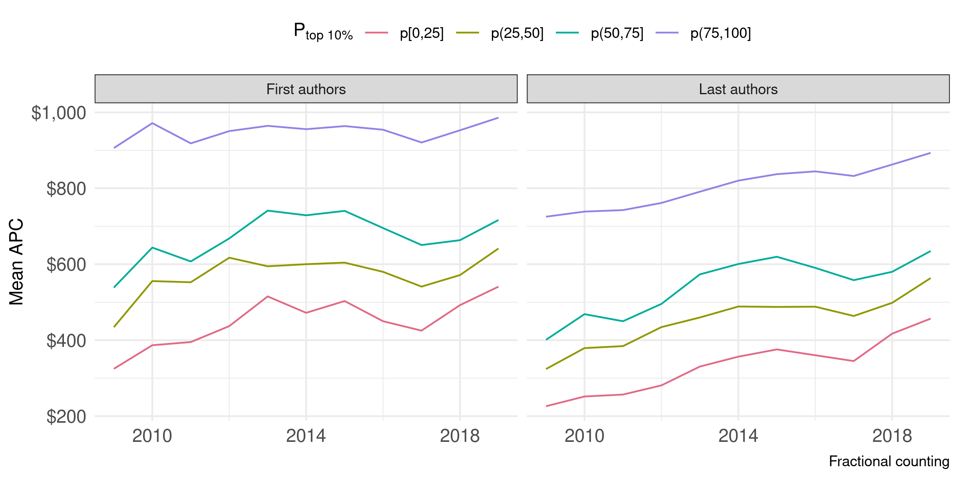
Linkage is stable over time
Top quartile has substantially higher APCs
Stratification (gaps between quartiles) mostly stable
Average APCs among last authors rising

Slide 13
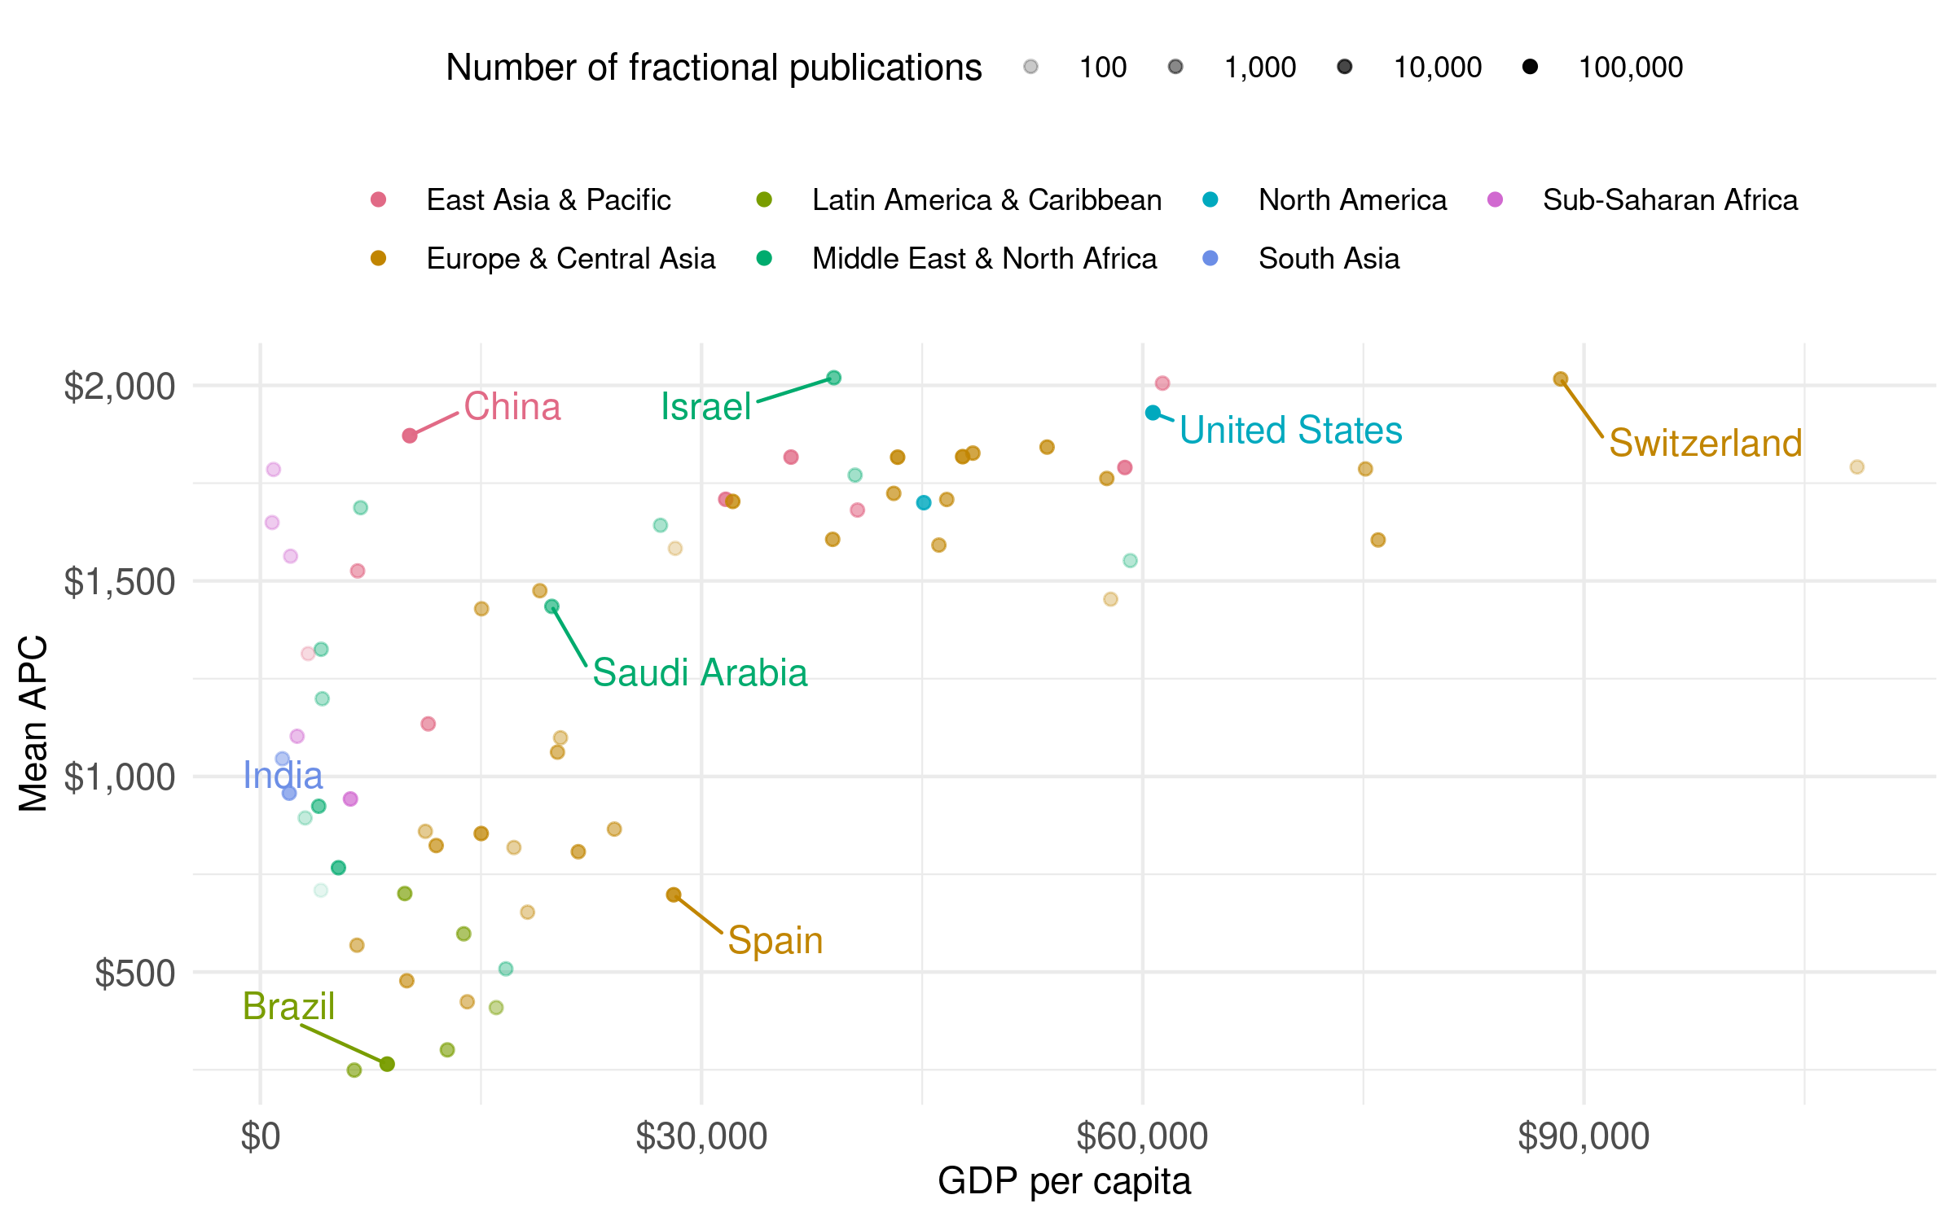
Heterogeneous dynamics on country level
High APCs in countries with > $30,000 GDP p. cap.
High variability for countries < $30,000 GDP p. cap

Slide 14
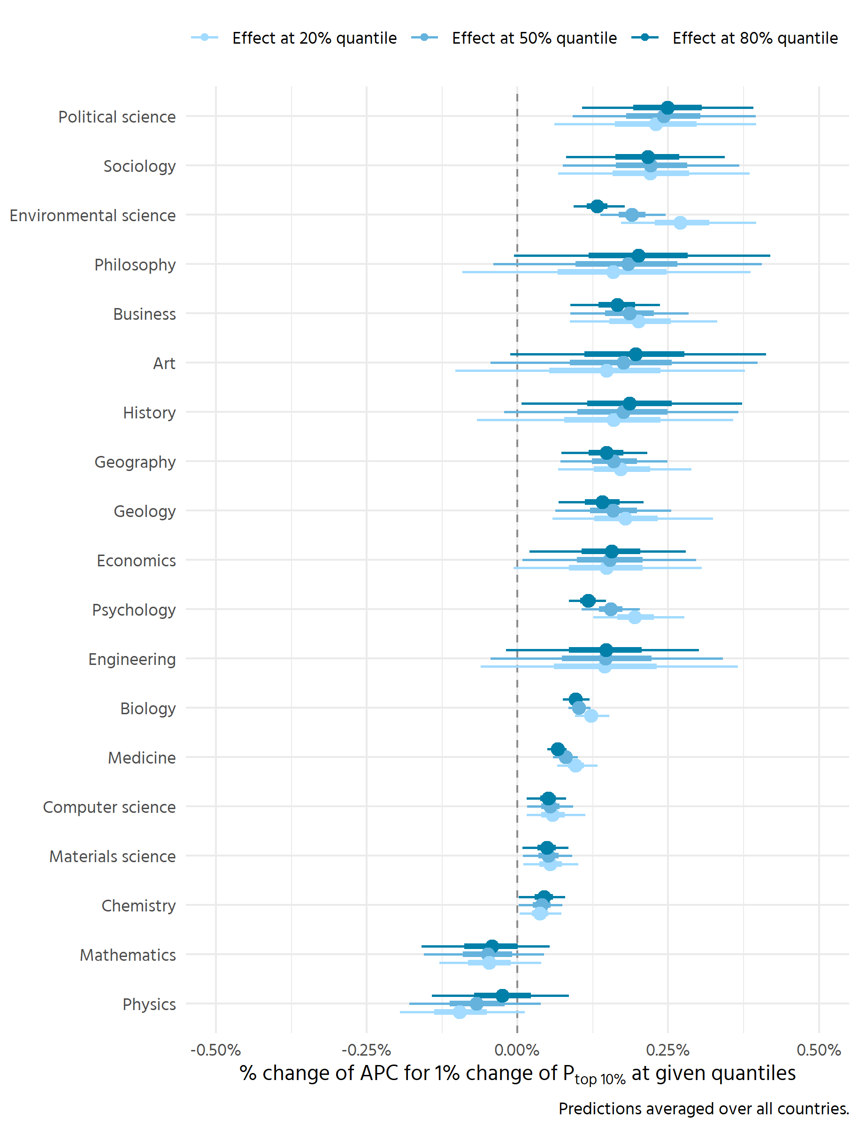
Multilevel mixing: fields differ
Bayesian multilevel hurdle model to control for field and country effects.
We find:
Small to moderate effect of institutional resources on APCs in most fields
Strongest effects in social sciences
Inverse effect in „Mathematics“ and „Physics“: better resourced institutions publish more in OA journals with no APC

Slide 15
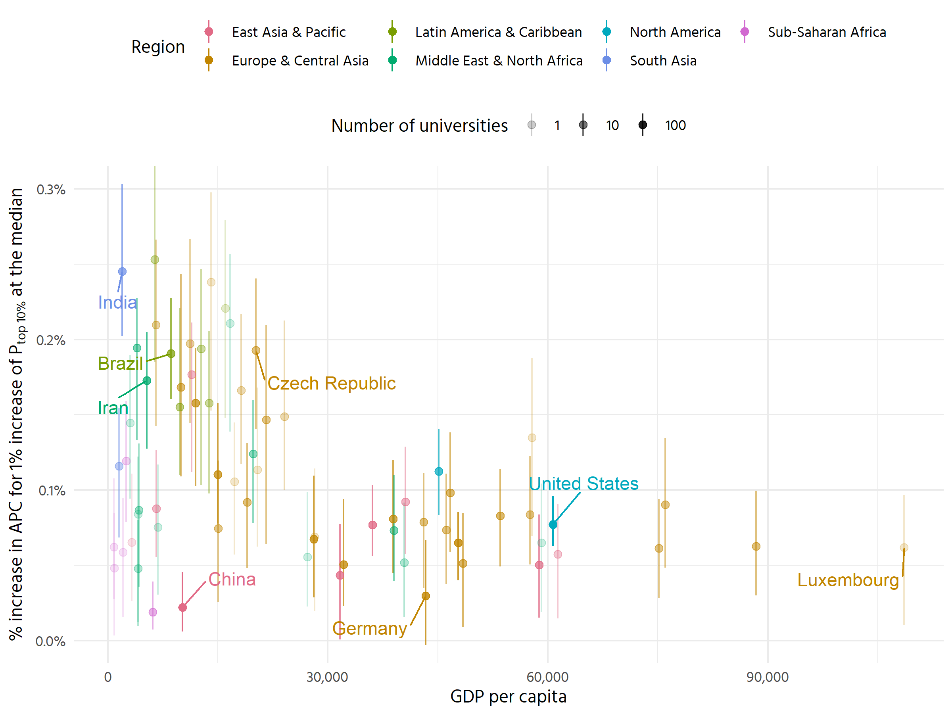
Countries as well
Effect of levels of resourcing on APCs low in high-GDP countries
High variability in low-GDP countries, but tendency for moderate effects (important exception: China)

Slide 16
Summary: Stratification in APC-based OA
Higher-ranked (better resourced) institutions publish more APC-based OA and pay higher APCs
OA publishing involving APCs is creating a new barrier for who can publish where
Implications
Voices from societies and communities less embedded in global science are further marginalised
Global issues need global perspectives, APC-OA is leading to the opposite
Existing inequities are amplified (citation advantage, future reward structures)
Photo by Joshua Hoehne on Unsplash

Slide 17
Contributing factors
Potential effect of institutional resources on research quality
Association between institutional resources and grant funding (policies)
Agreements between publishers and universities in higher-income countries
Waivers and discounts

Slide 18
How can we improve?

Slide 19
https://on-merrit.eu/results/
Hundreds of pages of primary research:
Cumulative Advantage in Open Science and RRI: A Large-Scale Quantitative Study
Investigating Institutional Structures of Reward & Recognition in Open Science & RRI
Drivers and barriers to uptake of Open Science resources in industry
Quantifying the influence of Open Access on innovation and patents
Results of a survey on the uptake of Open Science in information seeking practices in policymaking
Networks of engagement in deliberative policymaking: Expert reflections on barriers to participation
Leading into our recommendations:
Global Thinking. ON-MERRIT recommendations for maximising equity in open and responsible research
Notes:
30 recommendations, generated via iterative co-creation

Slide 20
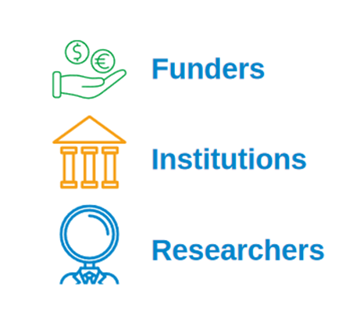
Co-Creating Recommendations
Internal revisions
Present recommendations
Co-creation Process
Discuss and debate
Notes:
To know what they think about the problems and how best to respond to them.
diverse, gender balanced group of 29 experts, drawn from each stakeholder category, representing 27 organizations from 16 countries, including participants from Africa and Latin America, ranging from early career to senior.
iterative, consensus-oriented process of presenting, discussing, and revising using a combination of survey tools and workshops with each stakeholder group

Slide 21
Find it on our website https://on-merrit.eu/ under Results, listed as D6.4, and at this link https://zenodo.org/record/6276753
Notes:
Created primarily by and with EU actors in mind, but awareness of and appreciation for the global inequities that exist within the research community and between regions
Need for joined-up approaches that target the research ecosystem as a whole
Recommendations aimed at leveling the resources playing-field to make ORR possible for more people
Some overlap with the UNESCO recommendations on OS
There are recommendations for everyone and actionable ones that you can implement right now

Slide 22
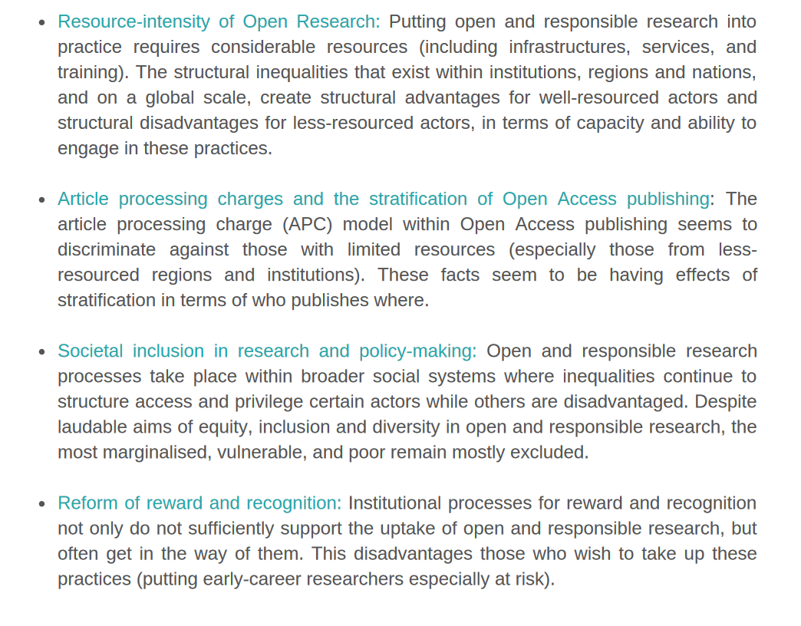
Four focus areas

Slide 23
How to reduce stratification in OA publishing?
Funders, institutions and researchers should collectively demand greater transparency from publishers on publication costs, regarding prices and services, and (where possible) support open infrastructures to collect this information.
Funders, institutions and researchers should support alternative publishing models where those show potential to be more inclusive, including consortial funding models for open publishing infrastructures which support Open Access publishing with no author-facing charges.
Funders, institutions and researchers should encourage and support the use and maintenance of sustainable, shared and open source publishing infrastructure, to reduce costs and promote open standards.
Institutions and researchers should ensure the accepted version (or later) of peer-reviewed works are deposited in an open repository.
Funders and institutions should consider supporting authors' right to self-archive publications by implementing rights retention strategies.

Slide 24
Thank you!
Thomas Klebel
tklebel@know-center.at
https://twitter.com/klebel_t
Slides: https://doi.org/10.5281/zenodo.7079196
Universidade do Minho

