Slide 1
Improving institutional visibility and reputation
in the Open Science era
Anton Degtev
CEE RI Solutions manager
Zadar, Sept 13th, 2022
Notes:
Dear colleagues, good afternoon. It's my pleasure to be here today.

Slide 2

Agenda:
Introduction
RIM/CRIS Portals for Open Science
How they works? How is that relevant to Open Science philosophy? Examples and close-ups How to start such project?
Digital Commons Repository Suite:
Broader output coverage Journal publishing Research Data management challenges
Q&A
Notes:
My name is Anton Degtev, I work with universities in CE and Southern Europe and focus on developing new projects around our analytics and visibility solutions. I will tell you today about what Elsevier can offer to support your Open Science strategy. Many customers are scouting for potential projects so I guess it might interesting for you to hear.
So we typically start discussions about Scopus data, metrics, university profiles, rankings, how to use analytics to develop or improve research strategy or how to find collaboration partners. And then at some point there is a realization that hey, this data

Slide 3

Research Information Management (RIM) Systems
…aka CRIS
Few words on:

Slide 4









Understanding RIM Systems
INTRODUCTION TO RESEARCH INFORMATION MANAGEMENT (RIM)
RIM systems support institution and researcher goals by improving access
to up-to-date research data campus-wide.
Research affiliations, collaborators
Research outputs
Instructional history
Patents
Research Information
Activities, service, awards
Grants
and projects
Media reports
Statement of impact
Equipment
“RIM Metadata” by OCLC Research, from Research Information Management: Defining RIM and the Library’s Role (doi.org/10.25333/C3NK88), CC BY 4.0
Notes:
RIM systems are used to aggregate, curate organize information about research in a broad sense – not only publications, preprints but projects, grants, equipment, media reports and others. What's more important that it links these data together.
Purpose is to provide complete view of the research activities and capabilities of your institution.

Slide 5





Importing Data from Multiple Channels
THE POWER OF PURE
Scopus
Web of Science
Mendeley
Embase
PubMed
CrossRef
RefWorks
EndNote
BibTeX
SciVal
Online
web content
Pure is designed to capture data from a wide selection of internal and external sources.
Profile Refinement Service (PRS) pre-populates researcher profiles with Scopus publications with minimal implementation and maintenance requirements.
Elsevier Fingerprint Engine
Data
validation and
deduplication workflows
Press Clippings
Applications
Awards
Projects
Datasets
Manually
added data
Pure
Scopus data
PRS processes
Scopus data
and metrics
Awarded grants
Institution information
Customer data
5
Notes:
Pure is designed to capture data from a wide selection of internal and external sources like online databases – Scopus, WOS, and others, your internal sources, manually added, and customer data
All data goes through validation and deduplication workflows before being added to Pure. So that you have an authoritative information in one place for basically two scenarios: internal – analyze, report, manage and external – showcasing.
That’s why it is relevant to Open Science

Slide 6
PURE USE CASES
Pure use case:
Encourage Openness, networking and collaboration
Notes:
Open Science calls for more transparency, inclusion and more collaborative environment. So you need to show what you do, what you’re good at, what you achieved and capable of.

Slide 7

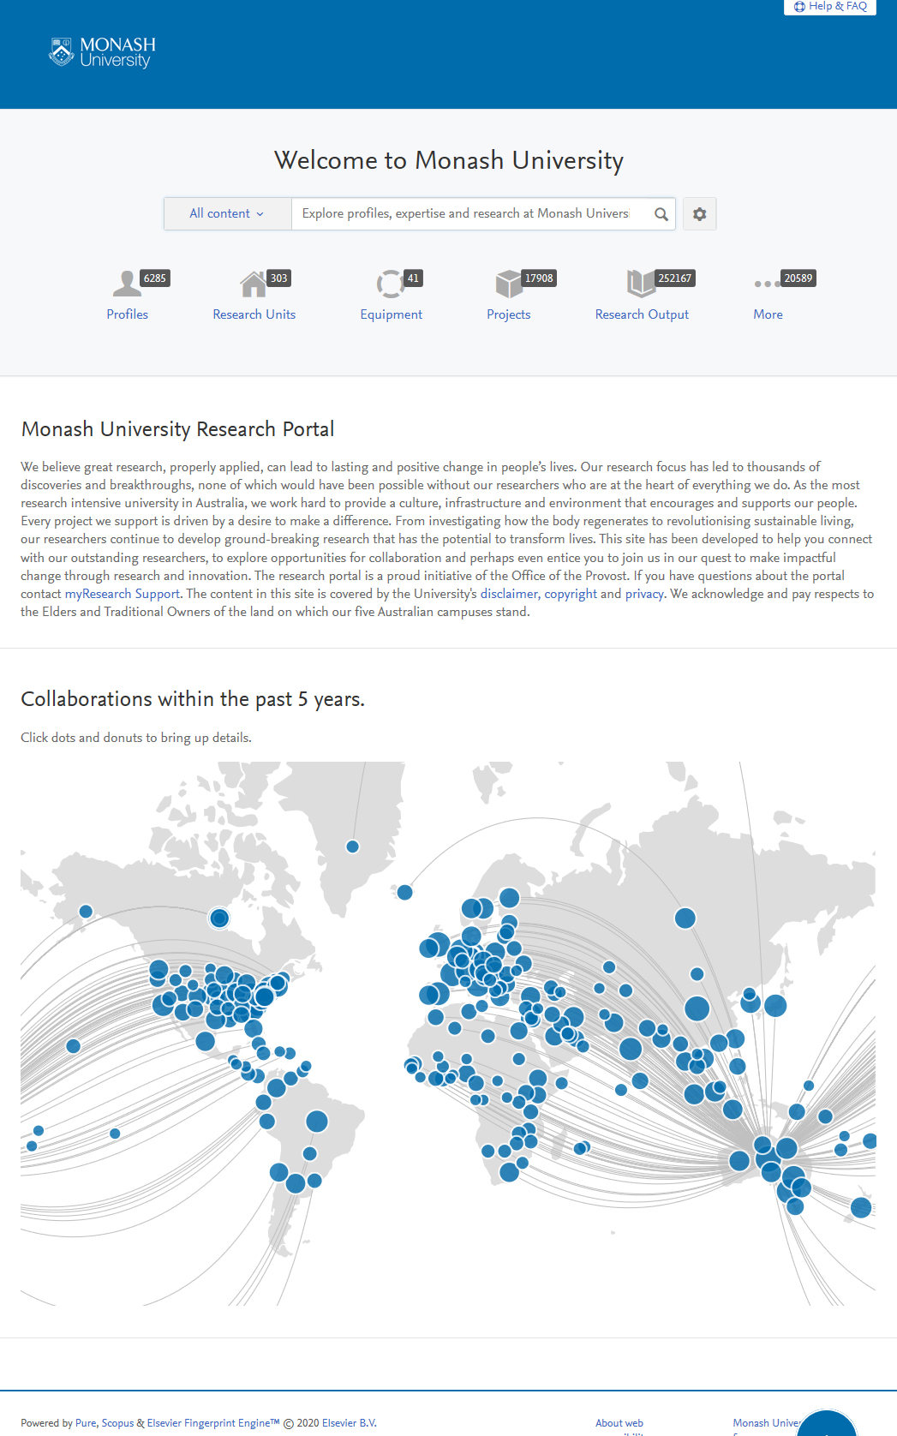
Solution
PURE USE CASES
The Pure Portal enables you to create websites that engage key audiences with curated content
Data Inputs
Integrations
Syncs
API Subscriptions
Scopus
PubMed
Web of Science
Bulk import tools
Wizards
File imports
Other
Manual
Profile Refinement Service (optional)
Elsevier
Fingerprint Engine
The Pure Portal
Pure
Notes:
So how do we do this? By importing data from multiple sources, checking and verifying it, identifying entities, linking together, deciding what should be publicly visible or not and . and the result is...

Slide 8

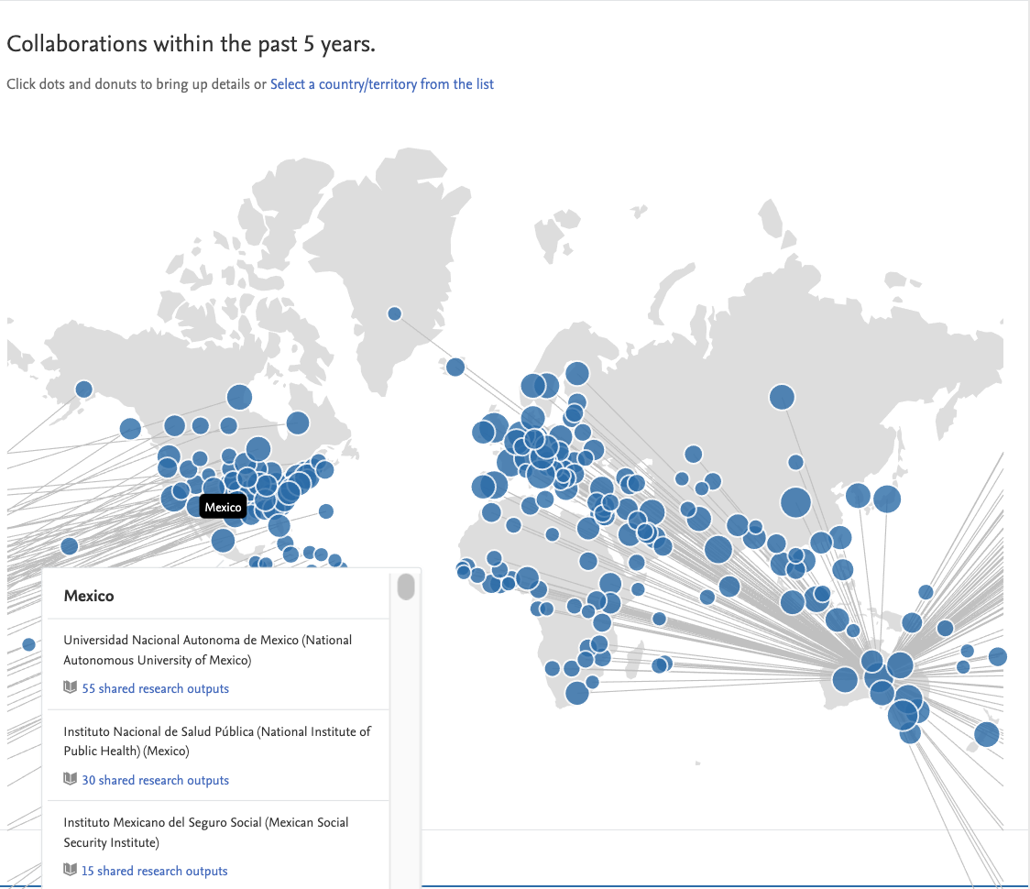
PURE USE CASES
Result
Increased global collaboration
and research visibility
The Pure Portal has enabled us to
have a uniform approach to showcasing [research] across campus. Previously, various departments and faculties would try to do their own thing, which resulted in a disjointed view of the institute.
— Simon Barrett,
Ethics and Compliance,
Monash University
https://research.monash.edu/
https://www.techvalidate.com/product-research/elsevier-pure/facts/C08-B23-1EF
Pure - Unlock your full research potential
Notes:
This how modern portal looks like – you can see the volume of research activity, collaborations, SDG contributions and who’s specifically working on which Goal.
In case of Monash university, before implementation, various departments and faculties managed data individually, which resulted in a disjointed view of the institution, suboptimal workflows.

Slide 9
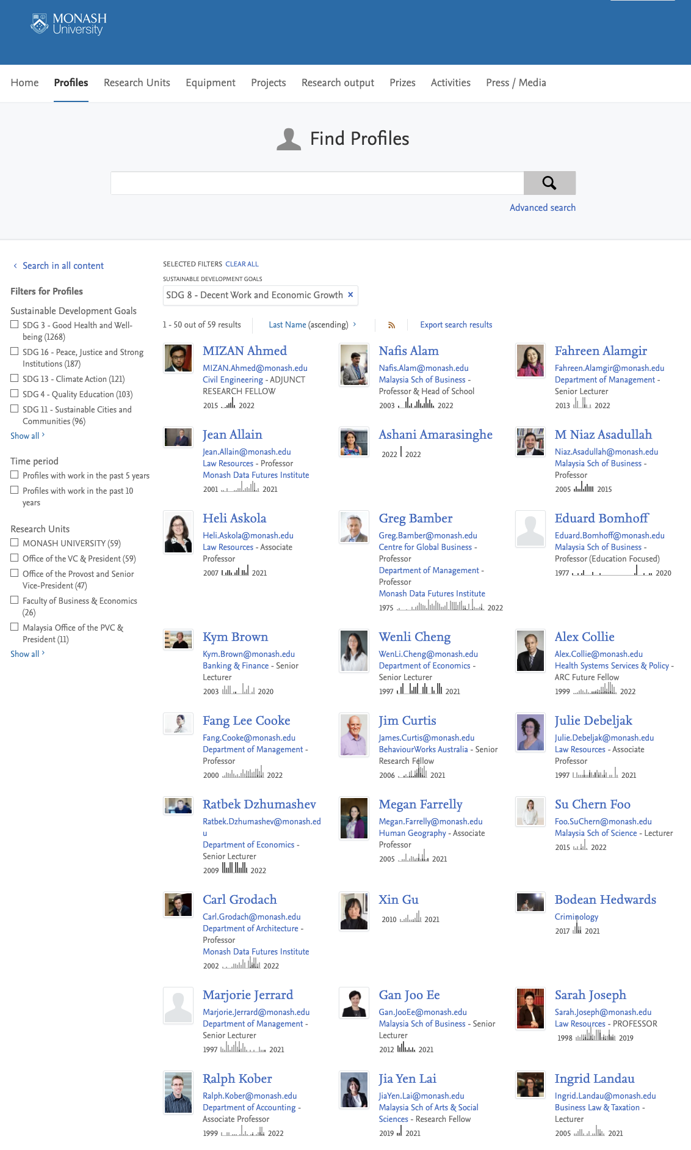

Expertise & Collaboration
We can make all your research output publicly visible to encourage networking and collaboration, increase institutional recognition and showcase your achievements
https://research.monash.edu/
https://www.techvalidate.com/product-research/elsevier-pure/facts/C08-B23-1EF
Notes:
You can easily check these portals yourself by the way – we have a complete list on our site that we extremely proud of. You can narrow down this list of authors to reveal only those with specific research focus, or SDG or department.
It is actually a recommended practice to showcase researchers profiles.

Slide 10
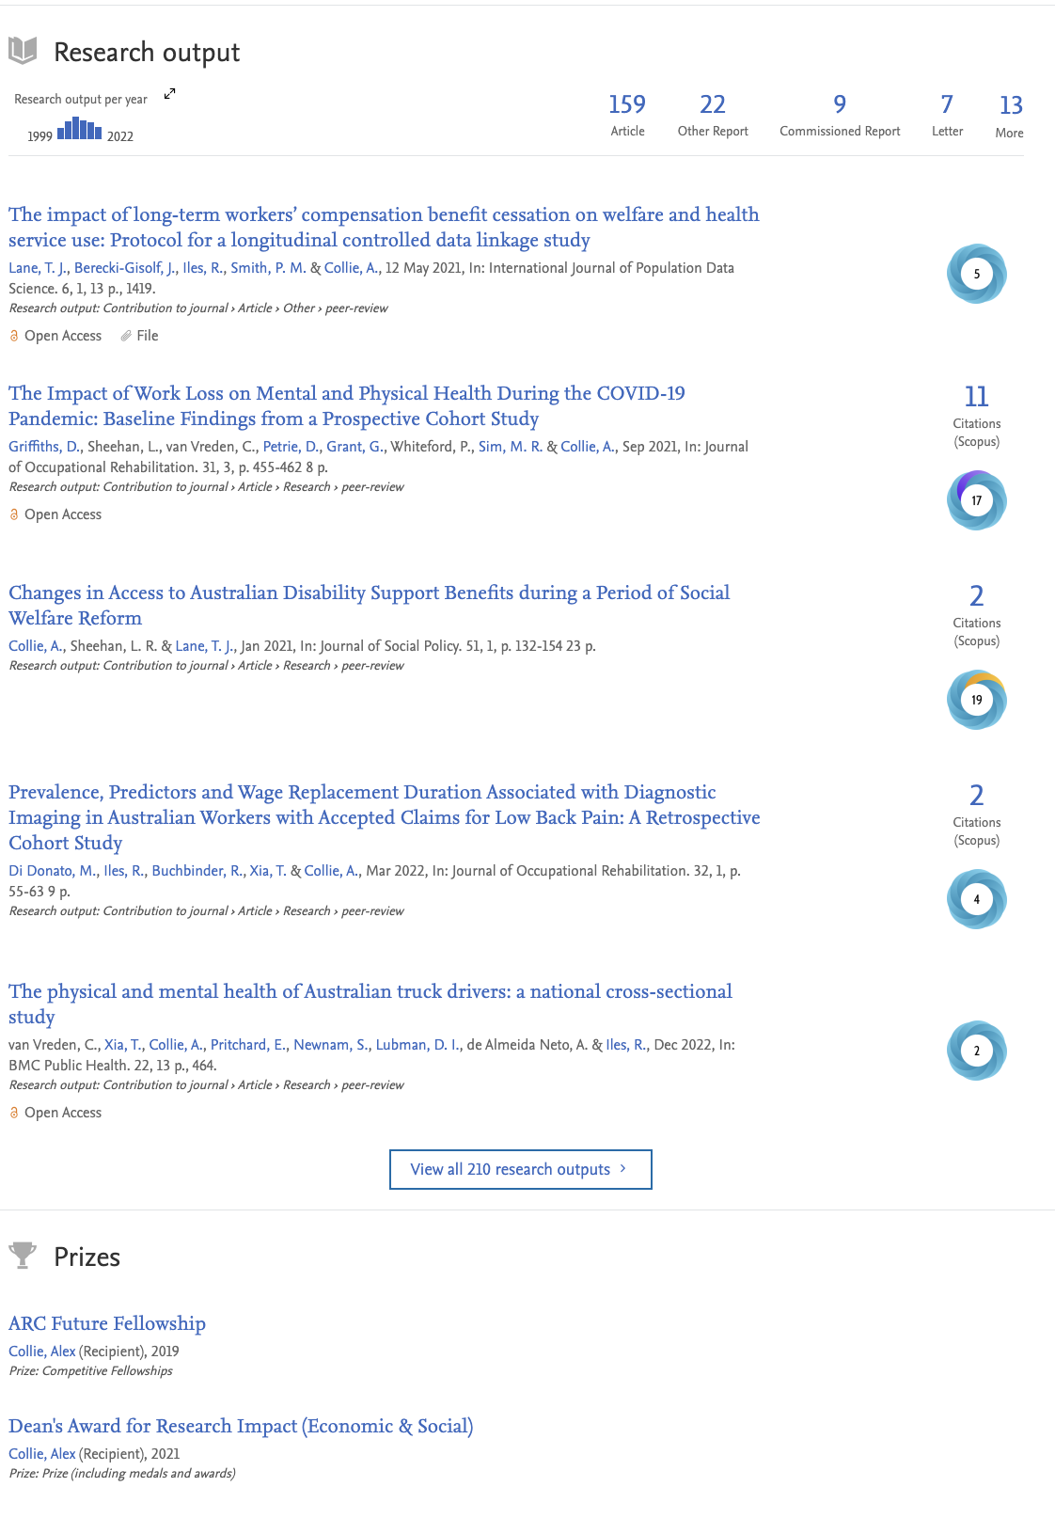
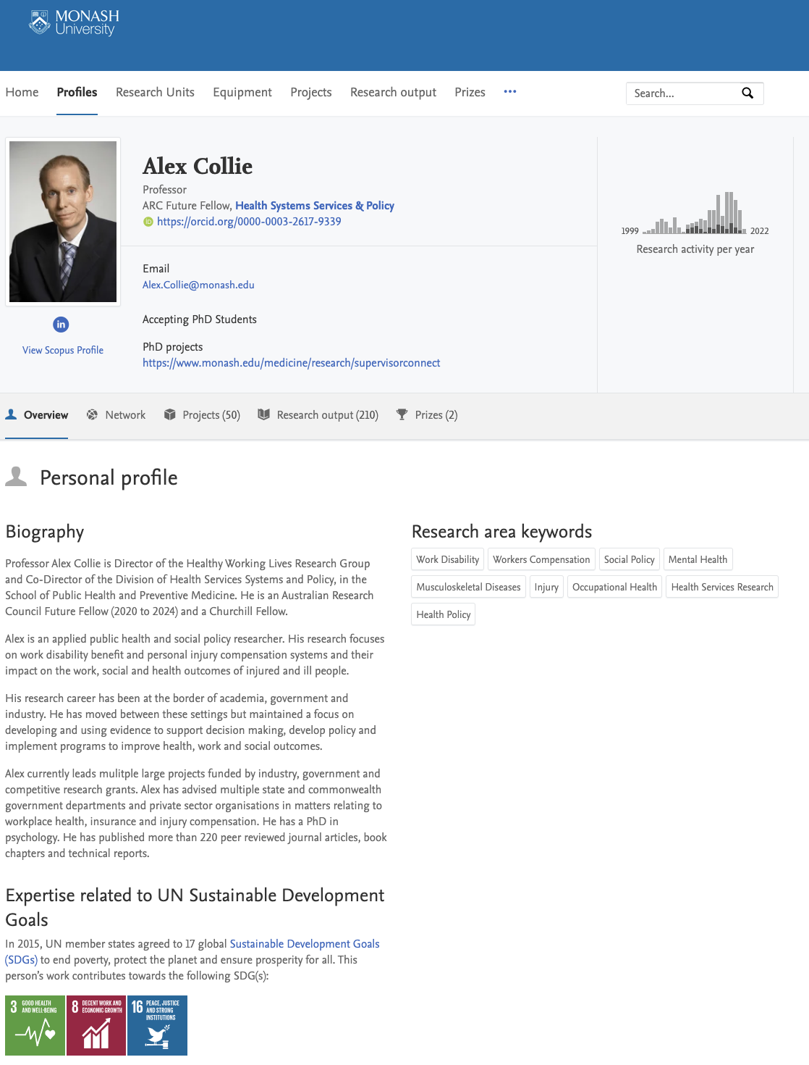
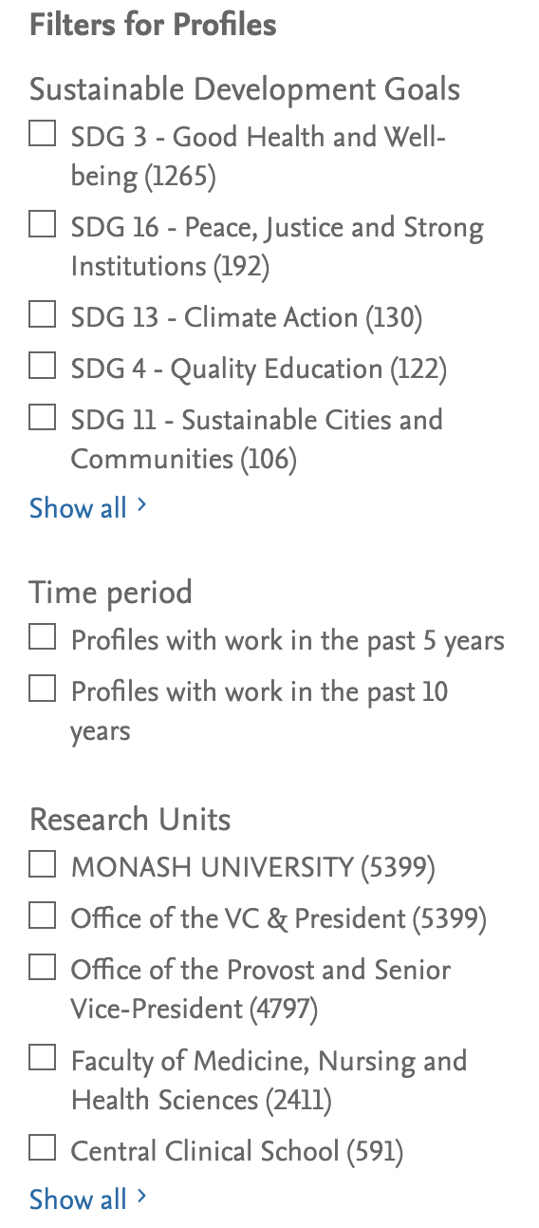
Pure portal:
https://research.monash.edu/
https://www.techvalidate.com/product-research/elsevier-pure/facts/C08-B23-1EF
Notes:
Author profiles are backed up by an array of metrics and visualizations that provide insights into focus, activity, productivity and impact, supporting the development of new and existing partnerships across all sectors.

Slide 11
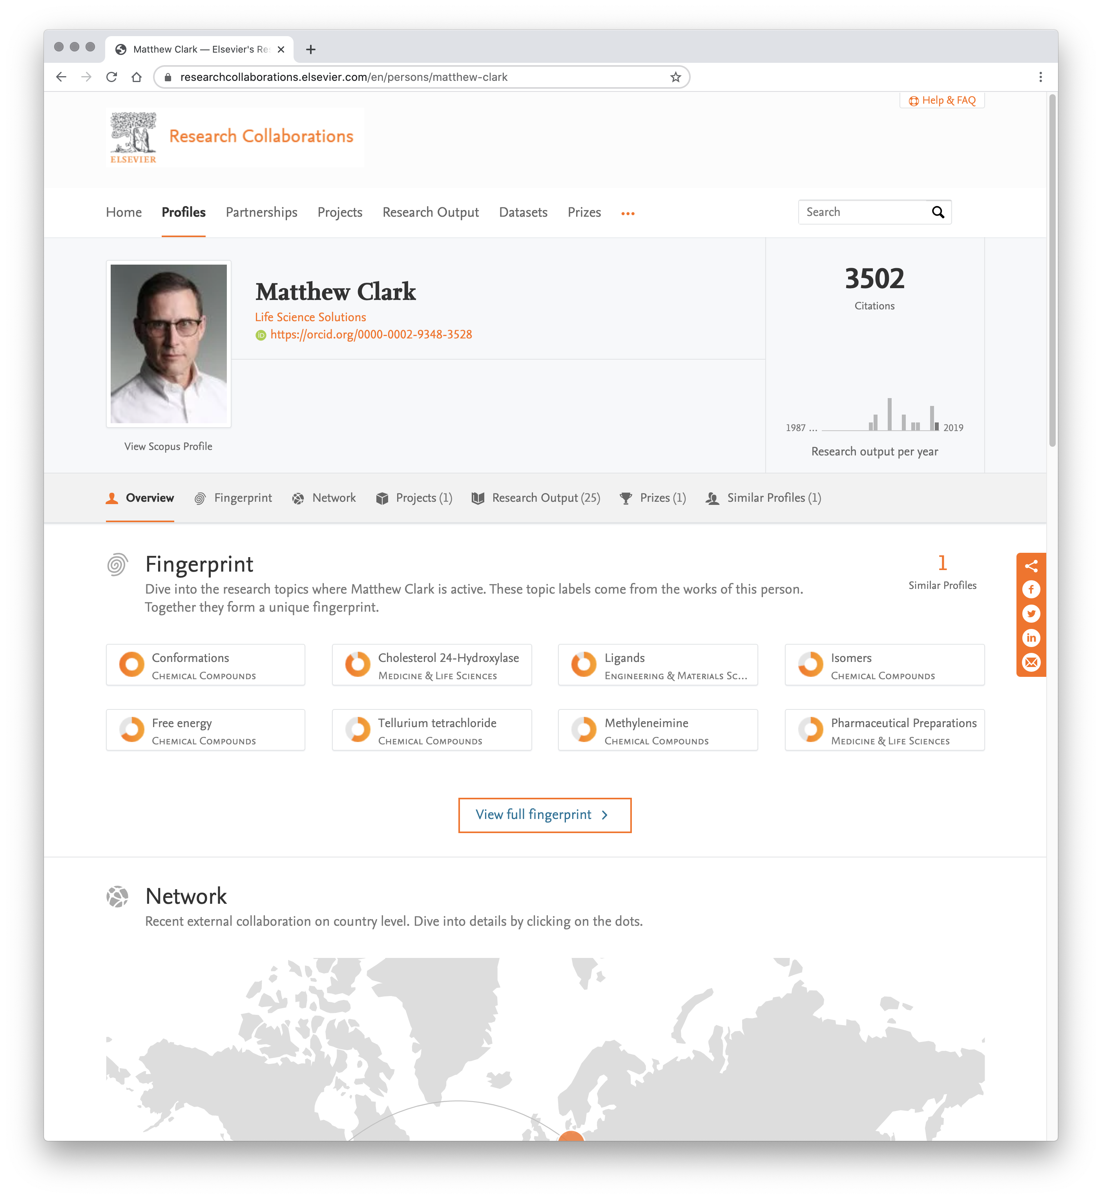
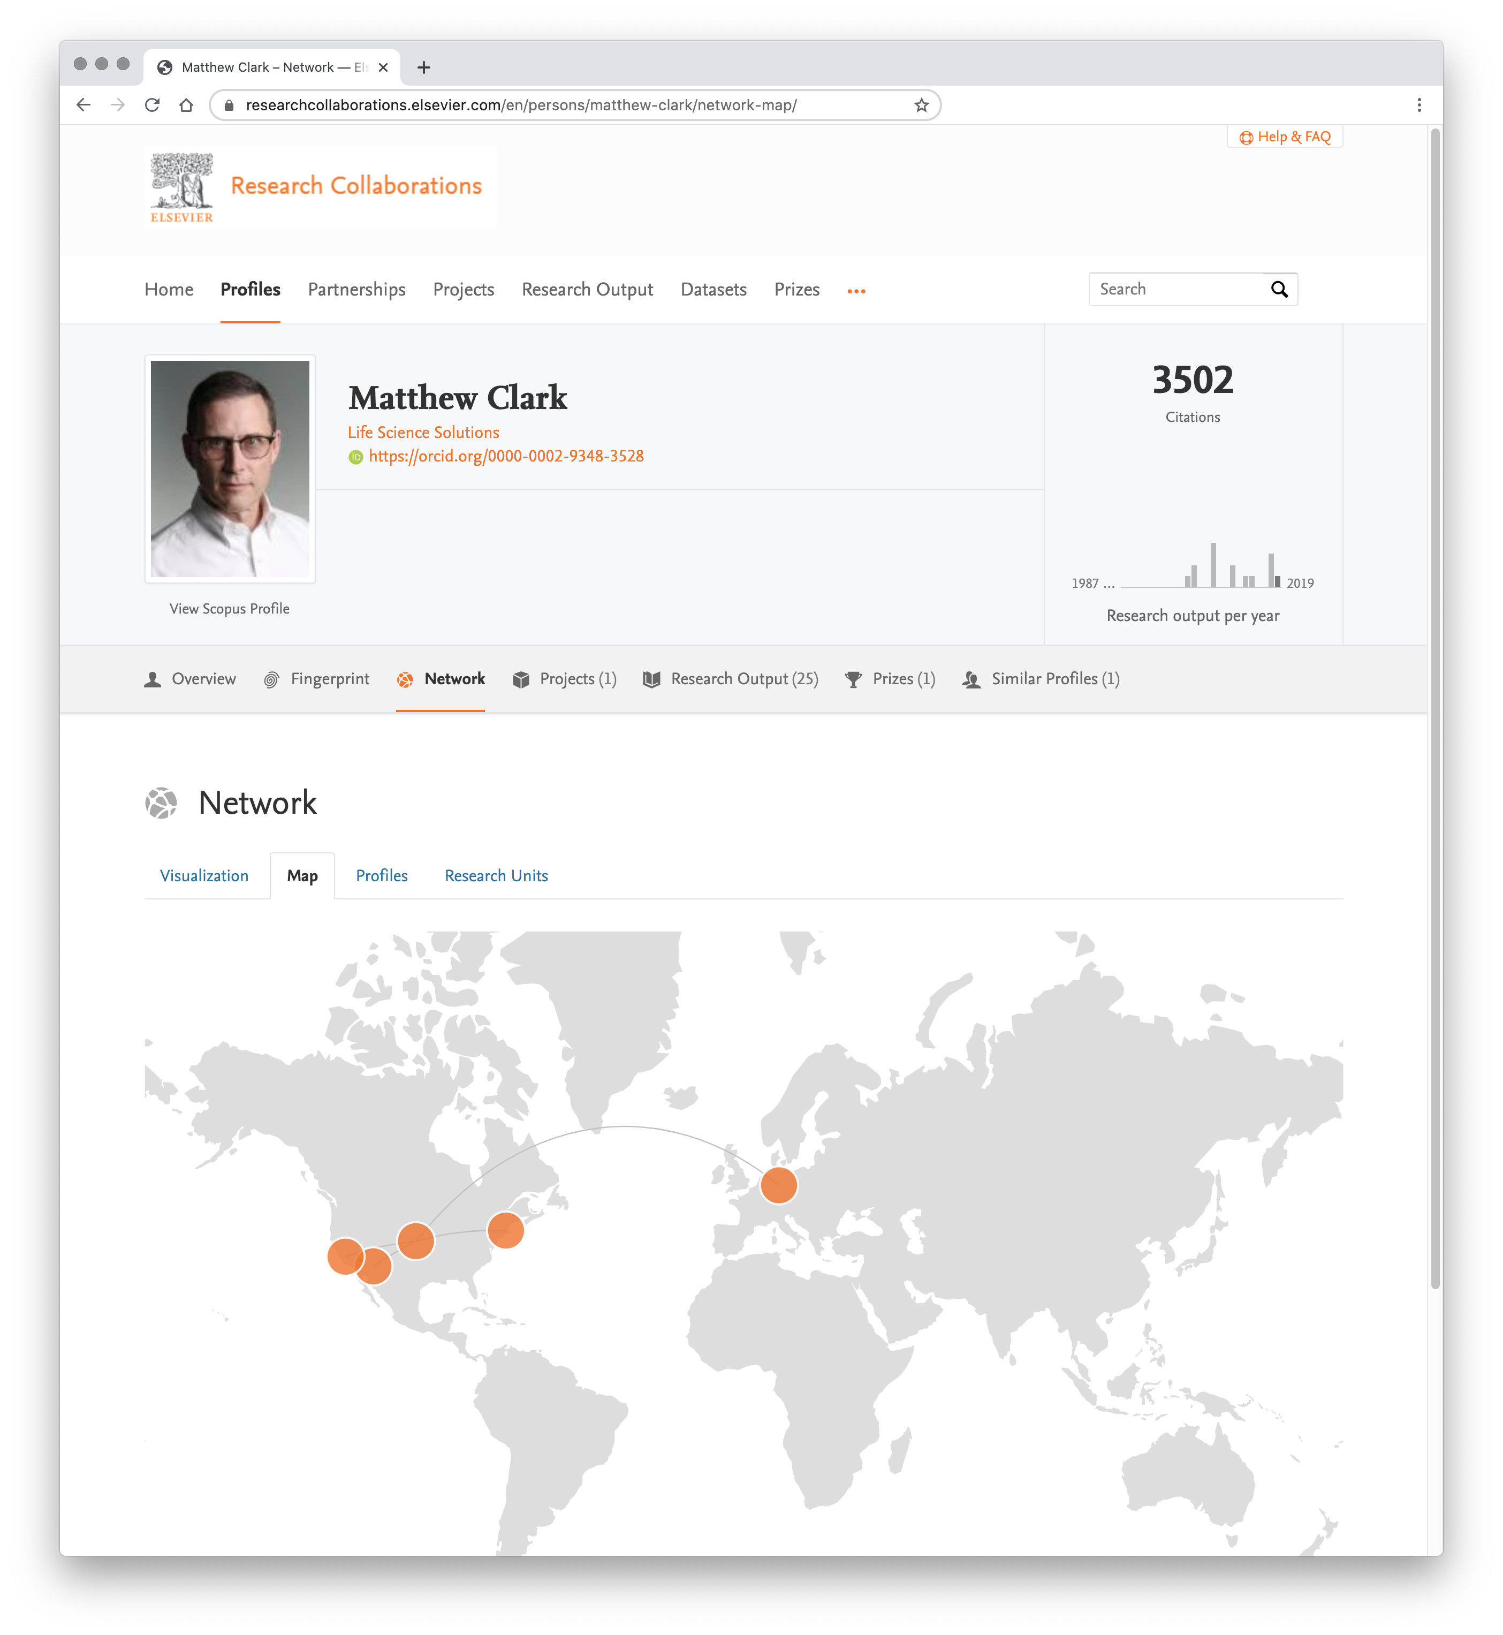
PORTAL EXAMPLES
Notes:
This author profile shows you specific research concepts, keywords that indicate specialization and allows you to find colleagues of this person who works with the similar subject.

Slide 12
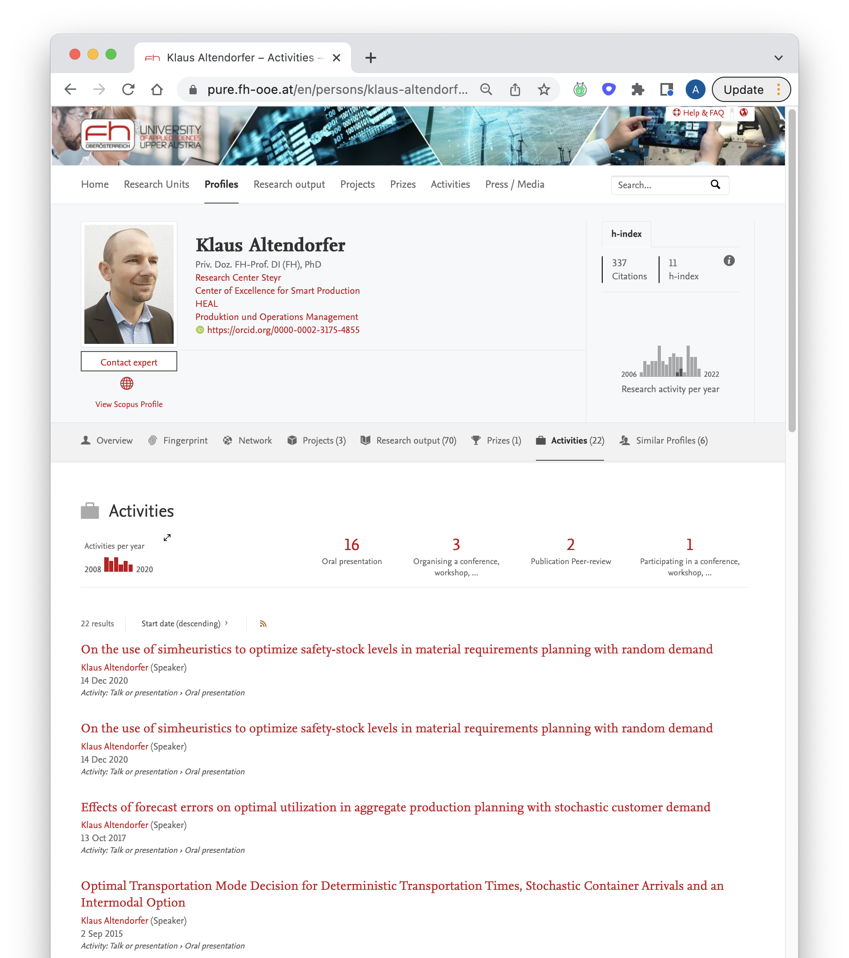
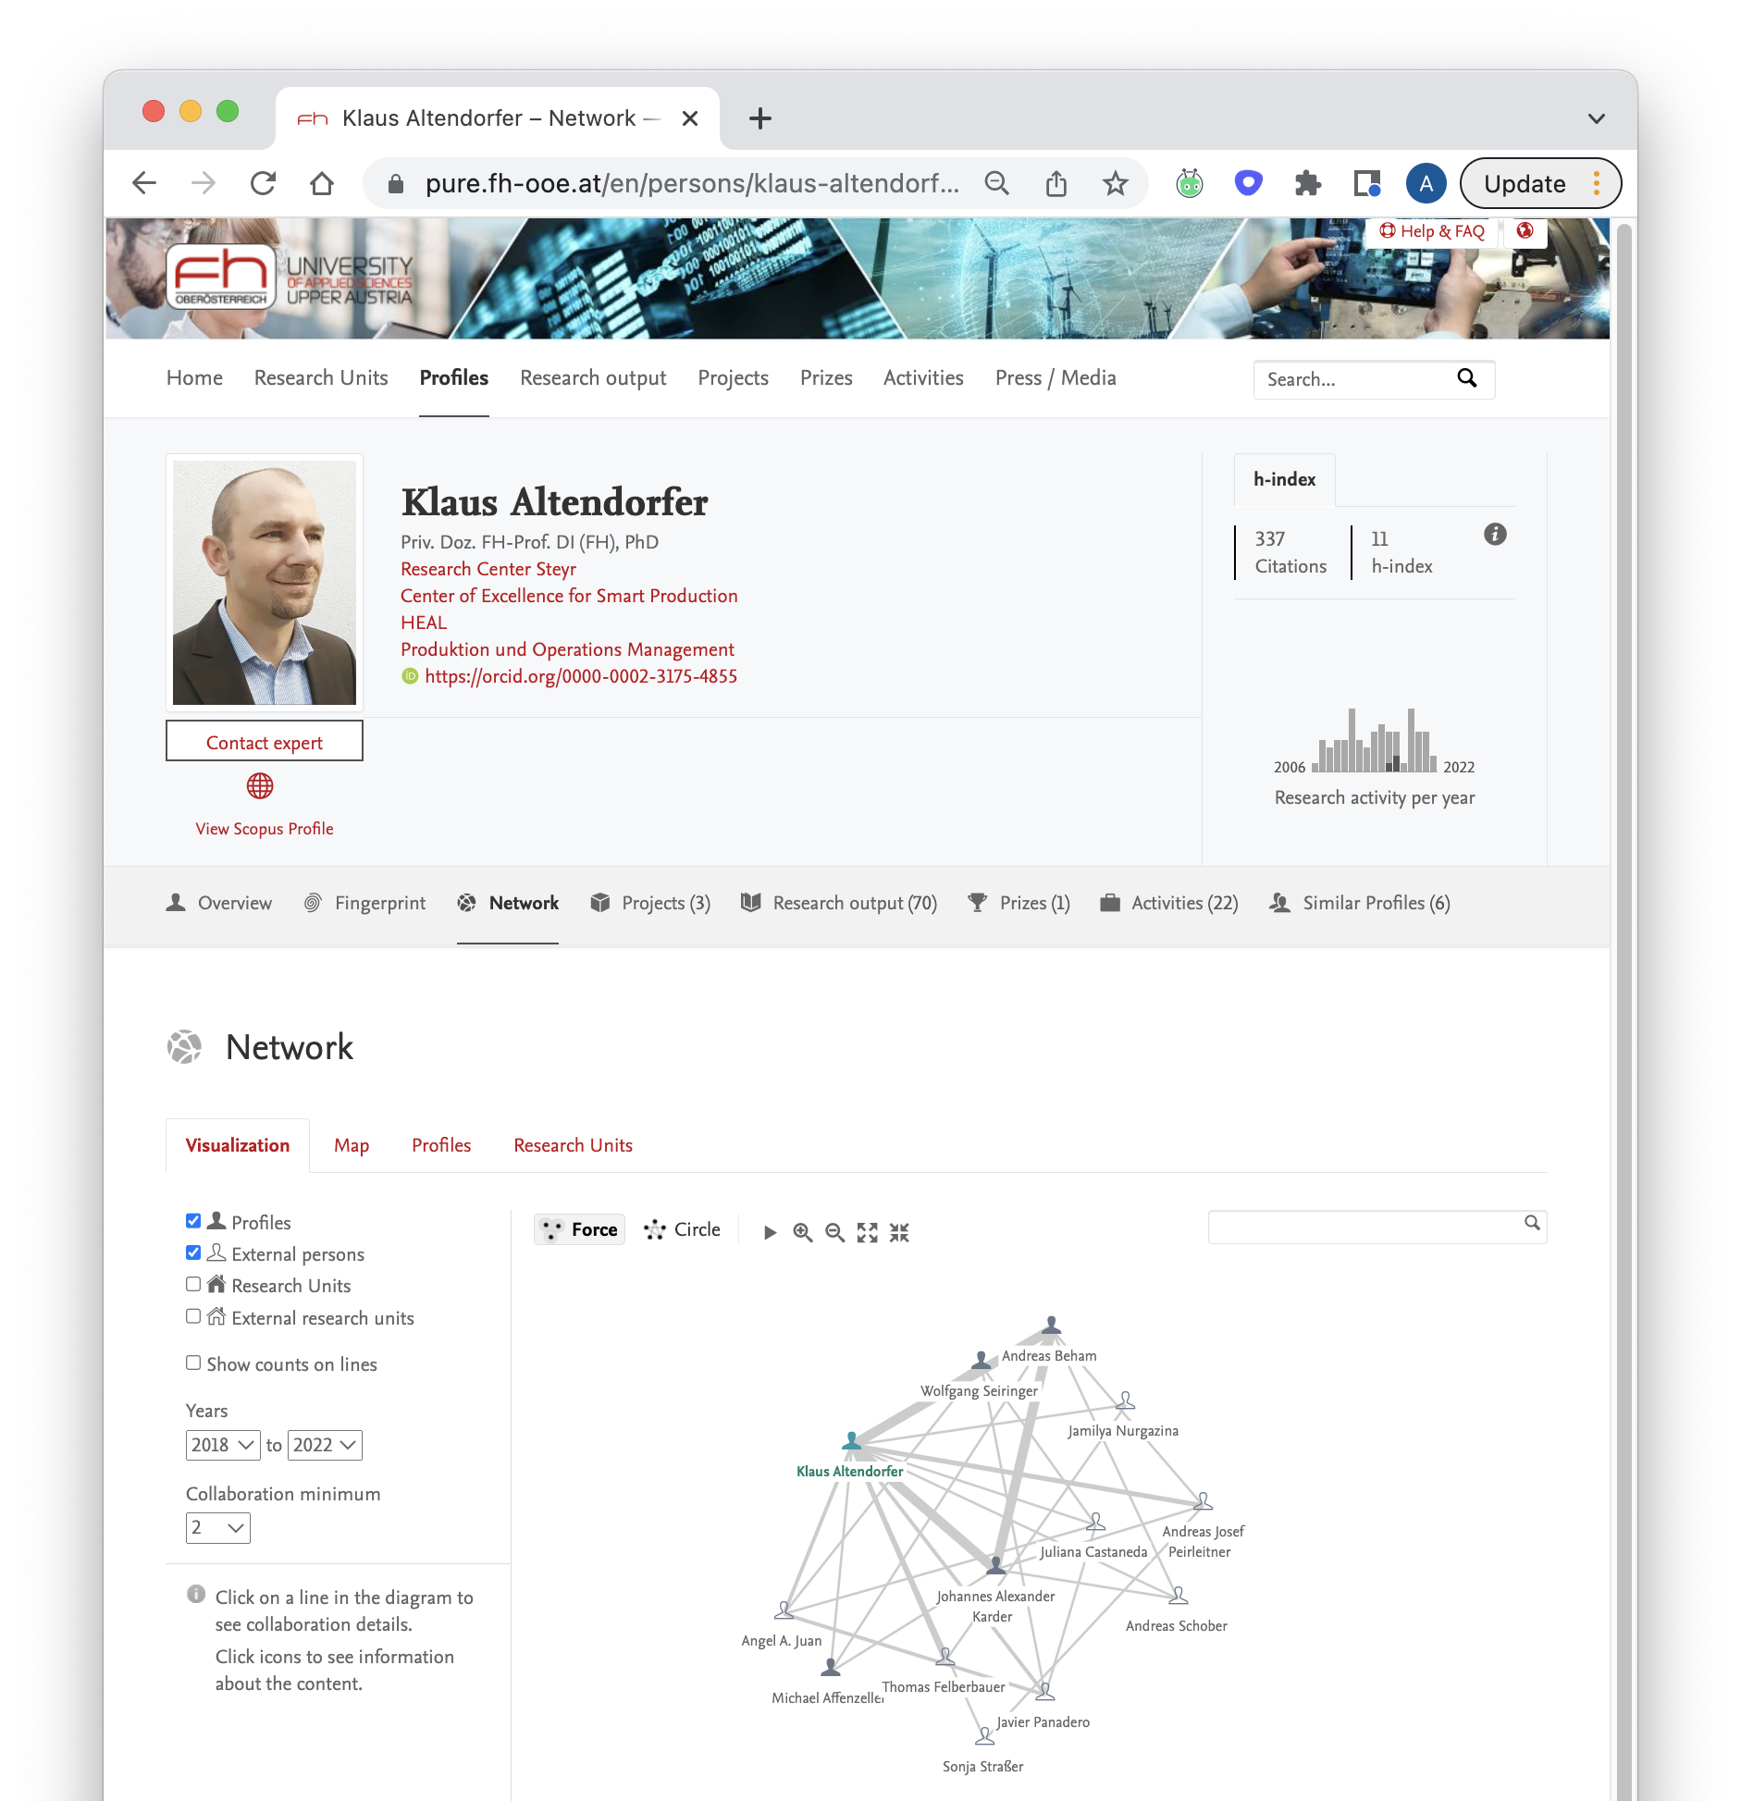
PORTAL EXAMPLES
Notes:
There are another perspectives on the output – activities, prizes, projects, media mentions in some cases. We can show the network of collaborators for a person.

Slide 13
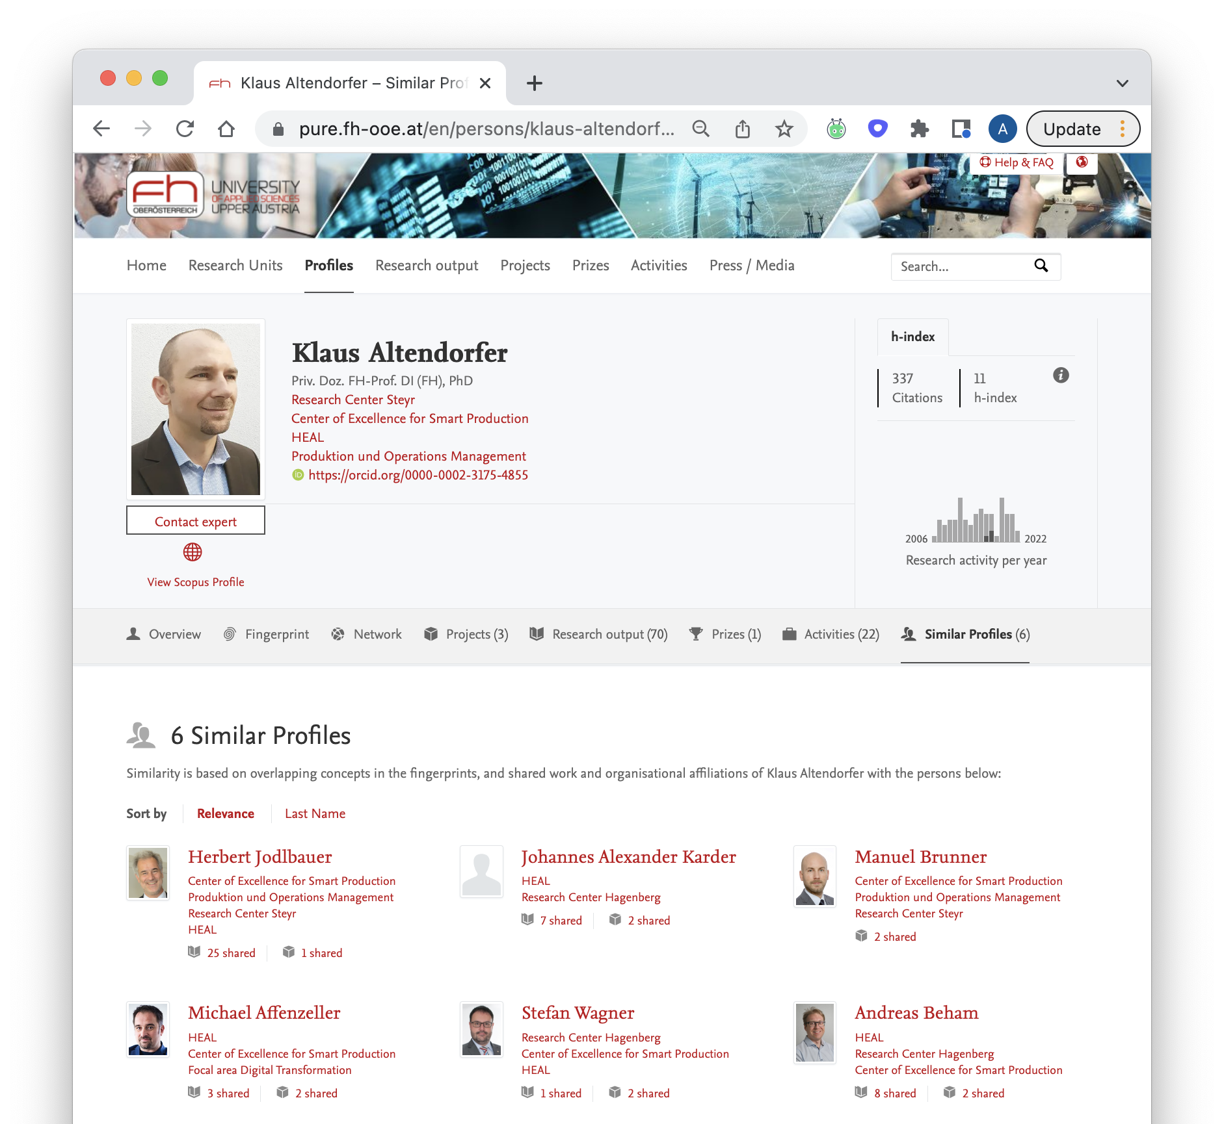
PORTAL EXAMPLES
Notes:
Here are 6 colleagues from the same university that share common research topic. It better indicates intellectual capabilities, resources of your organization.

Slide 14
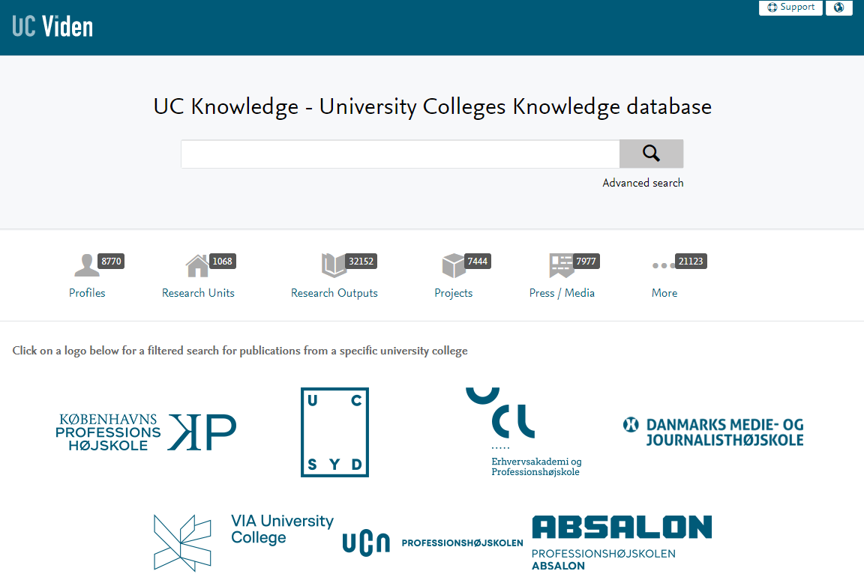

Community Module — Regional R&D Hubs
PURE MODULES
Netherlands
Denmark
Amsterdam academic institutes
5 institutes
University colleges knowledge database
7 institutes
https://www.elsevier.com/__data/assets/pdf_file/0005/525605/Day1_Plenary_Room_14_00_R_Brandsma_W_Klerkx.pdf
https://www.ucviden.dk/en
14
Notes:
We can do this kind of showcasing not only for a single institution but for a region hub, like in case of Amsterdam, Denmark or New Jersey where 5 or 7 institutions combined their profiles to visualise their united expertise for investors and corporations and other potential partners or collaborators. This is called community module.

Slide 15
Some of the built-in Open Science aspects in Pure
Integrations with Unpaywall, BioRxiv, CORE etc.
Sherpa Romeo integration
ORCID adoption
OA compliance to funder requirements
Full text handling
Preprints
APCs
Datasets: integration with DATA MONITOR (powerful discovery tool for datasets)
Project descriptions
Equipment
Press clippings, conference proceedings, etc
Reporting (to monitor adoption / compliance / performance)
Pure Portal (to showcase the research and projects), etc.
Notes:
There are many build-in features supporting Open Science in Pure – intergrations, sherpa romeo, ORCIDs, and wide range of entities or datatypes you’d like to make visible.

Slide 16
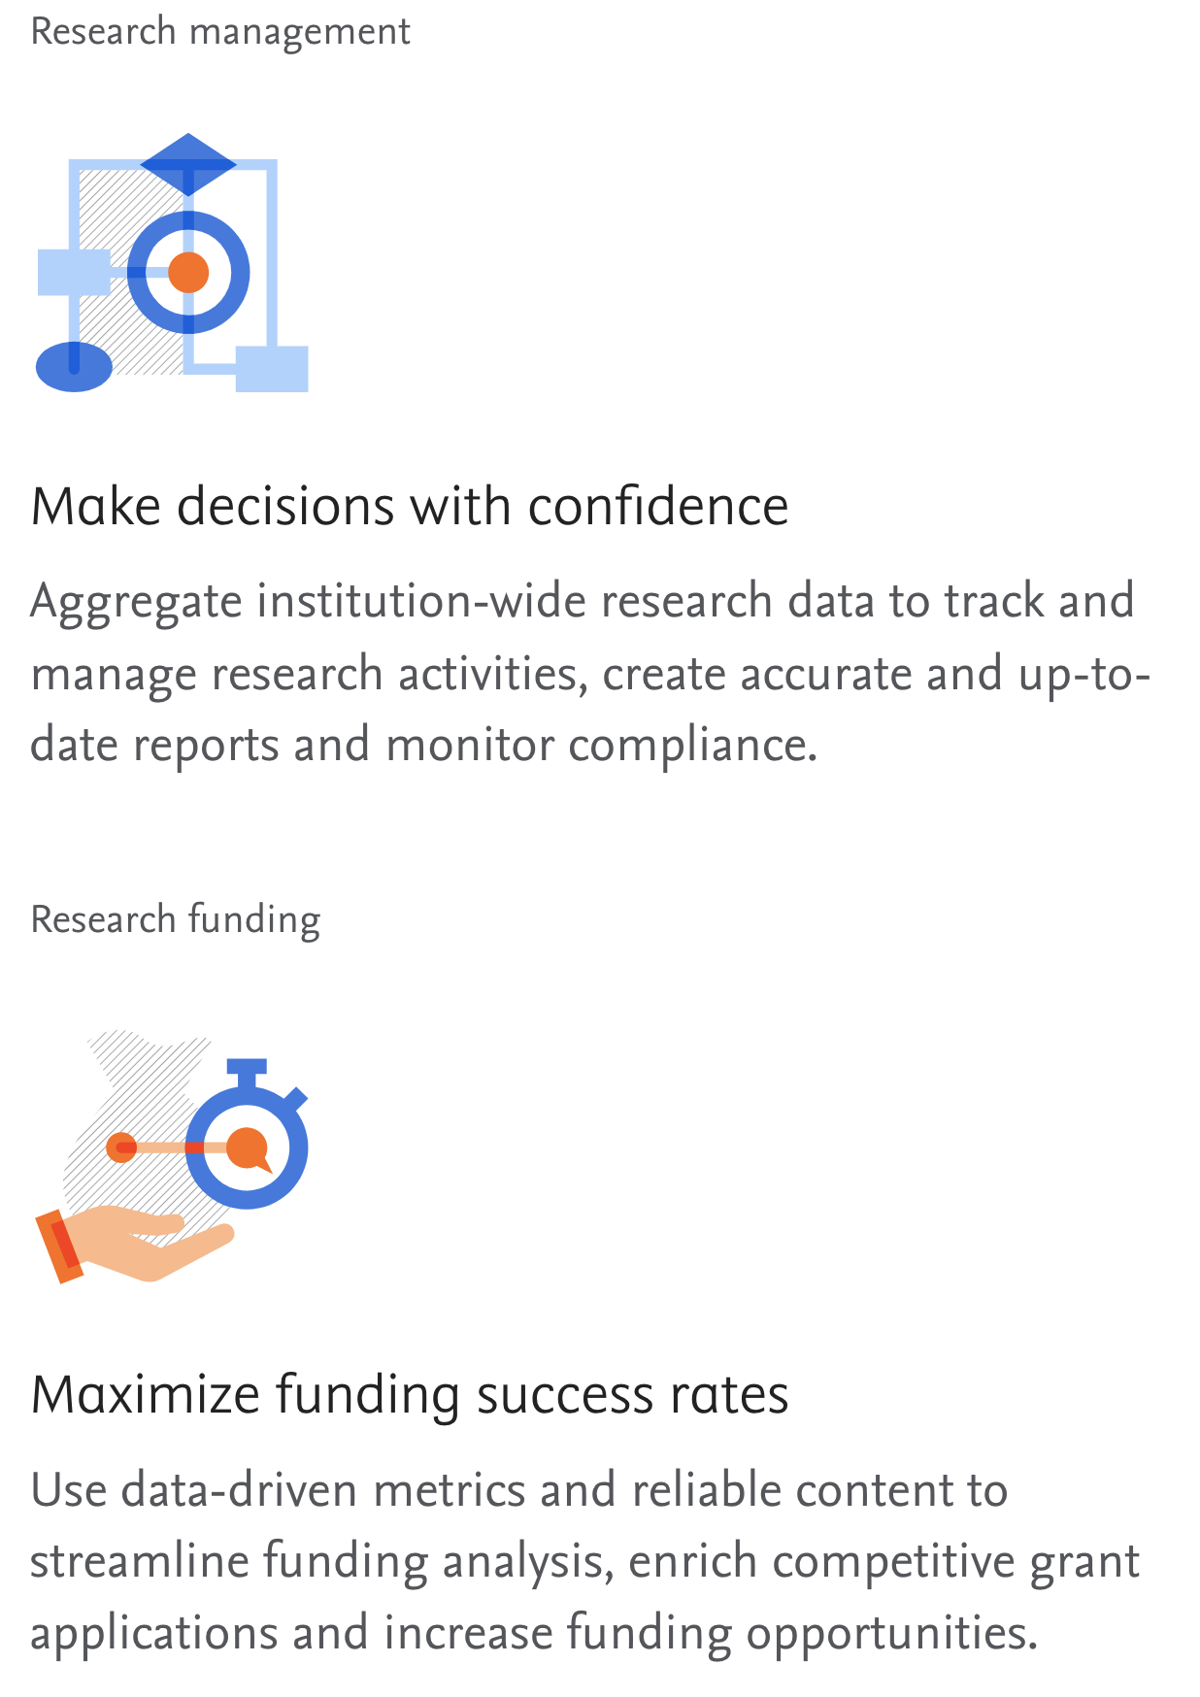
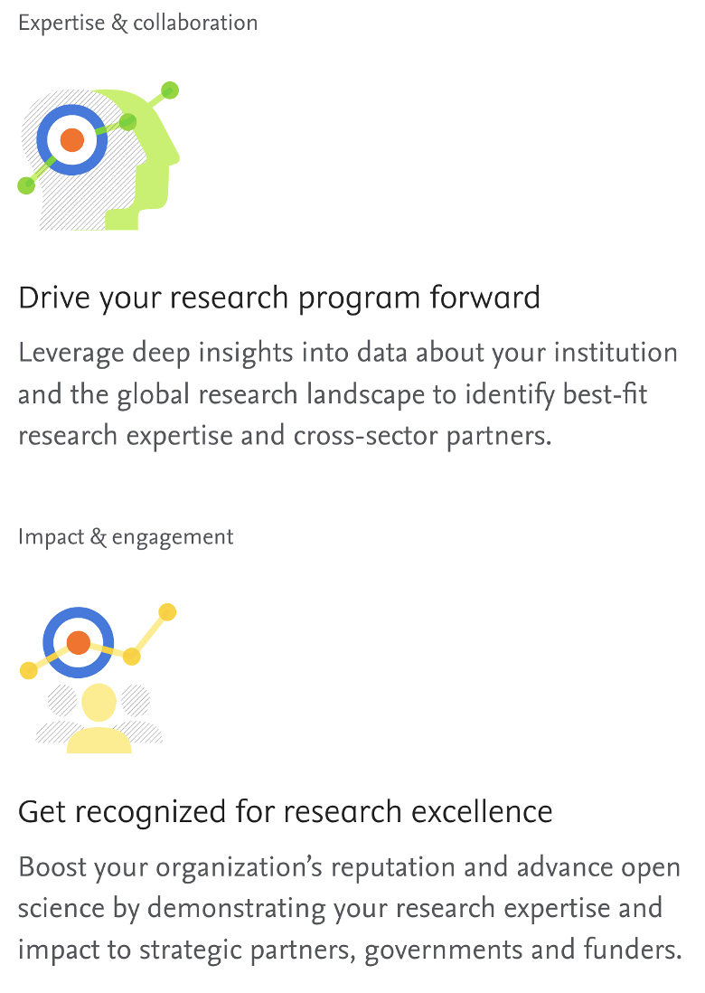
Additional use-cases:
Notes:
How to start such project if you’re interested? It's better to find synergies with other functions in your organization, because Pure helps you organize, automate data collection, analysis and reporting. To many customers it helps win more funding. Pure helps you find list of internal canditates with the relevent experience to apply for open calls. And this is where I stop talking about RIM systems.

Slide 17
Our Repository Suite:
Digital Commons

Slide 18




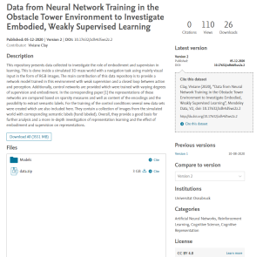
Digital Commons Repository Suite
Digital Commons helps institutions increase visibility and build a global reputation. A digital platform for all the institution’s research output, Digital Commons is extensible with journal publishing, research data management, and exhibit curation that can be added as the institution’s needs grow over time.
Highlight Faculty Publications
DC Repository
Manage Research Data
DC Data
Curate Digital Scholarship
DC Exhibits
Elevate Diamond
OA Journals
DC Publishing
Create a showcase out of your researcher’s published and
pre-published works
Drive forward your Research Data Management program, with specialized tools to store, manage, curate, share and preserve data.
Curate exhibits of research projects and portfolios of works to highlight key moments of your institution’s scholarship.
Launch and develop an OA journal publishing program to drive readership, downloads, and citations.
Notes:
We have a suite of repositories for storing full texts, host and publish journals, conferences, exhibitions, media files and data.

Slide 19

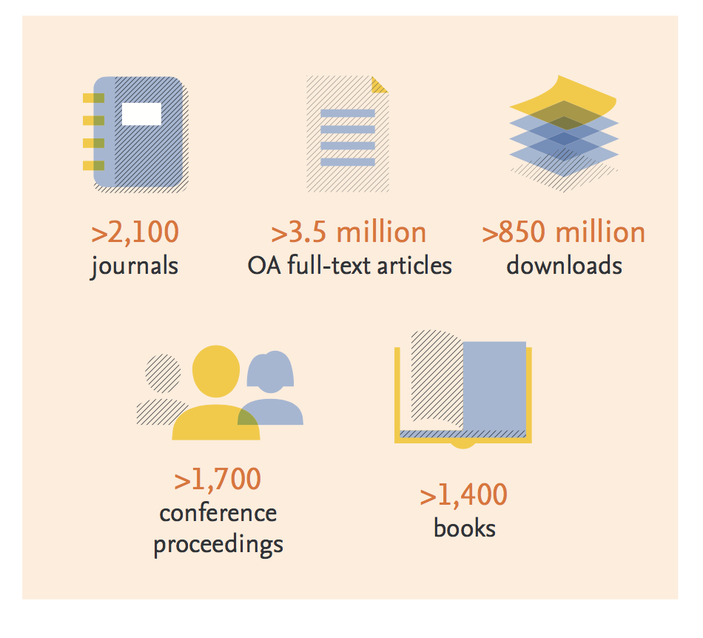
Digital Commons Community : Strength in Numbers
Notes:
Today over 650 institutions use Digital Commons
We have many customers and host more than 2000 journals on our platform. And most of the Open Access journals

Slide 20
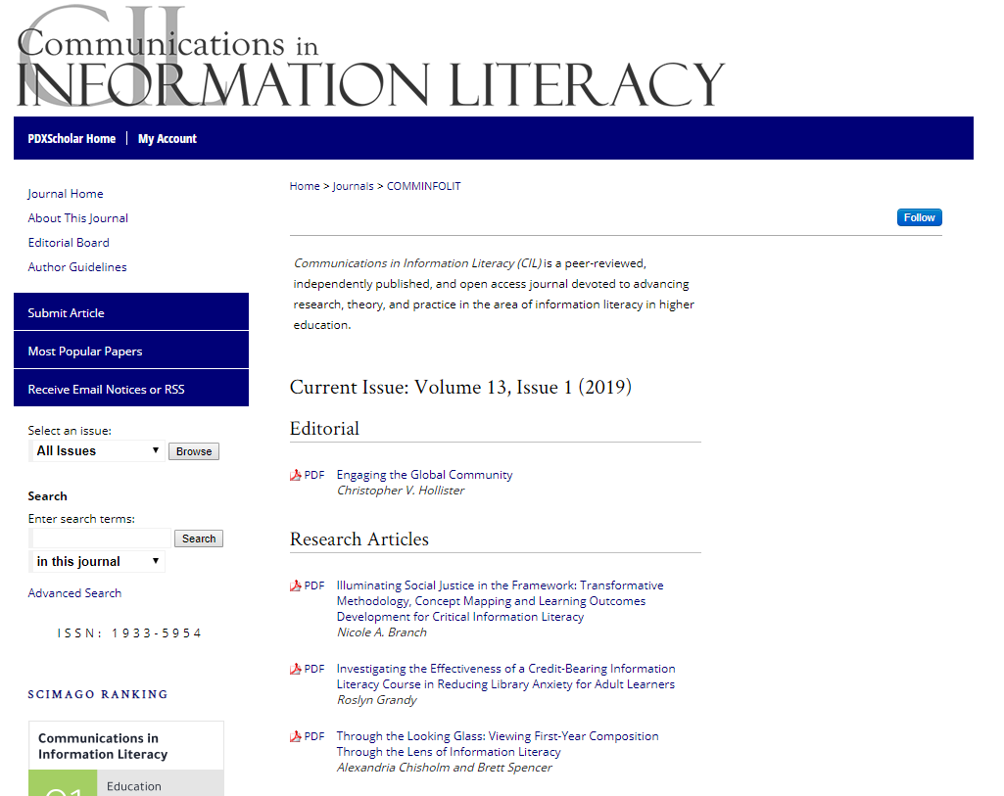
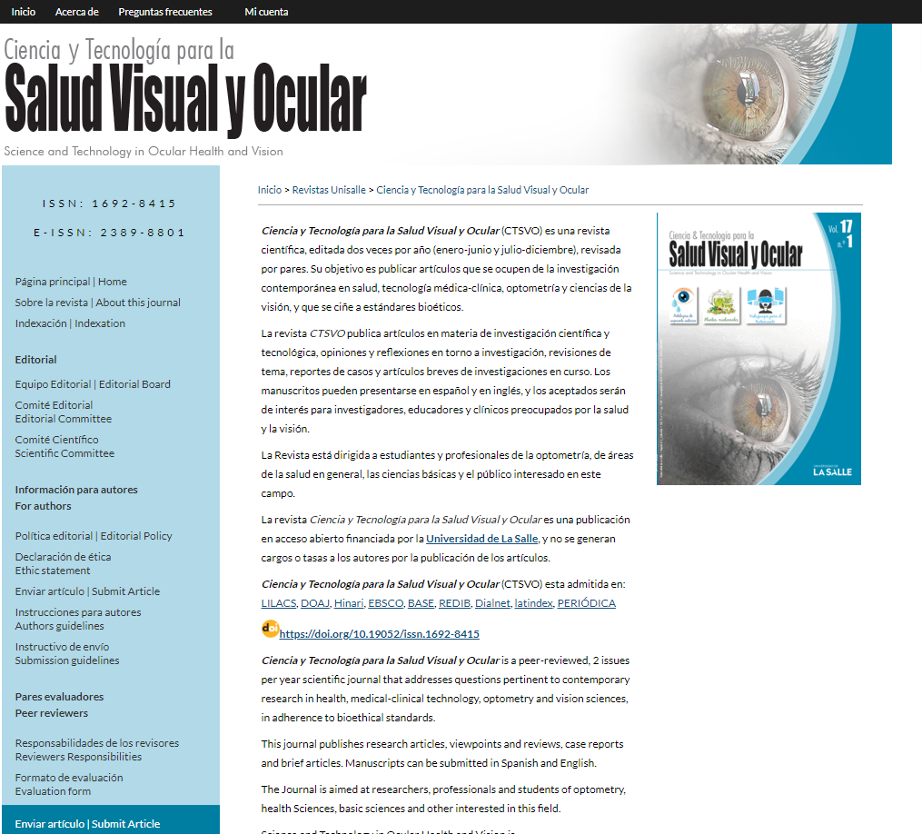

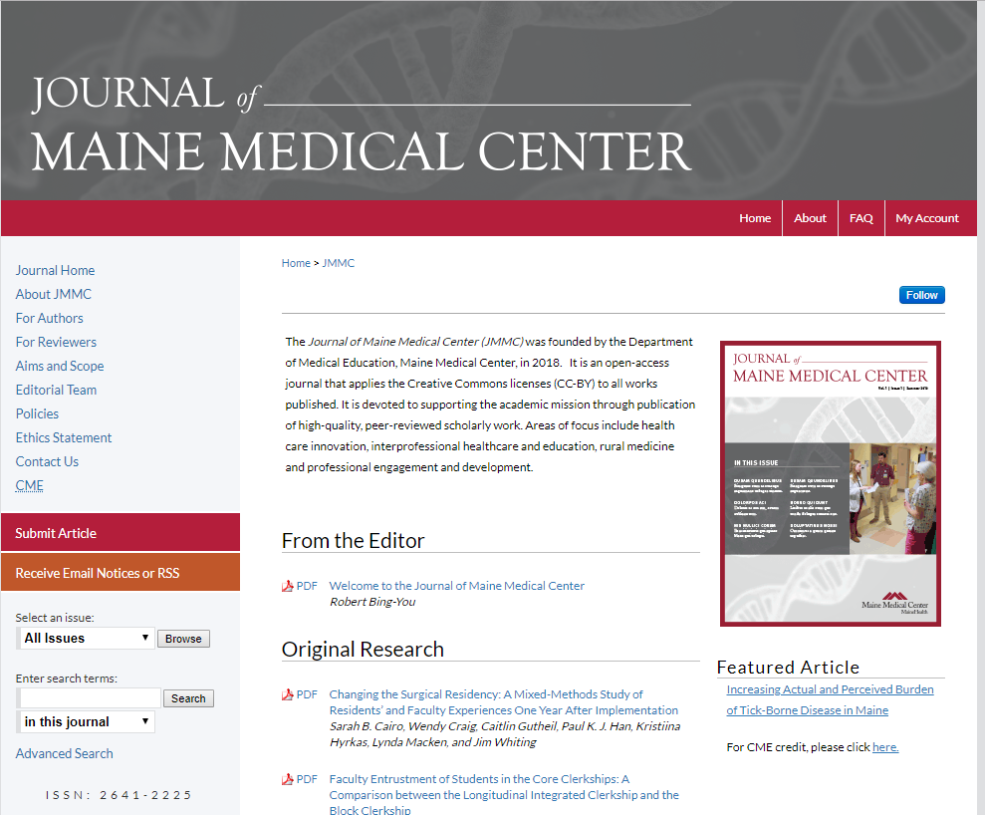
Professional and beautiful journals
Professional Design
SEO
Language Support
Hosted Model
Complies with Scopus technical requirements
Notes:
DC provides a model for hosted journals. Our Design team partner with you to develop an unique professional design . We can support any language and our hosted model means that you can trust in continuous availability for your journals. Our templates comply with all of Scopus’s technical requirements for journal hosting.

Slide 21
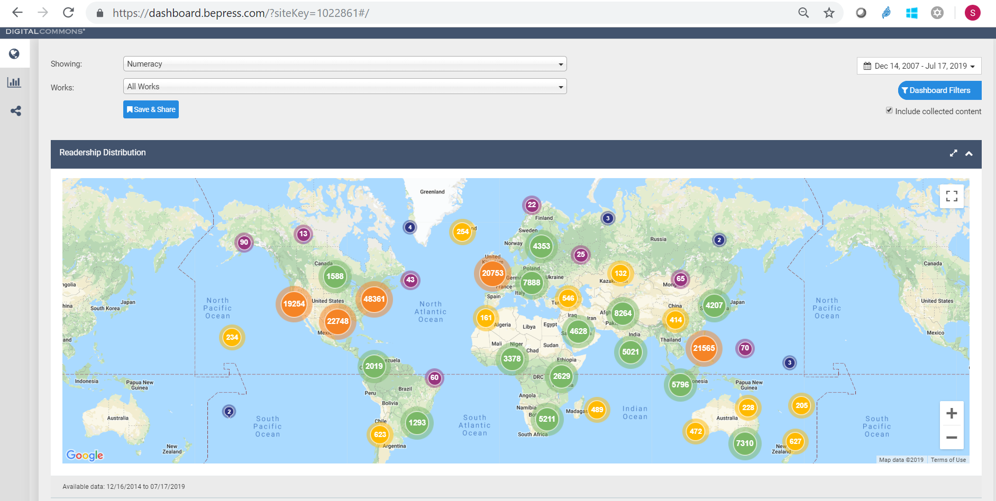
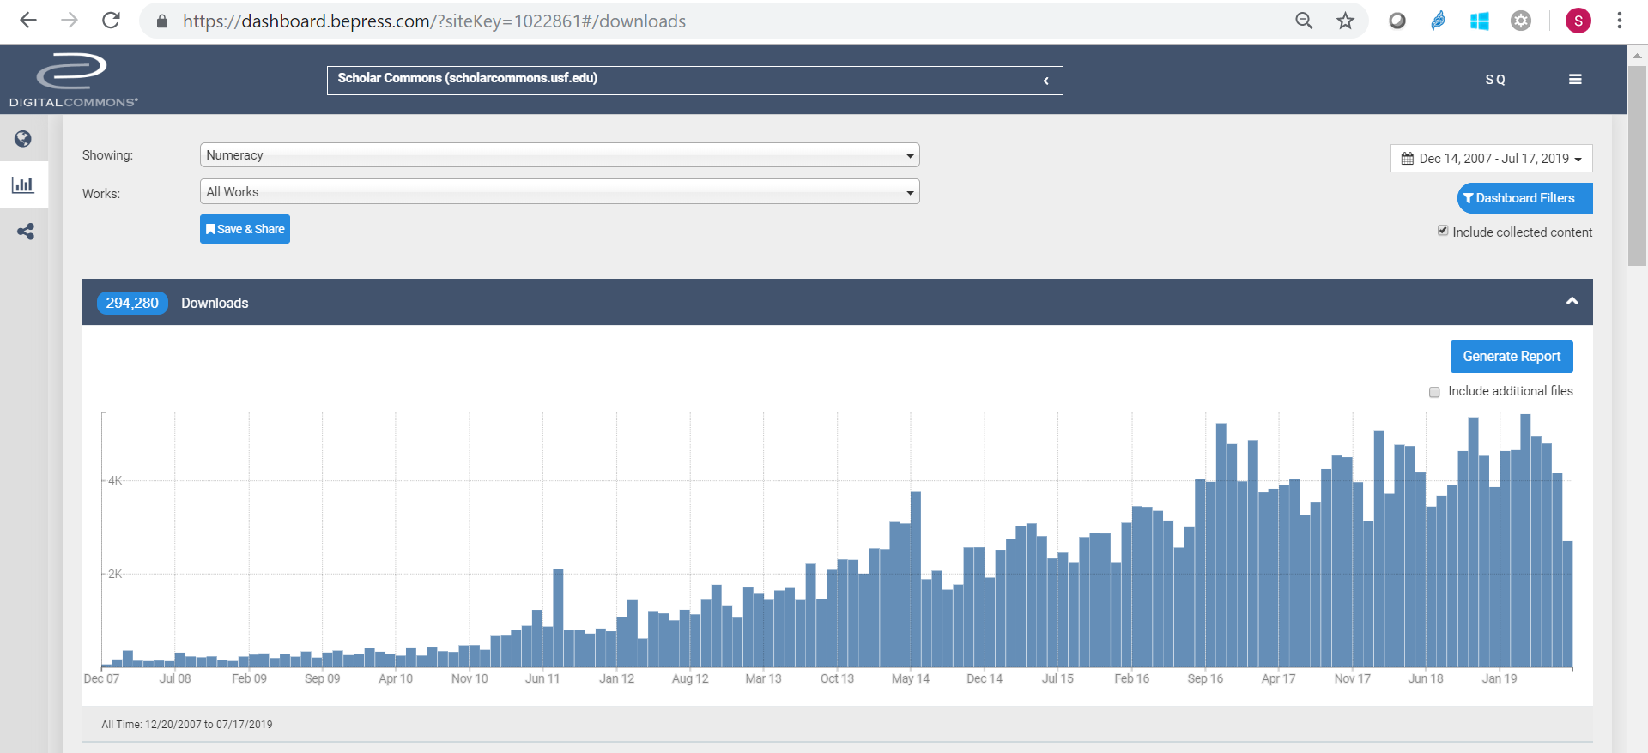
Dynamic dashboards enable journal editors and authors to analyze performance
Notes:
DC enables editors and authors to log into their own individual dashboards. In this example, the image is linked to the dashboard for the Australian Journal of Teacher Education

Slide 22
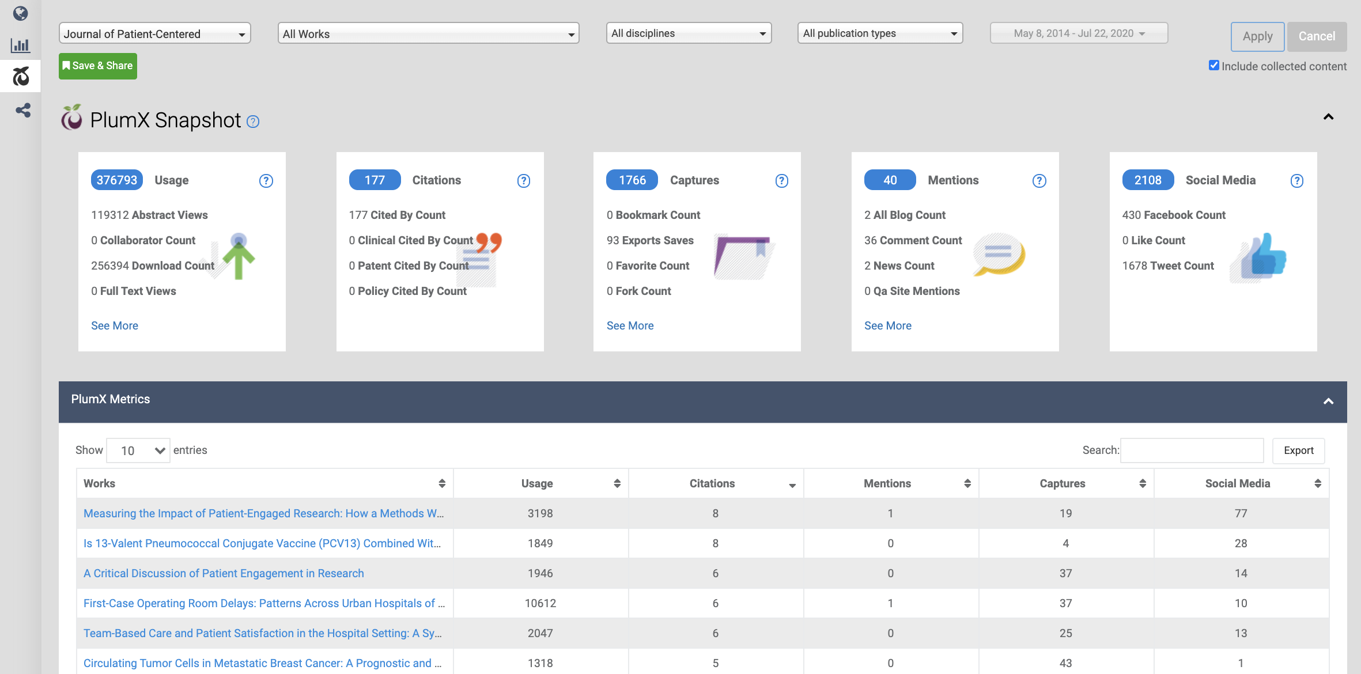
PlumX Metrics drive insights with citation metrics, social media, news mentions, and more
Citation counts
Tweets, Facebook, and other social media mentions
News and other public impact
“Because selective indexes use citation counts as measure of journal performance, these metrics will provide more insight into which articles are more impactful and how we are doing overall.”
Managing Editor, Journal of Patient-Centered Research and Reviews

Slide 23
Digital Commons Repository Suite
Digital Commons helps institutions increase visibility and build a global reputation. A digital platform for all the institution’s research output, Digital Commons is extensible with journal publishing, research data management, and exhibit curation that can be added as the institution’s needs grow over time.
Highlight Faculty Publications
DC Repository
Manage Research Data
DC Data
Curate Digital Scholarship
DC Exhibits
Elevate Diamond
OA Journals
DC Publishing
Create a showcase out of your researcher’s published and
pre-published works
Drive forward your Research Data Management program, with specialized tools to store, manage, curate, share and preserve data.
Curate exhibits of research projects and portfolios of works to highlight key moments of your institution’s scholarship.
Launch and develop an OA journal publishing program to drive readership, downloads, and citations.
Notes:
But I’d like to focus now on novel approach to manage research data.

Slide 24
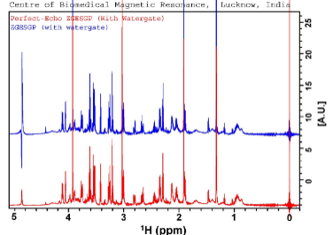
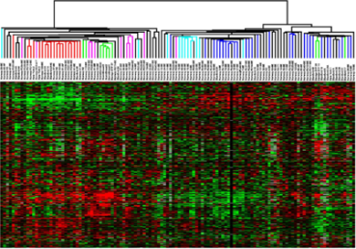

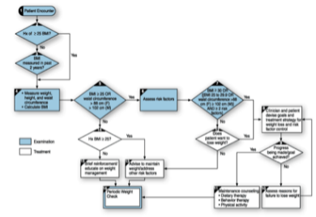
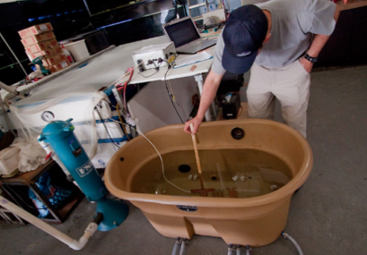
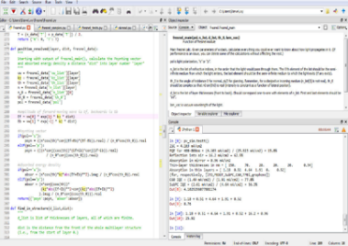
When talking about research data, we mean:
All forms of data
FAIR Data Principles
Findable
Accessible
Raw data
Processed data
Interoperable
Protocols, methods, workflows
Machine & environment settings
Reusable
Scripts, analyses & algorithms
Notes:
It means all forms of research data and methodology of how exactly you obtained your data: everything you need to reproduce and reuse or provide to academic community to increase trust in your work and comply with requirements.

Slide 25


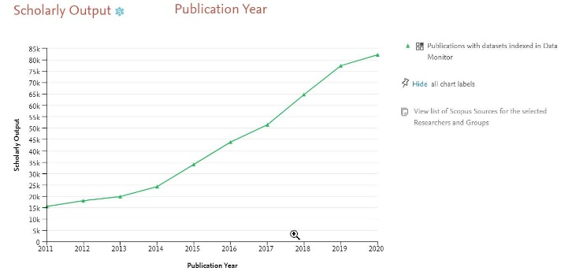
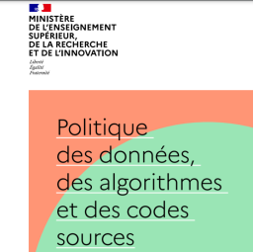
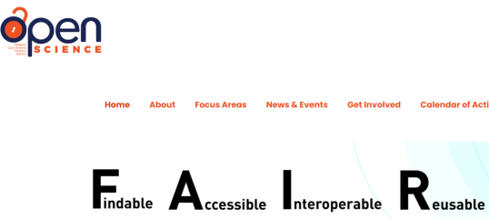
Research Data has become a high priority
Funders policies
Most funders around the world have a policy on Research Data sharing
Publishers policies
All the largest publishers (incl. Elsevier) have a policy on Research Data sharing
Government strategic agendas
Govts and national bodies around the world
“No opting out of RDM”
Publications w/ data are growing fast
France
Malaysia
Notes:
Data management has become a priority because of the push from funders, publishers and governments.

Slide 26

Institutions are ramping up RDM efforts
Hiring data stewards / data librarians
Data Management Plans
Data Repository
Reporting (compliance, assessment, etc) on Data
Showcasing Data
Highly strategic
Challenge: Where is the institutions’ research data?
Notes:
We see growing interest from libraries and other departments, new appointments and people are facing the common challenge.
what do we know about publications with data sets attached, higher collaboration, higher impact? Etc.
What do we know about research institutions with high data posting, do they generally ‘perform’ better in research quality/productivity vs peers?

Slide 27
Where is the Research Data?
Notes:
Reserachers have been sharing their data for a long time

Slide 28

Where is the institutions’ Research Data?
90%
Up to
is deposited in any of the 1000s domain-specific / generalist repositories
This is in accordance to community best practices and funders recommendations (e.g. NIH)
Sources:
1: E. Zudilova-Seinstra; A. Zigoni; W. Haak (2020), “Analysis of research data for 11 Institutions – Data Monitor”, doi: 10.17632/k5p45z33kb.3
Notes:
Why is that the case? Funders recommend domain-specific repositories.

Slide 29

Finding it manually is an impossible task
“With all the copy and pasting, checking and improving on the
metadata, it probably took us around 20-30 minutes a dataset”
“We knew we had to find an automated solution”
Christina Elsenga
University of Groningen Library
Sources: University of Groningen Case Study

Slide 30
Case study: helping leading universities track research data
 | In the institutional repository | In all repositories (domain-specific, generalist, institutional)
UK institution (Figshare) | 234 | 16724
NL institution (Figshare) | 534 | 16372
US institution (Dataverse) | 46 | 3951
Chinese institution (home-grown) | 1328 | 71760
Australian institution (DC Data) | 11 | 785
30x- 70x
Source: Data Monitor and institutional repositories public portal (data extracted on June 21, 2022)
Notes:
Part of the problem is that in many cases there’s missing attribution to a specific institution. There are may be 10 authors, but affiliation correctly mentioned only for one or two and for others the link is missing.
Call to action –

Slide 31
Data Monitor
The solution

Slide 32
Data Monitor helps to overcome 90% challenge
Webapp
Find & Track
2000+
domain and generalist repos
(incl. DataCite)
Other institution
systems
Clean up & enrichment pipeline
Data Integration feeds
API
Batch
Data Monitor (corpus)
Pure
DC/DCData
Other CRIS
Other IRs
Showcase page
(optional)
Institutional Data repo
(optional ingestion)
How we track the Research Data
Harvest metadata from 2000+ repos
  Optional: ingest the Institutional Data Repository
Normalize metadata (OpenAIRE schema)
Clean-up i.e. remove duplicates, non-research data e.g. articles
  How: ML techniques, integration w/ Scopus, experts
Enrich metadata with publications/ author / institution
  How: NLP techniques; integration w/ Scopus, Scholix, DataCite
What users see and get:
Webapp
Data Integration feeds
  API
  Bulk
Optional: Showcase page
32
Notes:
Data Monitors harvests metadata from over 2000 generalist and domain specific public repositories
Metadata is normalized according to the OpenAIRE metadata schema and accessible via a free API
To maximize dataset quality, non-reliable or non-data sources, duplicates, datasets with dead links, non-data/SPAM records are removed
Metadata is enriched with publications, author, institutional linking and more by triangulating other sources, such as DataCite, Scholix and Scopus and using text mining and NLP
The Data Monitor corpus can be accessed in range of other systems – including Pure, Digital Commons, and your chosen CRIS – via an API integration

Slide 33
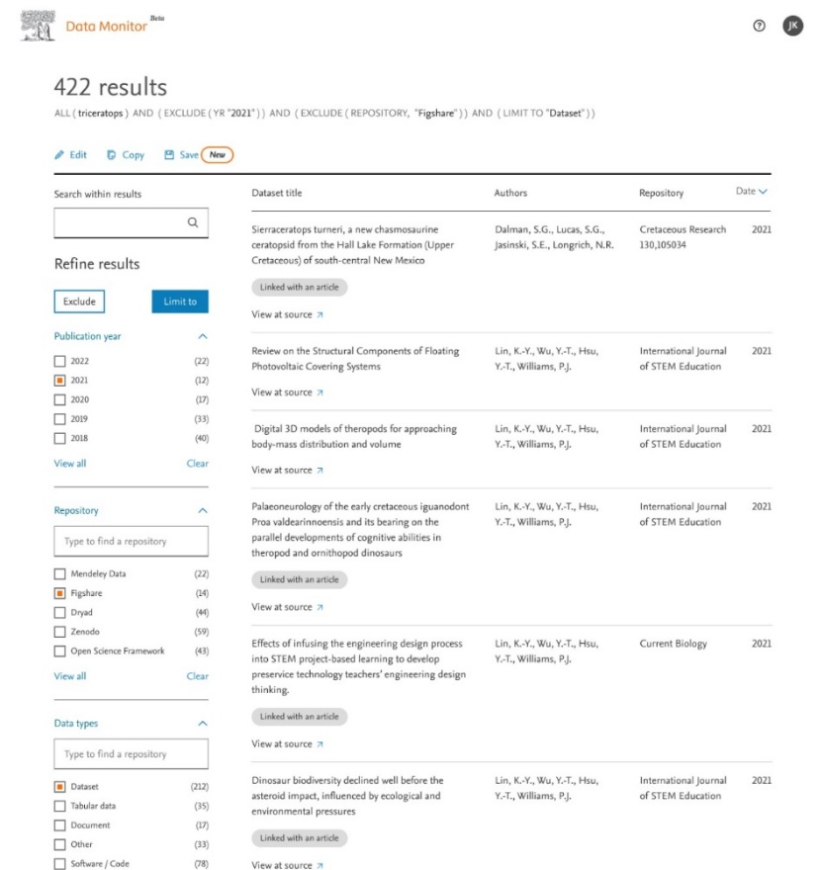
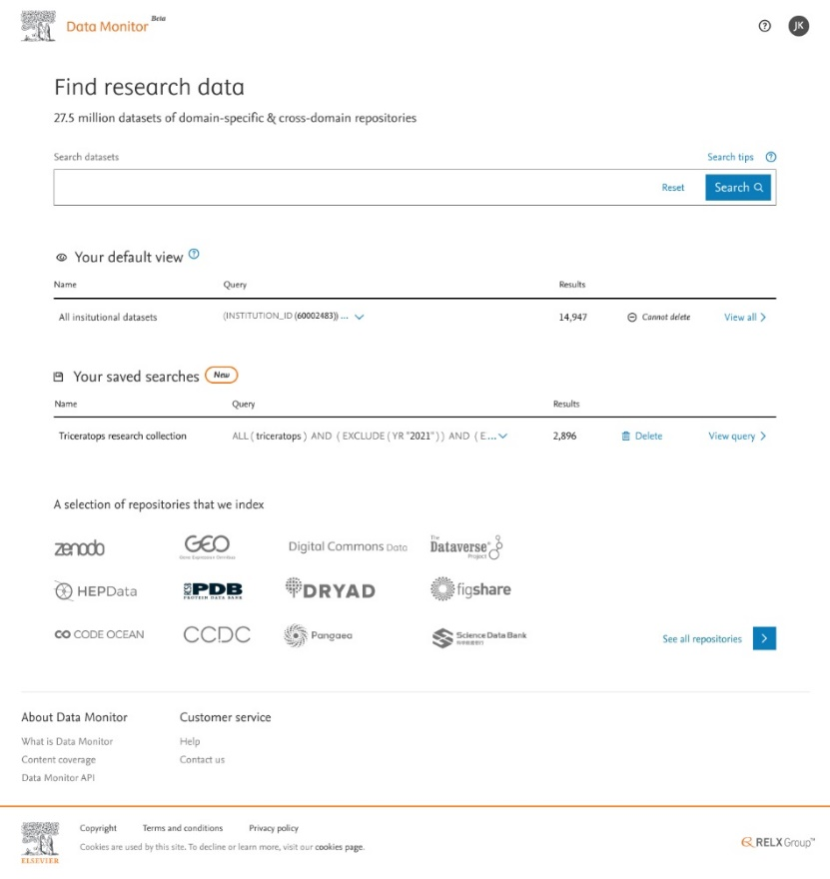


Data Monitor webapp
Based on thorough user research
Look and feel similar to Scopus (low learning threshold for users)

Slide 34
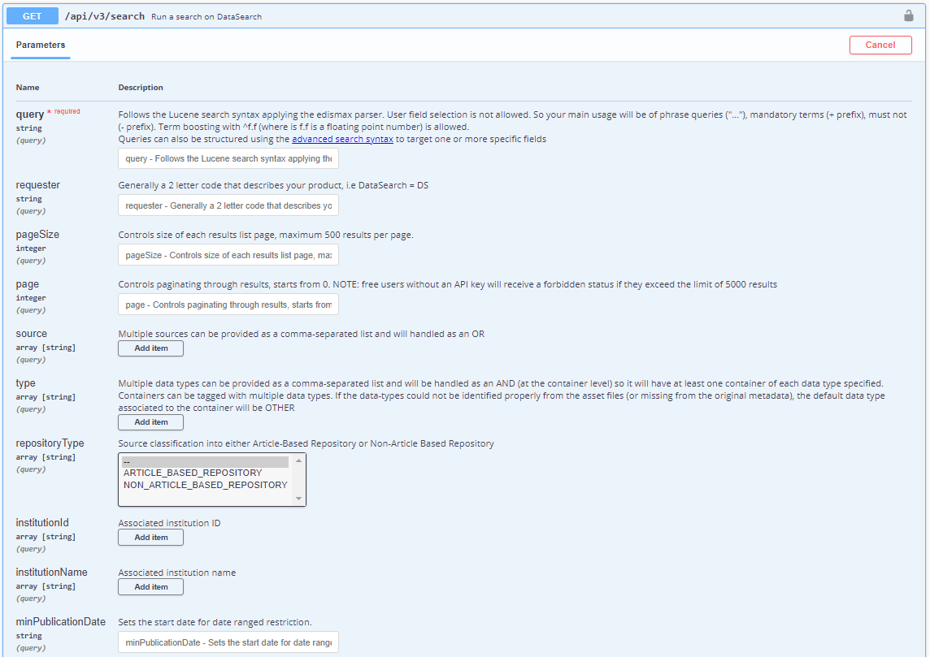
Data integration feeds
We support harvesting of institutional research data metadata into existing institutional systems
API
Batch
More options coming soon….
https://datasearch.elsevier.com/api/docs#/search/search

Slide 35
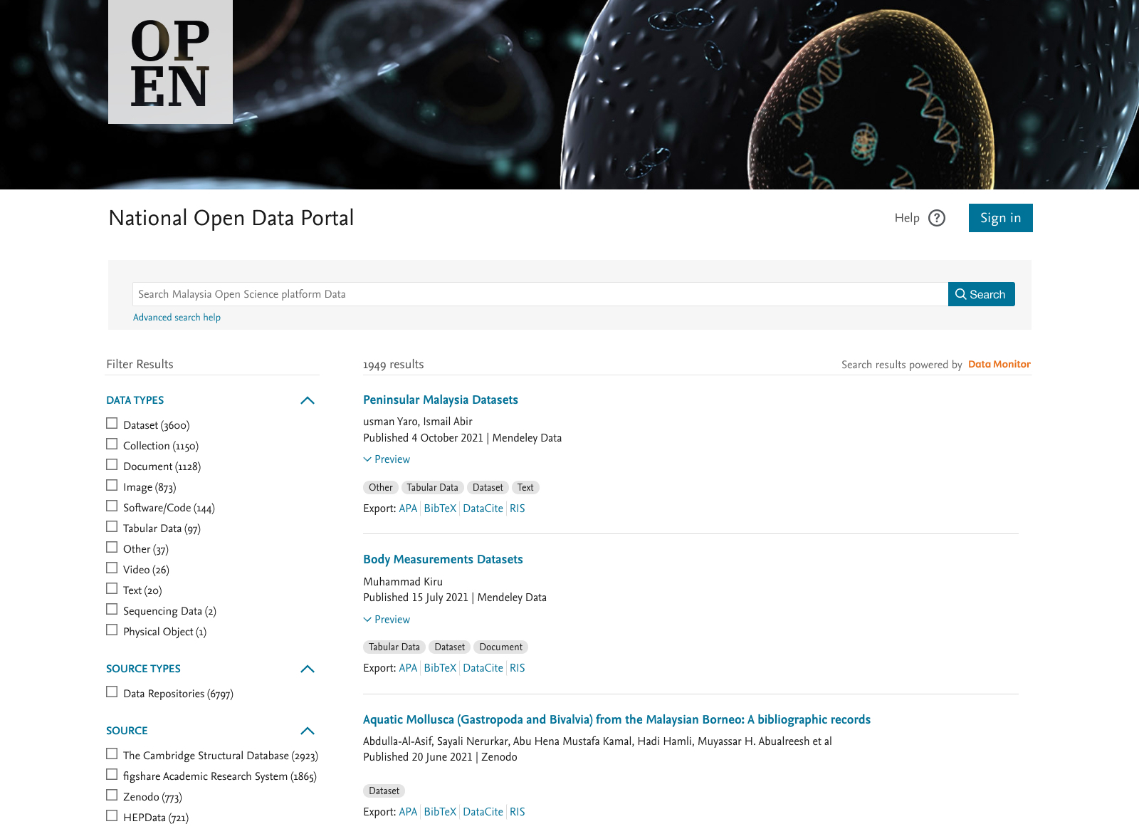
Showcase page
(optional)
Open Data Portal
Custom-branded for your institution
Powered by Data Monitor API
Data Monitor API

Slide 36

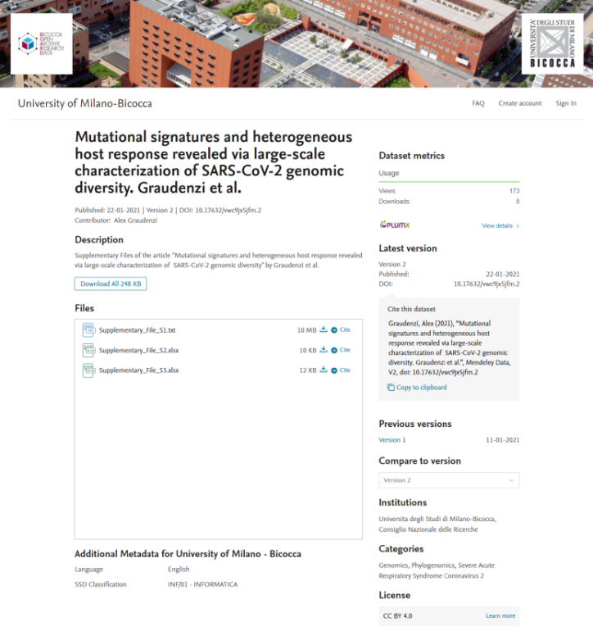
Expertise & Collaboration
A trusted data repository to store, share and archive datasets to comply with funder requirements and meet the FAIR principles.
Links your institution's data to the wider ecosystem, facilitating discovery and reproducibility via DOIs, DataCite, open APIs, deep indexing etc.
Best practices of Research Data Sharing through advanced data curation tools such as versioning, customized metadata, and moderation workflows.
A cloud-hosted platform that meets industry standards for secure storage, hosting, and preservation.
Notes:
Digital Commons Data is a secure trusted place to store and share datasets to comply with funder requirements and meet the highest standards for research data, including the FAIR principles.

Slide 37
Time for questions!

Slide 38
Thank you !
Anton Degtev
a.degtev@elsevier.com

Slide 39
Build versus buy: trade offs
Aspect | Build | or Buy ?
Functionality | Very specific | >95% off the shelf
Time to go-live | Several years | As fast as a few weeks
Budget | High | Low/Medium
Interoperability | Limited | High
Versatility, adaption to change | Slow and costly | Fast through configurations
Maintenance & support | Depends on few key people | Guaranteed through contract

Slide 40

No other RIM solution provider has successfully implemented more systems
Trusted by researchers and faculty members in 47 countries
—three times more than the next competitor

Slide 41




Pure Modules
PURE MODULES
The Core Module
Imports and ensures the maintenance of high-quality data.
Reporting Module
Enables you to generate reports
on all data stored in Pure.
Award Management Module
Streamlines and automates
the management of research projects.
National Assessment Module
Ensures compliance with national assessments in many countries.
The Pure Portal
Publicly-accessible website that showcases curated content in Pure.
CV Module
Helps researchers efficiently create CVs capturing Pure data in standard formats.

